Slide 1
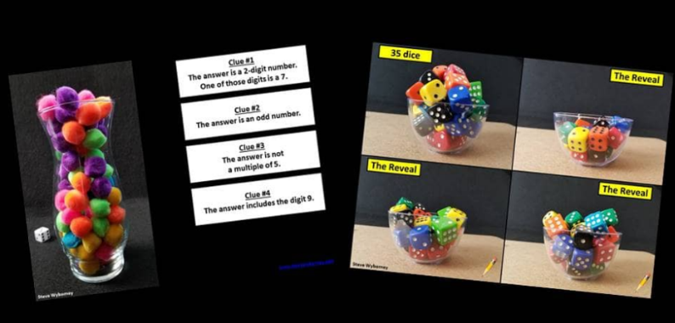

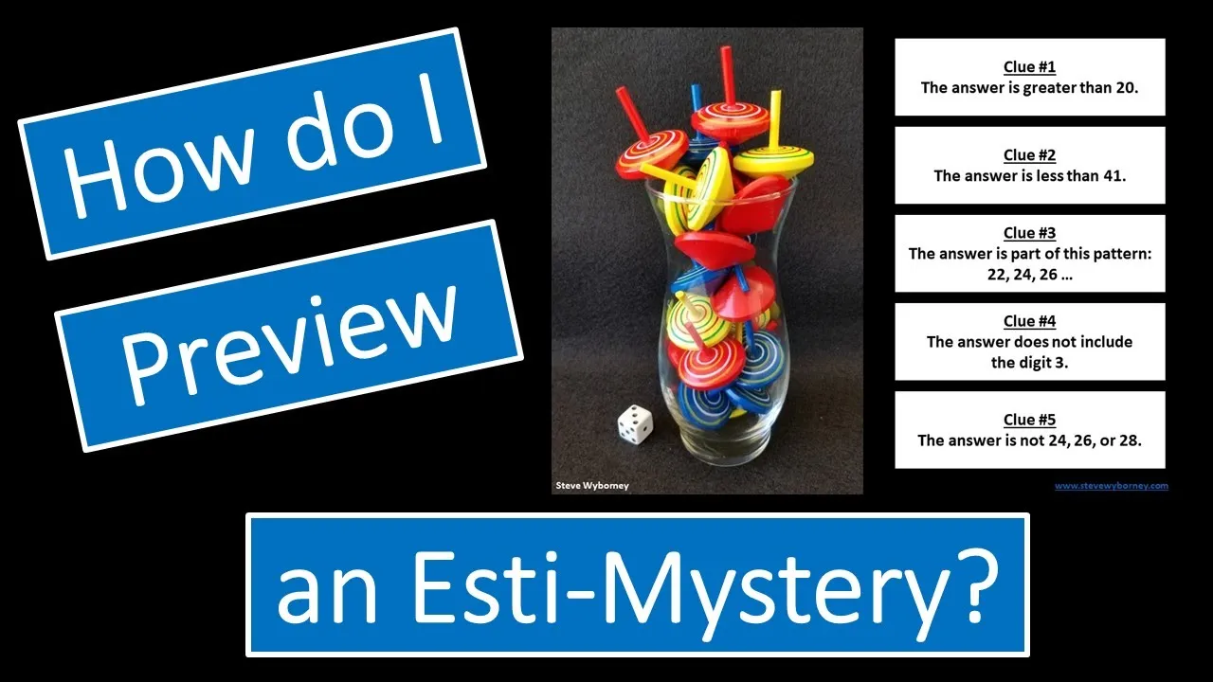
Two Resource Opportunities
Would you like to join the mailing list?
Subscribe to find out when new resources are posted.
Would you like to learn more about Esti-Mysteries?
Visit The Esti-Mystery Tips Playlist on YouTube.
Steve Wyborney
www.stevewyborney.com

Slide 2
I see 3 versions of this Esti-Mystery. Which one should I use?
“Esti-Mysteries are already working well for my class.”
Use slides 3-8 if your students have charts to write on. Your students are writing on a chart, writing down their estimates, and are discussing their ideas with each other after each clue. They may be writing on paper, writing on a dry erase surface, or using a digital tool to annotate – or they have another way of responding to clues in writing. You probably already notice that when students write down their estimate after each clue it helps to propel rich math talk and also builds anticipation for the next clue. If this sounds familiar, then I recommend using slides 2-7.
“I need to display a chart for everyone to see, and I have a way to write on it.”
Use slides 9-14 if you simply need an embedded chart to write on during discussion. This may be helpful if you want to show a chart at the same time as the Esti-Mystery. The chart (on slides 8-13) will appear on the screen so that you can write on it. You can simply write on your whiteboard, use a digital pen, or use the chart in many other ways.
“I need a step-by-step animated chart that eliminates numbers after every clue.”
Use slides 15-20 if you want to see numbers disappear from the chart after every clue. This may be helpful if you need a chart and don’t have an easy way to write on the chart. After each clue, you’ll see which numbers are eliminated – and which ones are left.

Slide 3
“The Bead Scoop”
Important Note:
If you can see this box, then the slide show is not playing and the reveal won’t work.
Here is the solution:
If you are using PowerPoint,
click on Slide Show,
then click on From Current Slide.
If you are using Google Slides,
click on View then Present.
Steve Wyborney
www.stevewyborney.com

Slide 4
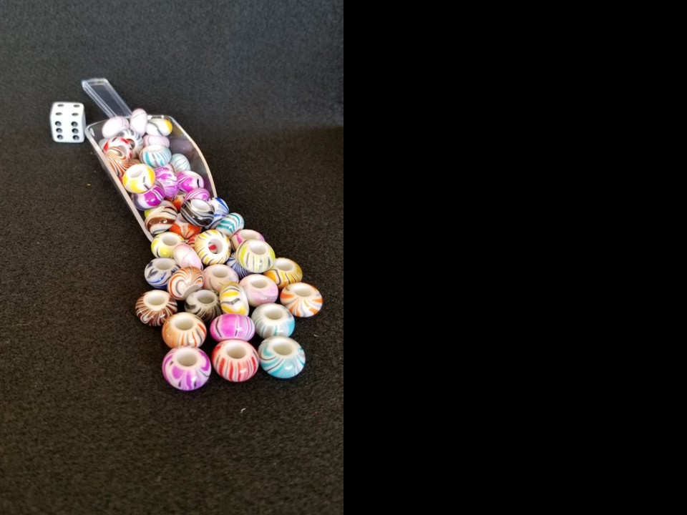
How many beads are there?
As the clues appear, use the information to narrow the possibilities to a smaller set. After each clue, use estimation again to determine which of the remaining answers is the most reasonable.
Write down your first estimate. After each clue, you’ll see if your estimate is still a possibility. After each clue, if it is no longer possible write down a new estimate – and be prepared to explain why you chose it.
Steve Wyborney
www.stevewyborney.com

Slide 5
Clue #1
Clue #1
The answer is an odd number between 50 and 80.
Clue #2
Clue #2
The answer is one more than
a multiple of 4.
Clue #3
Clue #3
The answer is not a multiple of 3.
Clue #4
Clue #4
The answer does not include
the digit 1.
Clue #5
Clue #5
The answer is a prime number.
Steve Wyborney
www.stevewyborney.com

Slide 6
After seeing the clues, you have narrowed the possibilities to a small set of numbers. Before you see the answer, select your final estimate. Write it down, and explain to someone why you chose that number.
Steve Wyborney
www.stevewyborney.com

Slide 7
53 beads
The Reveal
Click to see the answer.
Important Note:
If you can see this box, then the slide show is not playing and the reveal won’t work.
Here is the solution:
If you are using PowerPoint,
click on Slide Show,
then click on From Current Slide.
If you are using Google Slides,
click on View then Present.
Steve Wyborney
www.stevewyborney.com

Slide 8

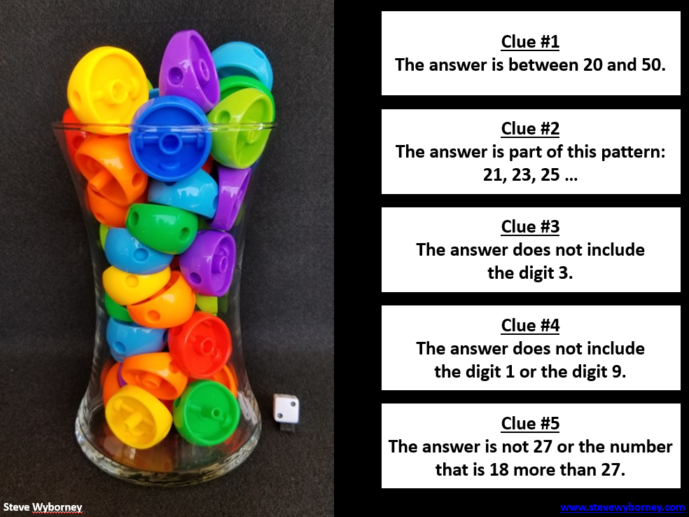

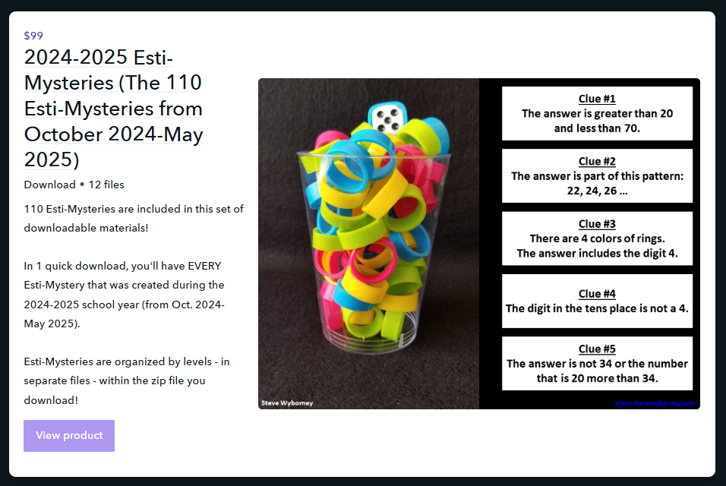




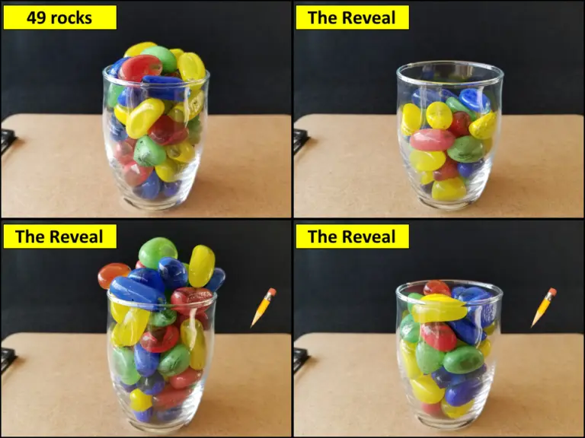
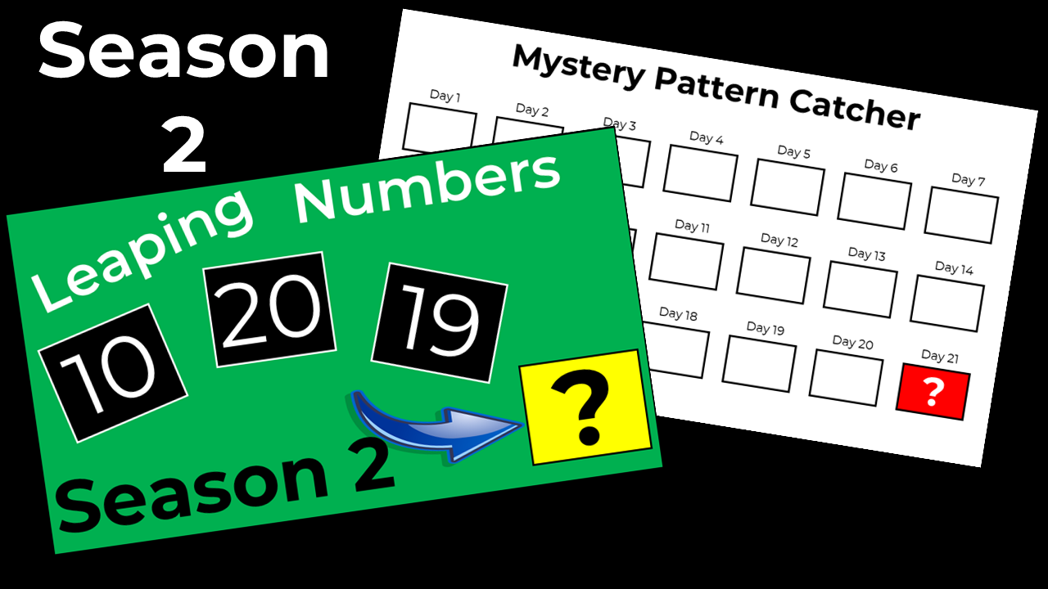









Are you subscribed to the
blog newsletter?
Sign Up Here
New Resources Every Week!
Steve Wyborney’s
Math Courses
Online courses
Digital Download Bundles
2025-2026
125 New Esti-Mysteries
The Multiplication Advantage!
Ask your school to purchase a copy
for every student in your class.
2024-2025
110 New Esti-Mysteries
2023-2024
100 New Esti-Mysteries
2022-2023
170 New Esti-Mysteries
2021-2022
150 New Esti-Mysteries
More Estimation Clipboards
Leaping Numbers
Season 2
February 2025
Leaping Numbers
Season 1
November 2024
The Original
Leaping Numbers
February 2024
The Mystery Number in the Box
60-Second Math Mystery Videos
View the entire playlist here.
The 3-Container
Estimation Routine
The Original
50 Splat! Lessons
The Original 20 Fraction Splat! Lessons
PowerPoint Files
Designed for Google Slides
80 Cube Conversations Lessons
20 Days of Number Sense
& Rich Math Talk

Slide 9
“The Bead Scoop”
Important Note:
If you can see this box, then the slide show is not playing and the reveal won’t work.
Here is the solution:
If you are using PowerPoint,
click on Slide Show,
then click on From Current Slide.
If you are using Google Slides,
click on View then Present.
Steve Wyborney
www.stevewyborney.com

Slide 10
How many beads are there?
As the clues appear, use the information to narrow the possibilities to a smaller set. After each clue, use estimation again to determine which of the remaining answers is the most reasonable.
Write down your first estimate. After each clue, you’ll see if your estimate is still a possibility. After each clue, if it is no longer possible write down a new estimate – and be prepared to explain why you chose it.
Steve Wyborney
www.stevewyborney.com

Slide 11
Clue #1
Clue #1
The answer is an odd number between 50 and 80.
Clue #2
Clue #2
The answer is one more than
a multiple of 4.
Clue #3
Clue #3
The answer is not a multiple of 3.
Clue #4
Clue #4
The answer does not include
the digit 1.
41 | 42 | 43 | 44 | 45 | 46 | 47 | 48 | 49 | 50
51 | 52 | 53 | 54 | 55 | 56 | 57 | 58 | 59 | 60
61 | 62 | 63 | 64 | 65 | 66 | 67 | 68 | 69 | 70
71 | 72 | 73 | 74 | 75 | 76 | 77 | 78 | 79 | 80
81 | 82 | 83 | 84 | 85 | 86 | 87 | 88 | 89 | 90
Clue #5
Clue #5
The answer is a prime number.
Steve Wyborney
www.stevewyborney.com

Slide 12
After seeing the clues, you have narrowed the possibilities to a small set of numbers. Before you see the answer, select your final estimate. Write it down, and explain to someone why you chose that number.
Steve Wyborney
www.stevewyborney.com

Slide 13
53 beads
The Reveal
Click to see the answer.
Important Note:
If you can see this box, then the slide show is not playing and the reveal won’t work.
Here is the solution:
If you are using PowerPoint,
click on Slide Show,
then click on From Current Slide.
If you are using Google Slides,
click on View then Present.
Steve Wyborney
www.stevewyborney.com

Slide 14
Are you subscribed to the
blog newsletter?
Sign Up Here
New Resources Every Week!
Steve Wyborney’s
Math Courses
Online courses
Digital Download Bundles
2025-2026
125 New Esti-Mysteries
The Multiplication Advantage!
Ask your school to purchase a copy
for every student in your class.
2024-2025
110 New Esti-Mysteries
2023-2024
100 New Esti-Mysteries
2022-2023
170 New Esti-Mysteries
2021-2022
150 New Esti-Mysteries
More Estimation Clipboards
Leaping Numbers
Season 2
February 2025
Leaping Numbers
Season 1
November 2024
The Original
Leaping Numbers
February 2024
The Mystery Number in the Box
60-Second Math Mystery Videos
View the entire playlist here.
The 3-Container
Estimation Routine
The Original
50 Splat! Lessons
The Original 20 Fraction Splat! Lessons
PowerPoint Files
Designed for Google Slides
80 Cube Conversations Lessons
20 Days of Number Sense
& Rich Math Talk

Slide 15
“The Bead Scoop”
Important Note:
If you can see this box, then the slide show is not playing and the reveal won’t work.
Here is the solution:
If you are using PowerPoint,
click on Slide Show,
then click on From Current Slide.
If you are using Google Slides,
click on View then Present.
Steve Wyborney
www.stevewyborney.com

Slide 16
How many beads are there?
As the clues appear, use the information to narrow the possibilities to a smaller set. After each clue, use estimation again to determine which of the remaining answers is the most reasonable.
Write down your first estimate. After each clue, you’ll see if your estimate is still a possibility. After each clue, if it is no longer possible write down a new estimate – and be prepared to explain why you chose it.
Steve Wyborney
www.stevewyborney.com

Slide 17
Clue #1
Clue #1
The answer is an odd number between 50 and 80.
Clue #2
Clue #2
The answer is one more than
a multiple of 4.
Clue #3
Clue #3
The answer is not a multiple of 3.
Clue #4
Clue #4
The answer does not include
the digit 1.
41 | 42 | 43 | 44 | 45 | 46 | 47 | 48 | 49 | 50
51 | 52 | 53 | 54 | 55 | 56 | 57 | 58 | 59 | 60
61 | 62 | 63 | 64 | 65 | 66 | 67 | 68 | 69 | 70
71 | 72 | 73 | 74 | 75 | 76 | 77 | 78 | 79 | 80
81 | 82 | 83 | 84 | 85 | 86 | 87 | 88 | 89 | 90
41 | 42 | 43 | 44 | 45 | 46 | 47 | 48 | 49 | 50
51 | 52 | 53 | 54 | 55 | 56 | 57 | 58 | 59 | 60
61 | 62 | 63 | 64 | 65 | 66 | 67 | 68 | 69 | 70
71 | 72 | 73 | 74 | 75 | 76 | 77 | 78 | 79 | 80
81 | 82 | 83 | 84 | 85 | 86 | 87 | 88 | 89 | 90
41 | 42 | 43 | 44 | 45 | 46 | 47 | 48 | 49 | 50
51 | 52 | 53 | 54 | 55 | 56 | 57 | 58 | 59 | 60
61 | 62 | 63 | 64 | 65 | 66 | 67 | 68 | 69 | 70
71 | 72 | 73 | 74 | 75 | 76 | 77 | 78 | 79 | 80
81 | 82 | 83 | 84 | 85 | 86 | 87 | 88 | 89 | 90
41 | 42 | 43 | 44 | 45 | 46 | 47 | 48 | 49 | 50
51 | 52 | 53 | 54 | 55 | 56 | 57 | 58 | 59 | 60
61 | 62 | 63 | 64 | 65 | 66 | 67 | 68 | 69 | 70
71 | 72 | 73 | 74 | 75 | 76 | 77 | 78 | 79 | 80
81 | 82 | 83 | 84 | 85 | 86 | 87 | 88 | 89 | 90
41 | 42 | 43 | 44 | 45 | 46 | 47 | 48 | 49 | 50
51 | 52 | 53 | 54 | 55 | 56 | 57 | 58 | 59 | 60
61 | 62 | 63 | 64 | 65 | 66 | 67 | 68 | 69 | 70
71 | 72 | 73 | 74 | 75 | 76 | 77 | 78 | 79 | 80
81 | 82 | 83 | 84 | 85 | 86 | 87 | 88 | 89 | 90
41 | 42 | 43 | 44 | 45 | 46 | 47 | 48 | 49 | 50
51 | 52 | 53 | 54 | 55 | 56 | 57 | 58 | 59 | 60
61 | 62 | 63 | 64 | 65 | 66 | 67 | 68 | 69 | 70
71 | 72 | 73 | 74 | 75 | 76 | 77 | 78 | 79 | 80
81 | 82 | 83 | 84 | 85 | 86 | 87 | 88 | 89 | 90
Clue #5
Clue #5
The answer is a prime number.
Steve Wyborney
www.stevewyborney.com

Slide 18
After seeing the clues, you have narrowed the possibilities to a small set of numbers. Before you see the answer, select your final estimate. Write it down, and explain to someone why you chose that number.
Steve Wyborney
www.stevewyborney.com

Slide 19
53 beads
The Reveal
Click to see the answer.
Important Note:
If you can see this box, then the slide show is not playing and the reveal won’t work.
Here is the solution:
If you are using PowerPoint,
click on Slide Show,
then click on From Current Slide.
If you are using Google Slides,
click on View then Present.
Steve Wyborney
www.stevewyborney.com

Slide 20
Are you subscribed to the
blog newsletter?
Sign Up Here
New Resources Every Week!
Steve Wyborney’s
Math Courses
Online courses
Digital Download Bundles
2025-2026
125 New Esti-Mysteries
The Multiplication Advantage!
Ask your school to purchase a copy
for every student in your class.
2024-2025
110 New Esti-Mysteries
2023-2024
100 New Esti-Mysteries
2022-2023
170 New Esti-Mysteries
2021-2022
150 New Esti-Mysteries
More Estimation Clipboards
Leaping Numbers
Season 2
February 2025
Leaping Numbers
Season 1
November 2024
The Original
Leaping Numbers
February 2024
The Mystery Number in the Box
60-Second Math Mystery Videos
View the entire playlist here.
The 3-Container
Estimation Routine
The Original
50 Splat! Lessons
The Original 20 Fraction Splat! Lessons
PowerPoint Files
Designed for Google Slides
80 Cube Conversations Lessons
20 Days of Number Sense
& Rich Math Talk

