Slide 1
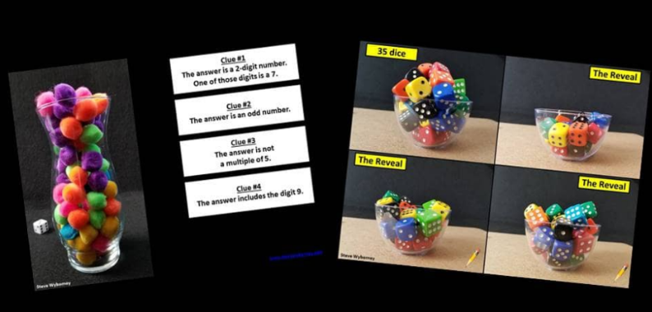

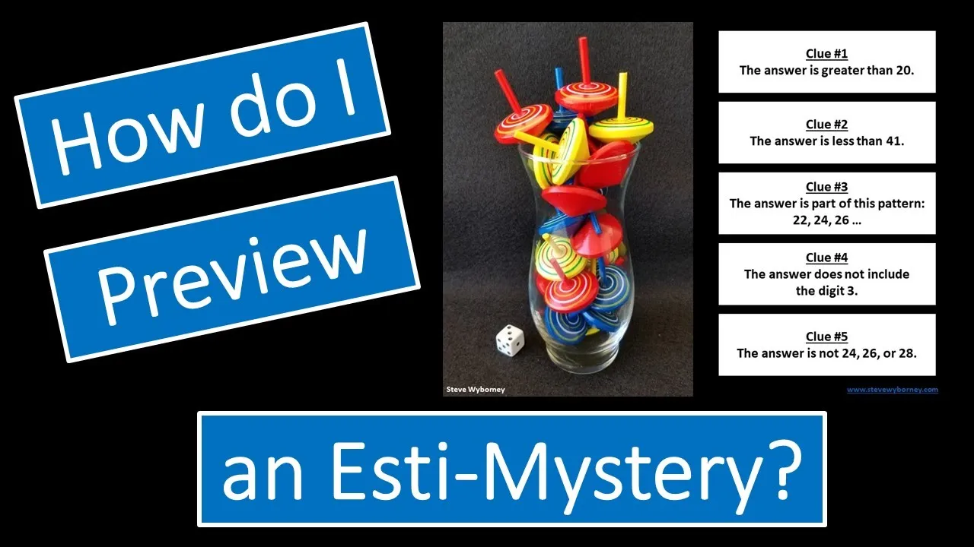
Two Resource Opportunities
Would you like to join the mailing list?
Subscribe to find out when new resources are posted.
Would you like to learn more about Esti-Mysteries?
Visit The Esti-Mystery Tips Playlist on YouTube.
Steve Wyborney
www.stevewyborney.com

Slide 2
“Hearts”
Important Note:
If you can see this box, then the slide show is not playing and the reveal won’t work.
Here is the solution:
If you are using PowerPoint,
click on Slide Show,
then click on From Current Slide.
If you are using Google Slides,
click on View then Present.
Steve Wyborney
www.stevewyborney.com

Slide 3

How many hearts are there?
As the clues appear, use the information to narrow the possibilities to a smaller set. After each clue, use estimation again to determine which of the remaining answers is the most reasonable.
Write down your first estimate. After each clue, you’ll see if your estimate is still a possibility. After each clue, if it is no longer possible write down a new estimate – and be prepared to explain why you chose it.
Steve Wyborney
www.stevewyborney.com

Slide 4
Clue #1
Clue #1
The answer is less than 20.
Clue #2
Clue #2
The answer is greater than 13.
Clue #3
Clue #3
The answer does not include the digits 5 or 6.
Clue #4
Clue #4
The answer does not include the digits 7 or 8.
1 | 2 | 3 | 4 | 5 | 6 | 7 | 8 | 9 | 10
11 | 12 | 13 | 14 | 15 | 16 | 17 | 18 | 19 | 20
1 | 2 | 3 | 4 | 5 | 6 | 7 | 8 | 9 | 10
11 | 12 | 13 | 14 | 15 | 16 | 17 | 18 | 19 | 20
1 | 2 | 3 | 4 | 5 | 6 | 7 | 8 | 9 | 10
11 | 12 | 13 | 14 | 15 | 16 | 17 | 18 | 19 | 20
1 | 2 | 3 | 4 | 5 | 6 | 7 | 8 | 9 | 10
11 | 12 | 13 | 14 | 15 | 16 | 17 | 18 | 19 | 20
1 | 2 | 3 | 4 | 5 | 6 | 7 | 8 | 9 | 10
11 | 12 | 13 | 14 | 15 | 16 | 17 | 18 | 19 | 20
Steve Wyborney
www.stevewyborney.com

Slide 5
After seeing the clues, you have narrowed the possibilities to a small set of numbers. Before you see the answer, select your final estimate. Write it down, and explain to someone why you chose that number.
Steve Wyborney
www.stevewyborney.com

Slide 6
14 hearts
The Reveal
Click to see the answer.
Important Note:
If you can see this box, then the slide show is not playing and the reveal won’t work.
Here is the solution:
If you are using PowerPoint,
click on Slide Show,
then click on From Current Slide.
If you are using Google Slides,
click on View then Present.
Steve Wyborney
www.stevewyborney.com

Slide 7

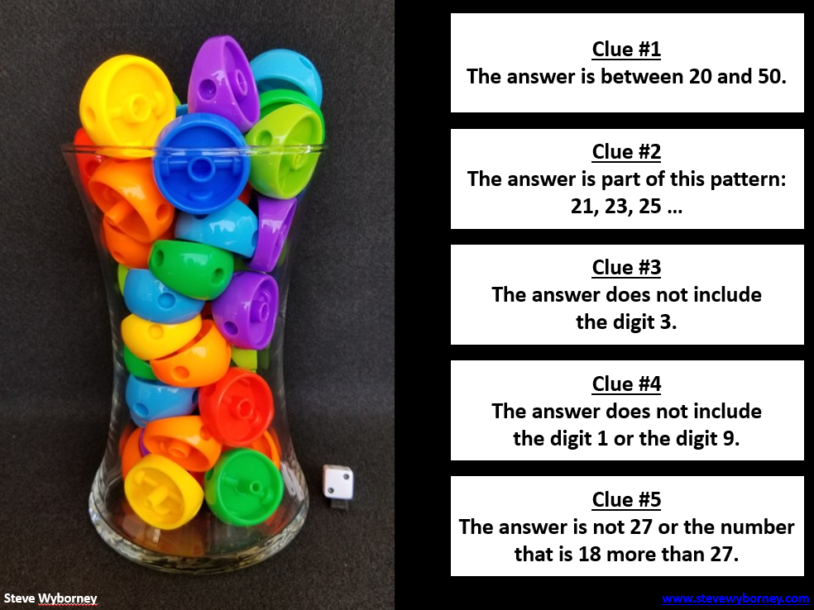

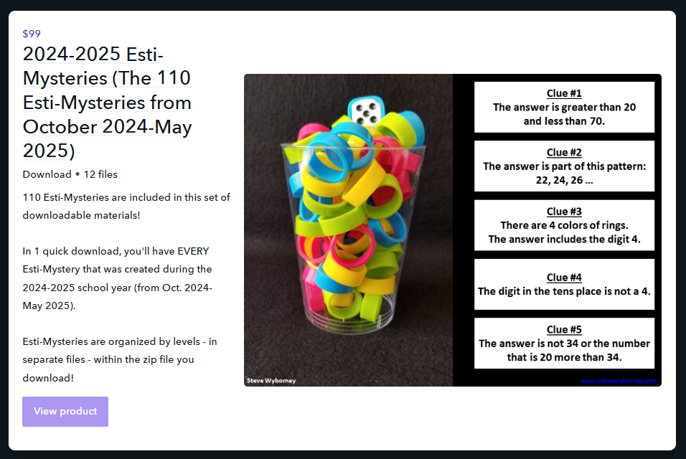




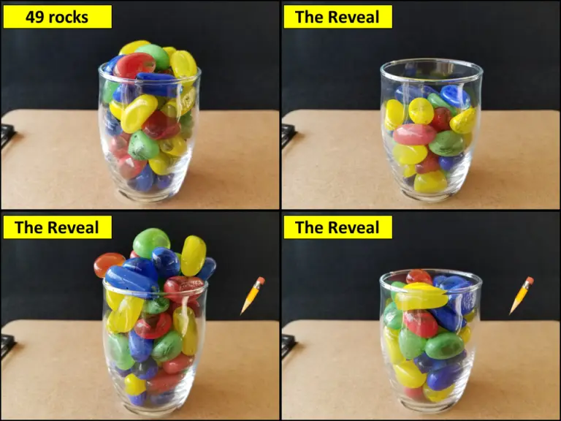










Are you subscribed to the
blog newsletter?
Sign Up Here
New Resources Every Week!
Steve Wyborney’s
Math Courses
Online courses
Digital Download Bundles
2025-2026
125 New Esti-Mysteries
The Multiplication Advantage!
Ask your school to purchase a copy
for every student in your class.
2024-2025
110 New Esti-Mysteries
2023-2024
100 New Esti-Mysteries
2022-2023
170 New Esti-Mysteries
2021-2022
150 New Esti-Mysteries
More Estimation Clipboards
Leaping Numbers
Season 2
February 2025
Leaping Numbers
Season 1
November 2024
The Original
Leaping Numbers
February 2024
The Mystery Number in the Box
60-Second Math Mystery Videos
View the entire playlist here.
The 3-Container
Estimation Routine
The Original
50 Splat! Lessons
The Original 20 Fraction Splat! Lessons
PowerPoint Files
Designed for Google Slides
80 Cube Conversations Lessons
20 Days of Number Sense
& Rich Math Talk

