Slide 1
Watch this YouTube video
for more information about
How to Use Esti-Mysteries
with Embedded Charts
I see 3 versions of this Esti-Mystery. Which one should I use?
“Esti-Mysteries are already working well for my class.”
Use slides 2-7 if your students have charts to write on. Your students are writing on a chart, writing down their estimates, and are discussing their ideas with each other after each clue. They may be writing on paper, writing on a dry erase surface, or using a digital tool to annotate – or they have another way of responding to clues in writing. You probably already notice that when students write down their estimate after each clue it helps to propel rich math talk and also builds anticipation for the next clue. If this sounds familiar, then I recommend using slides 2-7.
“I need to display a chart for everyone to see, and I have a way to write on it.”
Use slides 8-13 if you simply need an embedded chart to write on during discussion. This may be helpful if you want to show a chart at the same time as the Esti-Mystery. The chart (on slides 8-13) will appear on the screen so that you can write on it. You can simply write on your whiteboard, use a digital pen, or use the chart in many other ways.
“I need a step-by-step animated chart that eliminates numbers after every clue.”
Use slides 14-19 if you want to see numbers disappear from the chart after every clue. This may be helpful if you need a chart and don’t have an easy way to write on the chart. After each clue, you’ll see which numbers are eliminated – and which ones are left.

Slide 2
“Less than
a Square Number”
Important Note:
If you can see this box, then the slide show is not playing and the reveal won’t work.
Here is the solution:
If you are using PowerPoint,
click on Slide Show,
then click on From Current Slide.
If you are using Google Slides,
click on View then Present.
Steve Wyborney
www.stevewyborney.com

Slide 3
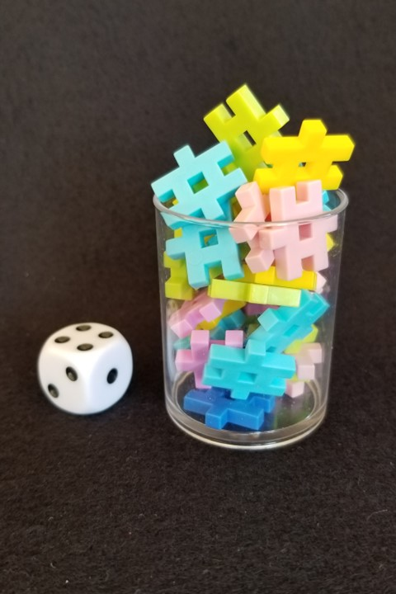
How many connectors
are in the container?
As the clues appear, use the information to narrow the possibilities to a smaller set. After each clue, use estimation again to determine which of the remaining answers is the most reasonable.
Write down your first estimate. After each clue, you’ll see if your estimate is still a possibility. After each clue, if it is no longer possible write down a new estimate – and be prepared to explain why you chose it.
Steve Wyborney
www.stevewyborney.com

Slide 4
Clue #1
Clue #1
The answer is between 20 and 70.
Clue #2
Clue #2
The answer is 3 less
than a square number.
Clue #3
Clue #3
The answer is not a prime number.
Clue #4
Clue #4
The answer is not a factor of 88.
Steve Wyborney
www.stevewyborney.com

Slide 5
After seeing the clues, you have narrowed the possibilities to a small set of numbers. Before you see the answer, select your final estimate. Write it down, and explain to someone why you chose that number.
Steve Wyborney
www.stevewyborney.com

Slide 6
33 connectors
The Reveal
Click to see the answer.
Important Note:
If you can see this box, then the slide show is not playing and the reveal won’t work.
Here is the solution:
If you are using PowerPoint,
click on Slide Show,
then click on From Current Slide.
If you are using Google Slides,
click on View then Present.
Steve Wyborney
www.stevewyborney.com

Slide 7
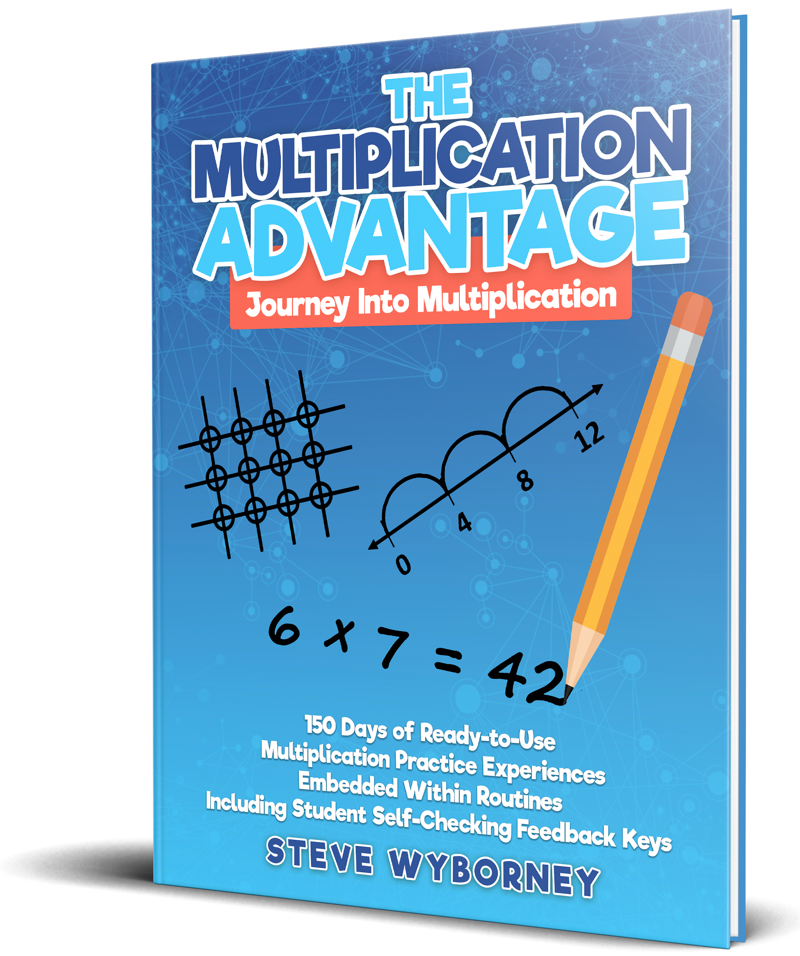
















New Materials for 2024-2025
How do I subscribe to the mailing list?
Sign Up Here
The Multiplication Advantage!
Ask your school to purchase a copy
for every student in your class.
Multiplication Facts
and Concepts Videos
Learn more here.
110 New Esti-Mysteries
The Mystery Number in the Box
60-Second Math Mystery Videos
View the entire playlist here.
Leaping Numbers:
Leap Day Pattern Challenge Series
The 3-Container
Estimation Routine
2023-24
100 New Esti-Mysteries
2022-2023
170 New Esti-Mysteries
2021-2022
150 New Esti-Mysteries
More Estimation Clipboards
80 Cube Conversations Lessons
51 Esti-Mysteries
The Original
50 Splat! Lessons
The Original 20 Fraction Splat! Lessons
The Original 40 Estimation Clipboard Sets
20 Days of Number Sense
& Rich Math Talk

Slide 8
“Less than
a Square Number”
Important Note:
If you can see this box, then the slide show is not playing and the reveal won’t work.
Here is the solution:
If you are using PowerPoint,
click on Slide Show,
then click on From Current Slide.
If you are using Google Slides,
click on View then Present.
Steve Wyborney
www.stevewyborney.com

Slide 9
How many connectors
are in the container?
As the clues appear, use the information to narrow the possibilities to a smaller set. After each clue, use estimation again to determine which of the remaining answers is the most reasonable.
Write down your first estimate. After each clue, you’ll see if your estimate is still a possibility. After each clue, if it is no longer possible write down a new estimate – and be prepared to explain why you chose it.
Steve Wyborney
www.stevewyborney.com

Slide 10
Clue #1
Clue #1
The answer is between 20 and 70.
Clue #2
Clue #2
The answer is 3 less
than a square number.
Clue #3
Clue #3
The answer is not a prime number.
Clue #4
Clue #4
The answer is not a factor of 88.
21 | 22 | 23 | 24 | 25 | 26 | 27 | 28 | 29 | 30
31 | 32 | 33 | 34 | 35 | 36 | 37 | 38 | 39 | 40
41 | 42 | 43 | 44 | 45 | 46 | 47 | 48 | 49 | 50
51 | 52 | 53 | 54 | 55 | 56 | 57 | 58 | 59 | 60
61 | 62 | 63 | 64 | 65 | 66 | 67 | 68 | 69 | 70
Steve Wyborney
www.stevewyborney.com

Slide 11
After seeing the clues, you have narrowed the possibilities to a small set of numbers. Before you see the answer, select your final estimate. Write it down, and explain to someone why you chose that number.
Steve Wyborney
www.stevewyborney.com

Slide 12
33 connectors
The Reveal
Click to see the answer.
Important Note:
If you can see this box, then the slide show is not playing and the reveal won’t work.
Here is the solution:
If you are using PowerPoint,
click on Slide Show,
then click on From Current Slide.
If you are using Google Slides,
click on View then Present.
Steve Wyborney
www.stevewyborney.com

Slide 13
New Materials for 2024-2025
How do I subscribe to the mailing list?
Sign Up Here
The Multiplication Advantage!
Ask your school to purchase a copy
for every student in your class.
Multiplication Facts
and Concepts Videos
Learn more here.
110 New Esti-Mysteries
The Mystery Number in the Box
60-Second Math Mystery Videos
View the entire playlist here.
Leaping Numbers:
Leap Day Pattern Challenge Series
The 3-Container
Estimation Routine
2023-24
100 New Esti-Mysteries
2022-2023
170 New Esti-Mysteries
2021-2022
150 New Esti-Mysteries
More Estimation Clipboards
80 Cube Conversations Lessons
51 Esti-Mysteries
The Original
50 Splat! Lessons
The Original 20 Fraction Splat! Lessons
The Original 40 Estimation Clipboard Sets
20 Days of Number Sense
& Rich Math Talk

Slide 14
“Less than
a Square Number”
Important Note:
If you can see this box, then the slide show is not playing and the reveal won’t work.
Here is the solution:
If you are using PowerPoint,
click on Slide Show,
then click on From Current Slide.
If you are using Google Slides,
click on View then Present.
Steve Wyborney
www.stevewyborney.com

Slide 15
How many connectors
are in the container?
As the clues appear, use the information to narrow the possibilities to a smaller set. After each clue, use estimation again to determine which of the remaining answers is the most reasonable.
Write down your first estimate. After each clue, you’ll see if your estimate is still a possibility. After each clue, if it is no longer possible write down a new estimate – and be prepared to explain why you chose it.
Steve Wyborney
www.stevewyborney.com

Slide 16
Clue #1
Clue #1
The answer is between 20 and 70.
Clue #2
Clue #2
The answer is 3 less
than a square number.
Clue #3
Clue #3
The answer is not a prime number.
Clue #4
Clue #4
The answer is not a factor of 88.
21 | 22 | 23 | 24 | 25 | 26 | 27 | 28 | 29 | 30
31 | 32 | 33 | 34 | 35 | 36 | 37 | 38 | 39 | 40
41 | 42 | 43 | 44 | 45 | 46 | 47 | 48 | 49 | 50
51 | 52 | 53 | 54 | 55 | 56 | 57 | 58 | 59 | 60
61 | 62 | 63 | 64 | 65 | 66 | 67 | 68 | 69 | 70
21 | 22 | 23 | 24 | 25 | 26 | 27 | 28 | 29 | 30
31 | 32 | 33 | 34 | 35 | 36 | 37 | 38 | 39 | 40
41 | 42 | 43 | 44 | 45 | 46 | 47 | 48 | 49 | 50
51 | 52 | 53 | 54 | 55 | 56 | 57 | 58 | 59 | 60
61 | 62 | 63 | 64 | 65 | 66 | 67 | 68 | 69 | 70
21 | 22 | 23 | 24 | 25 | 26 | 27 | 28 | 29 | 30
31 | 32 | 33 | 34 | 35 | 36 | 37 | 38 | 39 | 40
41 | 42 | 43 | 44 | 45 | 46 | 47 | 48 | 49 | 50
51 | 52 | 53 | 54 | 55 | 56 | 57 | 58 | 59 | 60
61 | 62 | 63 | 64 | 65 | 66 | 67 | 68 | 69 | 70
21 | 22 | 23 | 24 | 25 | 26 | 27 | 28 | 29 | 30
31 | 32 | 33 | 34 | 35 | 36 | 37 | 38 | 39 | 40
41 | 42 | 43 | 44 | 45 | 46 | 47 | 48 | 49 | 50
51 | 52 | 53 | 54 | 55 | 56 | 57 | 58 | 59 | 60
61 | 62 | 63 | 64 | 65 | 66 | 67 | 68 | 69 | 70
21 | 22 | 23 | 24 | 25 | 26 | 27 | 28 | 29 | 30
31 | 32 | 33 | 34 | 35 | 36 | 37 | 38 | 39 | 40
41 | 42 | 43 | 44 | 45 | 46 | 47 | 48 | 49 | 50
51 | 52 | 53 | 54 | 55 | 56 | 57 | 58 | 59 | 60
61 | 62 | 63 | 64 | 65 | 66 | 67 | 68 | 69 | 70
Steve Wyborney
www.stevewyborney.com

Slide 17
After seeing the clues, you have narrowed the possibilities to a small set of numbers. Before you see the answer, select your final estimate. Write it down, and explain to someone why you chose that number.
Steve Wyborney
www.stevewyborney.com

Slide 18
33 connectors
The Reveal
Click to see the answer.
Important Note:
If you can see this box, then the slide show is not playing and the reveal won’t work.
Here is the solution:
If you are using PowerPoint,
click on Slide Show,
then click on From Current Slide.
If you are using Google Slides,
click on View then Present.
Steve Wyborney
www.stevewyborney.com

Slide 19
New Materials for 2024-2025
How do I subscribe to the mailing list?
Sign Up Here
The Multiplication Advantage!
Ask your school to purchase a copy
for every student in your class.
Multiplication Facts
and Concepts Videos
Learn more here.
110 New Esti-Mysteries
The Mystery Number in the Box
60-Second Math Mystery Videos
View the entire playlist here.
Leaping Numbers:
Leap Day Pattern Challenge Series
The 3-Container
Estimation Routine
2023-24
100 New Esti-Mysteries
2022-2023
170 New Esti-Mysteries
2021-2022
150 New Esti-Mysteries
More Estimation Clipboards
80 Cube Conversations Lessons
51 Esti-Mysteries
The Original
50 Splat! Lessons
The Original 20 Fraction Splat! Lessons
The Original 40 Estimation Clipboard Sets
20 Days of Number Sense
& Rich Math Talk

