Slide 1
“Fuzzy Critters”
Important Note:
If you can see this box, then the slide show is not playing and the reveal won’t work.
Here is the solution:
If you are using PowerPoint,
click on Slide Show,
then click on From Current Slide.
If you are using Google Slides,
click on View then Present.
Steve Wyborney
www.stevewyborney.com

Slide 2
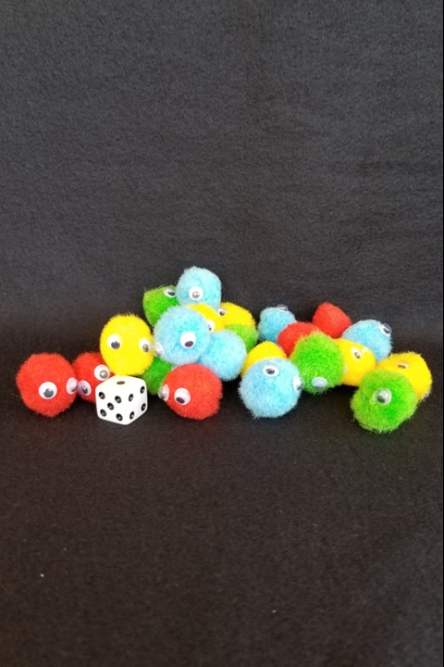
How many fuzzy critters
are in the pile?
As the clues appear, use the information to narrow the possibilities to a smaller set. After each clue, use estimation again to determine which of the remaining answers is the most reasonable.
Write down your first estimate. After each clue, you’ll see if your estimate is still a possibility. After each clue, if it is no longer possible write down a new estimate – and be prepared to explain why you chose it.
Steve Wyborney
www.stevewyborney.com

Slide 3
Clue #1
Clue #1
The answer is greater than 20.
Clue #2
Clue #2
The answer is less than 40.
Clue #3
Clue #3
The answer has a 3
in the ones place.
Clue #4
Clue #4
Not quite all of the fuzzy critters
can be seen.
1 | 2 | 3 | 4 | 5 | 6 | 7 | 8 | 9 | 10
11 | 12 | 13 | 14 | 15 | 16 | 17 | 18 | 19 | 20
21 | 22 | 23 | 24 | 25 | 26 | 27 | 28 | 29 | 30
31 | 32 | 33 | 34 | 35 | 36 | 37 | 38 | 39 | 40
1 | 2 | 3 | 4 | 5 | 6 | 7 | 8 | 9 | 10
11 | 12 | 13 | 14 | 15 | 16 | 17 | 18 | 19 | 20
21 | 22 | 23 | 24 | 25 | 26 | 27 | 28 | 29 | 30
31 | 32 | 33 | 34 | 35 | 36 | 37 | 38 | 39 | 40
1 | 2 | 3 | 4 | 5 | 6 | 7 | 8 | 9 | 10
11 | 12 | 13 | 14 | 15 | 16 | 17 | 18 | 19 | 20
21 | 22 | 23 | 24 | 25 | 26 | 27 | 28 | 29 | 30
31 | 32 | 33 | 34 | 35 | 36 | 37 | 38 | 39 | 40
1 | 2 | 3 | 4 | 5 | 6 | 7 | 8 | 9 | 10
11 | 12 | 13 | 14 | 15 | 16 | 17 | 18 | 19 | 20
21 | 22 | 23 | 24 | 25 | 26 | 27 | 28 | 29 | 30
31 | 32 | 33 | 34 | 35 | 36 | 37 | 38 | 39 | 40
1 | 2 | 3 | 4 | 5 | 6 | 7 | 8 | 9 | 10
11 | 12 | 13 | 14 | 15 | 16 | 17 | 18 | 19 | 20
21 | 22 | 23 | 24 | 25 | 26 | 27 | 28 | 29 | 30
31 | 32 | 33 | 34 | 35 | 36 | 37 | 38 | 39 | 40
Steve Wyborney
www.stevewyborney.com

Slide 4
After seeing the clues, you have narrowed the possibilities to a small set of numbers. Before you see the answer, select your final estimate. Write it down, and explain to someone why you chose that number.
Steve Wyborney
www.stevewyborney.com

Slide 5
23 fuzzy critters
The Reveal
Click to see the answer.
Important Note:
If you can see this box, then the slide show is not playing and the reveal won’t work.
Here is the solution:
If you are using PowerPoint,
click on Slide Show,
then click on From Current Slide.
If you are using Google Slides,
click on View then Present.
Steve Wyborney
www.stevewyborney.com

Slide 6

















New Materials for 2024-2025
How do I subscribe to the mailing list?
Sign Up Here
The Multiplication Advantage!
Ask your school to purchase a copy
for every student in your class.
Multiplication Facts
and Concepts Videos
Learn more here.
110 New Esti-Mysteries
The Mystery Number in the Box
60-Second Math Mystery Videos
View the entire playlist here.
Leaping Numbers:
Leap Day Pattern Challenge Series
The 3-Container
Estimation Routine
2023-24
100 New Esti-Mysteries
2022-2023
170 New Esti-Mysteries
2021-2022
150 New Esti-Mysteries
More Estimation Clipboards
80 Cube Conversations Lessons
51 Esti-Mysteries
The Original
50 Splat! Lessons
The Original 20 Fraction Splat! Lessons
The Original 40 Estimation Clipboard Sets
20 Days of Number Sense
& Rich Math Talk

