Slide 1
“A Scoop of Beads”
Important Note:
If you can see this box, then the slide show is not playing and the reveal won’t work.
Here is the solution:
If you are using PowerPoint, click on Slide Show, then click on From Current Slide.
If you are using Google Slides, click on View then Present.
Steve Wyborney
www.stevewyborney.com

Slide 2
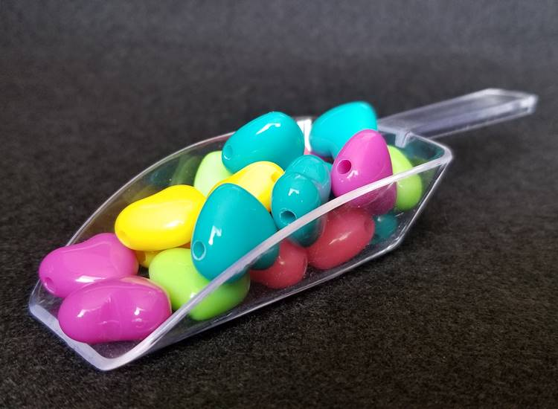
How many beads are in the scoop?
As the clues appear, use the information to narrow the possibilities to a smaller set. After each clue, use estimation again to determine which of the remaining answers is the most reasonable.
Write down your first estimate. After each clue, you’ll see if your estimate is still a possibility. After each clue, if it is no longer possible write down a new estimate – and be prepared to explain why you chose it.
Steve Wyborney
www.stevewyborney.com

Slide 3
Clue #1
Clue #1
The answer is greater than 10
and less than 31.
Clue #2
Clue #2
The answer is a number in this pattern: 12, 14, 16 …
Clue #3
Clue #3
The answer does not
include the digit 1
1 | 2 | 3 | 4 | 5 | 6 | 7 | 8 | 9 | 10
11 | 12 | 13 | 14 | 15 | 16 | 17 | 18 | 19 | 20
21 | 22 | 23 | 24 | 25 | 26 | 27 | 28 | 29 | 30
Clue #4
1 | 2 | 3 | 4 | 5 | 6 | 7 | 8 | 9 | 10
11 | 12 | 13 | 14 | 15 | 16 | 17 | 18 | 19 | 20
21 | 22 | 23 | 24 | 25 | 26 | 27 | 28 | 29 | 30
1 | 2 | 3 | 4 | 5 | 6 | 7 | 8 | 9 | 10
11 | 12 | 13 | 14 | 15 | 16 | 17 | 18 | 19 | 20
21 | 22 | 23 | 24 | 25 | 26 | 27 | 28 | 29 | 30
1 | 2 | 3 | 4 | 5 | 6 | 7 | 8 | 9 | 10
11 | 12 | 13 | 14 | 15 | 16 | 17 | 18 | 19 | 20
21 | 22 | 23 | 24 | 25 | 26 | 27 | 28 | 29 | 30
1 | 2 | 3 | 4 | 5 | 6 | 7 | 8 | 9 | 10
11 | 12 | 13 | 14 | 15 | 16 | 17 | 18 | 19 | 20
21 | 22 | 23 | 24 | 25 | 26 | 27 | 28 | 29 | 30
Clue #4
The answer is not 26.
The answer is not 2 more than 26.
Clue #5
Clue #5
The answer is not 24.
The answer is not 2 less than 24.
Steve Wyborney
www.stevewyborney.com

Slide 4
After seeing the clues, you have narrowed the possibilities to a small set of numbers. Before you see the answer, select your final estimate. Write it down, and explain to someone why you chose that number.
Steve Wyborney
www.stevewyborney.com

Slide 5
20 beads
The Reveal
Click to see the answer.
Important Note:
If you can see this box, then the slide show is not playing and the reveal won’t work.
Here is the solution:
If you are using PowerPoint, click on Slide Show, then click on From Beginning.
If you are using Google Slides, click on View then Present.
Steve Wyborney
www.stevewyborney.com

Slide 6

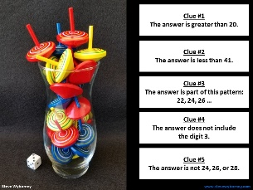
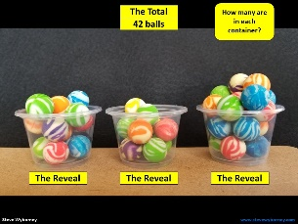
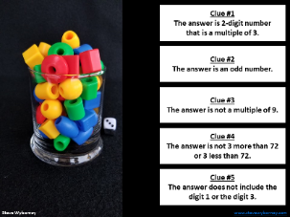
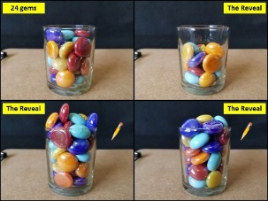
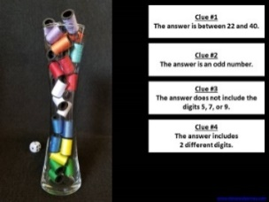
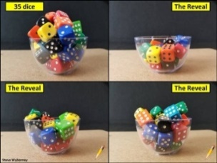
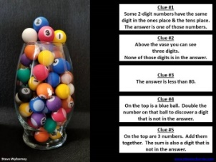
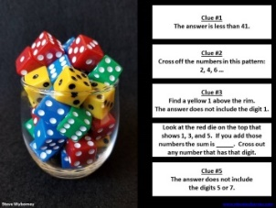
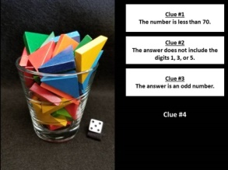
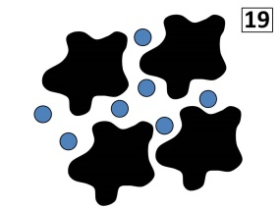
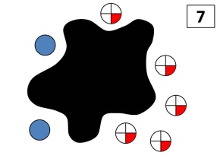
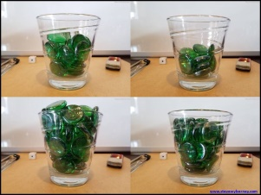
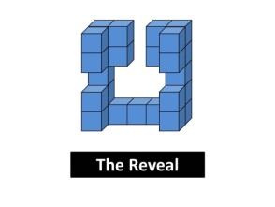

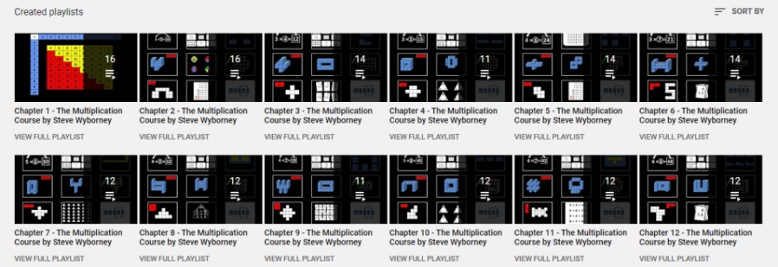
New Materials for 2022-2023
Daily Resources Posted in the 2021-2022 School Year
New Multiplication Workbook!
Ask your school to purchase a copy
for every student in your class.
Learn more here.
170 New Esti-Mysteries
The 3-Container
Estimation Routine
(2021-2022)
150 New Esti-Mysteries
(2021-2022)
More Estimation Clipboards
Daily Resources Posted in the 2020-2021 School Year
New Esti-Mysteries and Number Sense Resources Every Day
for the Rest of the School Year
Part 2 - New Esti-Mysteries and
Number Sense Resources Every Day
for the Rest of the School Year
Part 3 - New Esti-Mysteries and
Number Sense Resources Every Day
for the Rest of the School Year
Part 4 - New Esti-Mysteries and
Number Sense Resources Every Day
for the Rest of the School Year
More Free, Downloadable Resources From Blog Posts
51 Esti-Mysteries
The Original
50 Splat! Lessons
The Original 20 Fraction Splat! Lessons
The Original 40 Estimation Clipboard Sets
80 Cube Conversations
Lessons
20 Days of Number Sense
& Rich Math Talk
The Multiplication Course (the free course for students and teachers, posted in 2020)
For more information read the blog post about The Multiplication Course here.
To view the course on YouTube:
Click here to see the chapter playlists on my YouTube channel.
You’ll see all 12 chapters in the course.
Each chapter includes a sequence of lessons for students.

