Slide 1
Watch this YouTube video for more information about the charts.
https://youtu.be/pzPby1HUSQs
I see 3 versions of this Esti-Mystery. Which one should I use?
“Esti-Mysteries are already working well for my class.”
Use slides 2-7 if Esti-Mysteries if your students have charts to write on. You’re students are writing on a chart, writing down their estimates, and are discussing their ideas with each other after each clue. They may be writing on paper, writing on a dry erase surface, or using a digital tool to annotate – or they have another way of responding to clues in writing. You probably already notice that when students write down their estimate after each clue it helps to propel rich math talk and also builds anticipation for the next clue. If this sounds familiar, then I recommend using slides 2-7.
“I need to display a chart for everyone to see, and I have a way to write on it.”
Use slides 8-13 if you simply need an embedded chart to write on during discussion. This may be helpful if you want to show a chart at the same time as the Esti-Mystery. The chart (on slides 8-13) will appear on the screen so that you can write on it. You can simply write on your whiteboard , use a digital pen, or use the chart in may other ways.
“I need a step-by-step animated chart that eliminates numbers after every clue.”
Use slides 14-19 if you want to see numbers disappear from the chart after every clue. This may be helpful if you need a chart and don’t have an easy way to write on the chart. After each clue, you’ll see which numbers are eliminated – and which ones are left.

Slide 2
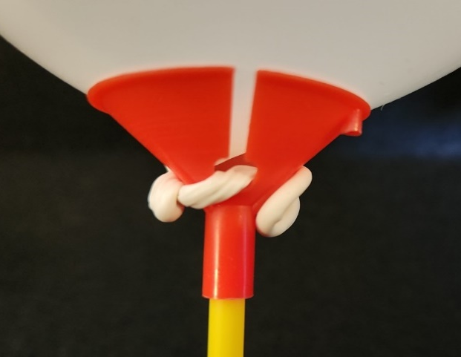
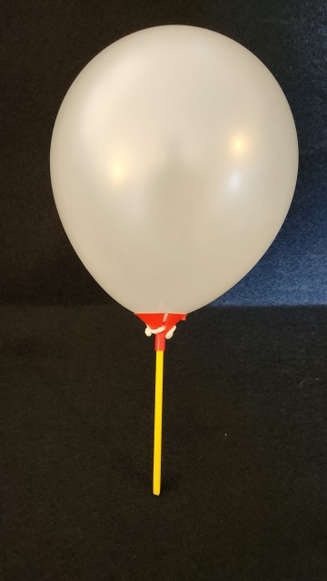
“Less Than
One Whole Balloon”
Important Note:
If you can see this box, then the slide show is not playing and the reveal won’t work.
Here is the solution:
If you are using PowerPoint,
click on Slide Show,
then click on From Current Slide.
If you are using Google Slides,
click on View then Present.
Steve Wyborney
www.stevewyborney.com

Slide 3
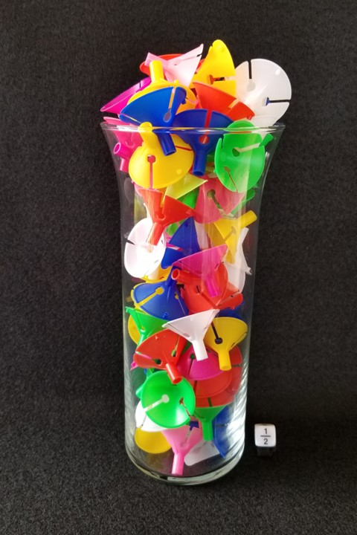
How many balloon holders
are in the vase?
As the clues appear, use the information to narrow the possibilities to a smaller set. After each clue, use estimation again to determine which of the remaining answers is the most reasonable.
Write down your first estimate. After each clue, you’ll see if your estimate is still a possibility. After each clue, if it is no longer possible write down a new estimate – and be prepared to explain why you chose it.
Steve Wyborney
www.stevewyborney.com

Slide 4
Clue #1
Clue #1
The answer is a an even number
between 40 and 91.
However, it is not a multiple of 4.
Clue #2
Clue #2
The answer is a multiple of 3.
Clue #3
Clue #3
The answer is not equal 156 halves.
Clue #4
Clue #4
Think about ½ of 10.
The answer does not include that digit.
Clue #5
Clue #5
The answer is not equal to ½ of 132.
Steve Wyborney
www.stevewyborney.com

Slide 5
After seeing the clues, you have narrowed the possibilities to a small set of numbers. Before you see the answer, select your final estimate. Write it down, and explain to someone why you chose that number.
Steve Wyborney
www.stevewyborney.com

Slide 6
90 balloon holders
The Reveal
Click to see the answer.
Important Note:
If you can see this box, then the slide show is not playing and the reveal won’t work.
Here is the solution:
If you are using PowerPoint,
click on Slide Show,
then click on From Current Slide.
If you are using Google Slides,
click on View then Present.
Steve Wyborney
www.stevewyborney.com

Slide 7
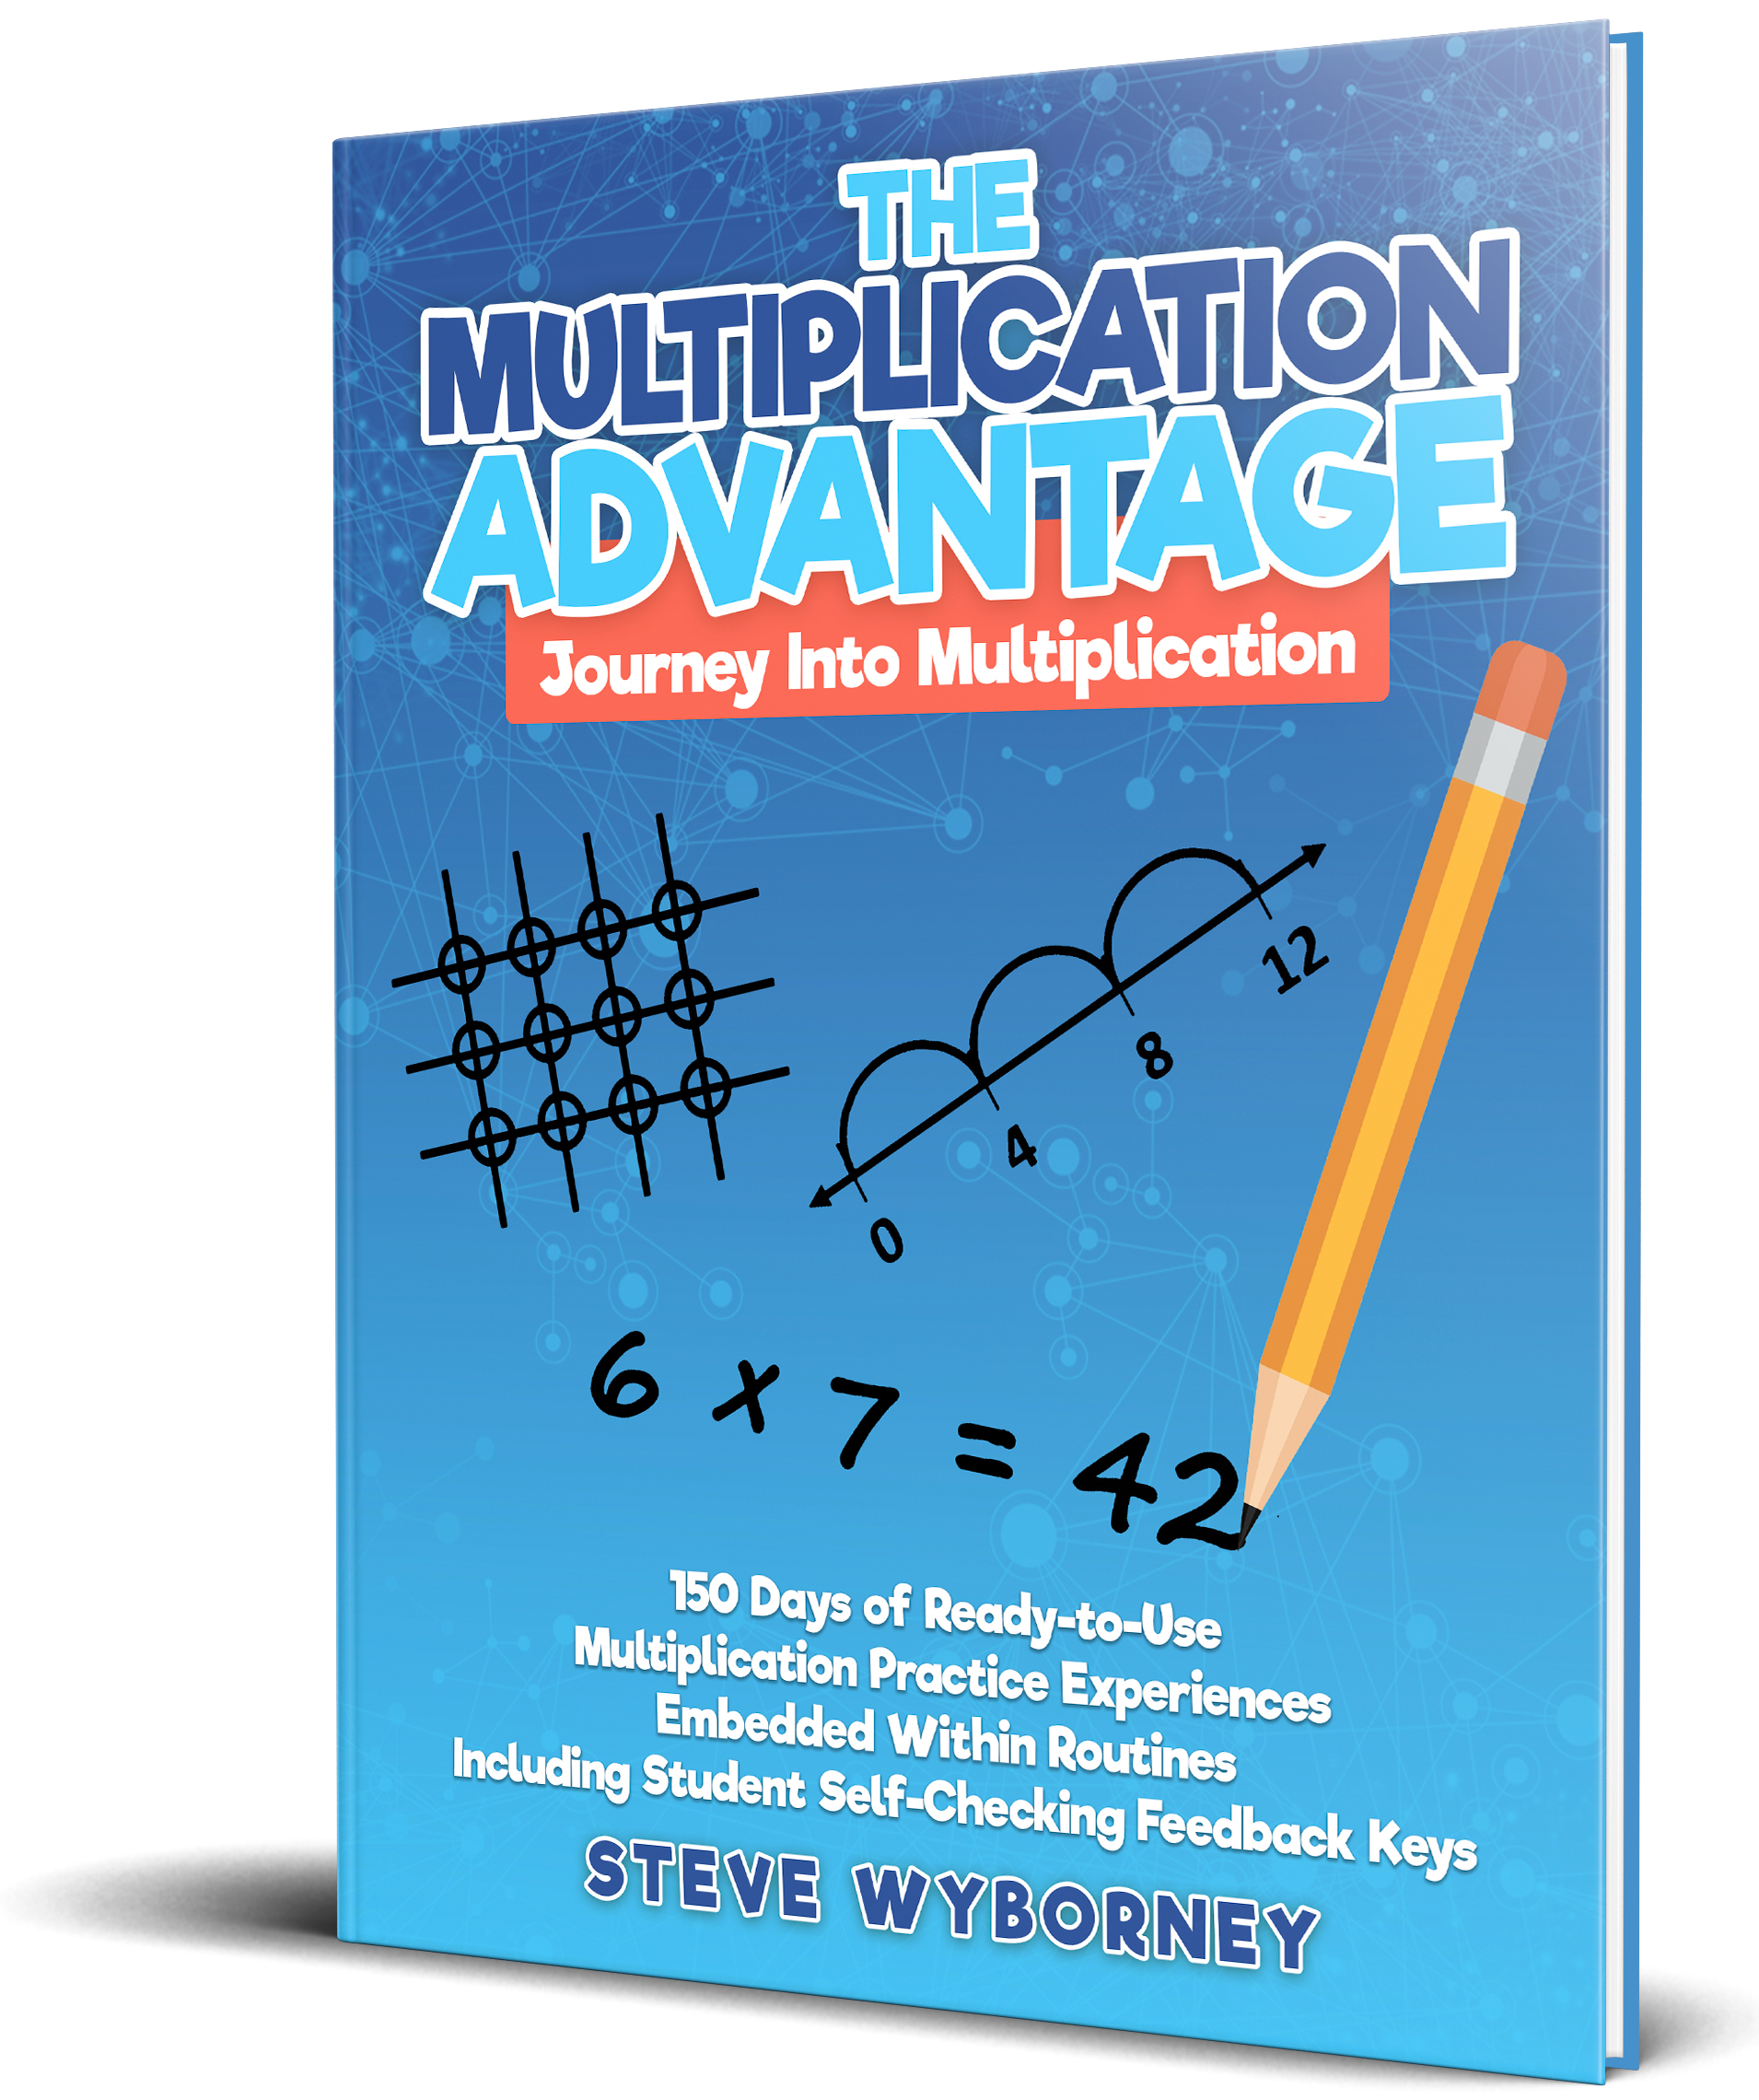
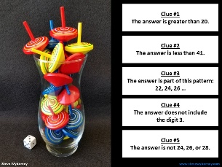
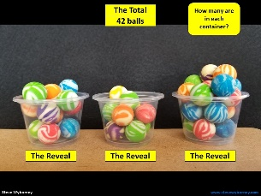
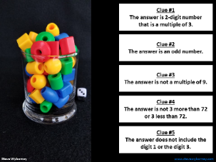
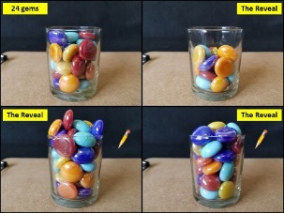
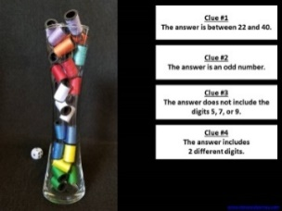
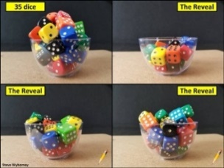
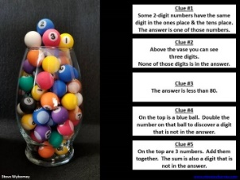
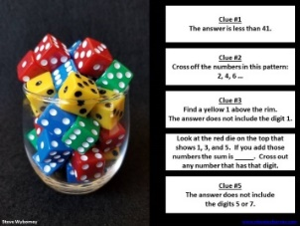
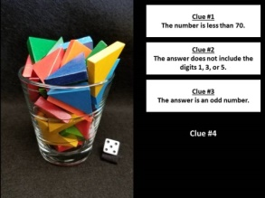
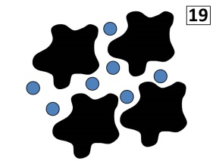
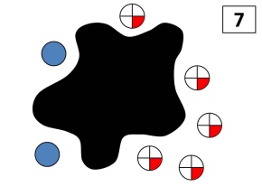
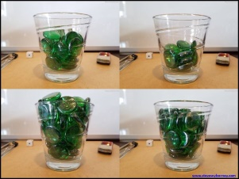
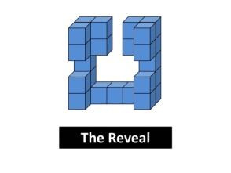

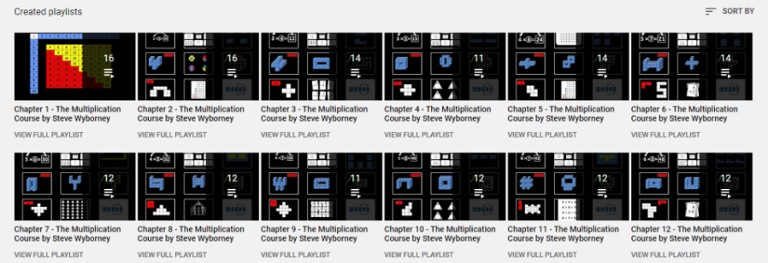
New Materials for 2022-2023
Daily Resources Posted in the 2021-2022 School Year
New Multiplication Workbook!
Ask your school to purchase a copy
for every student in your class.
Learn more here.
170 New Esti-Mysteries
The 3-Container
Estimation Routine
(2021-2022)
150 New Esti-Mysteries
(2021-2022)
More Estimation Clipboards
Daily Resources Posted in the 2020-2021 School Year
New Esti-Mysteries and Number Sense Resources Every Day
for the Rest of the School Year
Part 2 - New Esti-Mysteries and
Number Sense Resources Every Day
for the Rest of the School Year
Part 3 - New Esti-Mysteries and
Number Sense Resources Every Day
for the Rest of the School Year
Part 4 - New Esti-Mysteries and
Number Sense Resources Every Day
for the Rest of the School Year
More Free, Downloadable Resources From Blog Posts
51 Esti-Mysteries
The Original
50 Splat! Lessons
The Original 20 Fraction Splat! Lessons
The Original 40 Estimation Clipboard Sets
80 Cube Conversations
Lessons
20 Days of Number Sense
& Rich Math Talk
The Multiplication Course (the free course for students and teachers, posted in 2020)
For more information read the blog post about The Multiplication Course here.
To view the course on YouTube:
Click here to see the chapter playlists on my YouTube channel.
You’ll see all 12 chapters in the course.
Each chapter includes a sequence of lessons for students.

Slide 8
“Less Than
One Whole Balloon”
Important Note:
If you can see this box, then the slide show is not playing and the reveal won’t work.
Here is the solution:
If you are using PowerPoint,
click on Slide Show,
then click on From Current Slide.
If you are using Google Slides,
click on View then Present.
Steve Wyborney
www.stevewyborney.com

Slide 9
How many balloon holders
are in the vase?
As the clues appear, use the information to narrow the possibilities to a smaller set. After each clue, use estimation again to determine which of the remaining answers is the most reasonable.
Write down your first estimate. After each clue, you’ll see if your estimate is still a possibility. After each clue, if it is no longer possible write down a new estimate – and be prepared to explain why you chose it.
Steve Wyborney
www.stevewyborney.com

Slide 10
Clue #1
Clue #1
The answer is a an even number
between 40 and 91.
However, it is not a multiple of 4.
Clue #2
Clue #2
The answer is a multiple of 3.
Clue #3
Clue #3
The answer is not equal 156 halves.
Clue #4
Clue #4
Think about ½ of 10.
The answer does not include that digit.
41 | 42 | 43 | 44 | 45 | 46 | 47 | 48 | 49 | 50
51 | 52 | 53 | 54 | 55 | 56 | 57 | 58 | 59 | 60
61 | 62 | 63 | 64 | 65 | 66 | 67 | 68 | 69 | 70
71 | 72 | 73 | 74 | 75 | 76 | 77 | 78 | 79 | 80
81 | 82 | 83 | 84 | 85 | 86 | 87 | 88 | 89 | 90
Clue #5
Clue #5
The answer is not equal to ½ of 132.
Steve Wyborney
www.stevewyborney.com

Slide 11
After seeing the clues, you have narrowed the possibilities to a small set of numbers. Before you see the answer, select your final estimate. Write it down, and explain to someone why you chose that number.
Steve Wyborney
www.stevewyborney.com

Slide 12
90 balloon holders
The Reveal
Click to see the answer.
Important Note:
If you can see this box, then the slide show is not playing and the reveal won’t work.
Here is the solution:
If you are using PowerPoint,
click on Slide Show,
then click on From Current Slide.
If you are using Google Slides,
click on View then Present.
Steve Wyborney
www.stevewyborney.com

Slide 13
New Materials for 2022-2023
Daily Resources Posted in the 2021-2022 School Year
New Multiplication Workbook!
Ask your school to purchase a copy
for every student in your class.
Learn more here.
170 New Esti-Mysteries
The 3-Container
Estimation Routine
(2021-2022)
150 New Esti-Mysteries
(2021-2022)
More Estimation Clipboards
Daily Resources Posted in the 2020-2021 School Year
New Esti-Mysteries and Number Sense Resources Every Day
for the Rest of the School Year
Part 2 - New Esti-Mysteries and
Number Sense Resources Every Day
for the Rest of the School Year
Part 3 - New Esti-Mysteries and
Number Sense Resources Every Day
for the Rest of the School Year
Part 4 - New Esti-Mysteries and
Number Sense Resources Every Day
for the Rest of the School Year
More Free, Downloadable Resources From Blog Posts
51 Esti-Mysteries
The Original
50 Splat! Lessons
The Original 20 Fraction Splat! Lessons
The Original 40 Estimation Clipboard Sets
80 Cube Conversations
Lessons
20 Days of Number Sense
& Rich Math Talk
The Multiplication Course (the free course for students and teachers, posted in 2020)
For more information read the blog post about The Multiplication Course here.
To view the course on YouTube:
Click here to see the chapter playlists on my YouTube channel.
You’ll see all 12 chapters in the course.
Each chapter includes a sequence of lessons for students.

Slide 14
“Less Than
One Whole Balloon”
Important Note:
If you can see this box, then the slide show is not playing and the reveal won’t work.
Here is the solution:
If you are using PowerPoint,
click on Slide Show,
then click on From Current Slide.
If you are using Google Slides,
click on View then Present.
Steve Wyborney
www.stevewyborney.com

Slide 15
How many balloon holders
are in the vase?
As the clues appear, use the information to narrow the possibilities to a smaller set. After each clue, use estimation again to determine which of the remaining answers is the most reasonable.
Write down your first estimate. After each clue, you’ll see if your estimate is still a possibility. After each clue, if it is no longer possible write down a new estimate – and be prepared to explain why you chose it.
Steve Wyborney
www.stevewyborney.com

Slide 16
Clue #1
Clue #1
The answer is a an even number
between 40 and 91.
However, it is not a multiple of 4.
Clue #2
Clue #2
The answer is a multiple of 3.
Clue #3
Clue #3
The answer is not equal 156 halves.
Clue #4
Clue #4
Think about ½ of 10.
The answer does not include that digit.
41 | 42 | 43 | 44 | 45 | 46 | 47 | 48 | 49 | 50
51 | 52 | 53 | 54 | 55 | 56 | 57 | 58 | 59 | 60
61 | 62 | 63 | 64 | 65 | 66 | 67 | 68 | 69 | 70
71 | 72 | 73 | 74 | 75 | 76 | 77 | 78 | 79 | 80
81 | 82 | 83 | 84 | 85 | 86 | 87 | 88 | 89 | 90
41 | 42 | 43 | 44 | 45 | 46 | 47 | 48 | 49 | 50
51 | 52 | 53 | 54 | 55 | 56 | 57 | 58 | 59 | 60
61 | 62 | 63 | 64 | 65 | 66 | 67 | 68 | 69 | 70
71 | 72 | 73 | 74 | 75 | 76 | 77 | 78 | 79 | 80
81 | 82 | 83 | 84 | 85 | 86 | 87 | 88 | 89 | 90
41 | 42 | 43 | 44 | 45 | 46 | 47 | 48 | 49 | 50
51 | 52 | 53 | 54 | 55 | 56 | 57 | 58 | 59 | 60
61 | 62 | 63 | 64 | 65 | 66 | 67 | 68 | 69 | 70
71 | 72 | 73 | 74 | 75 | 76 | 77 | 78 | 79 | 80
81 | 82 | 83 | 84 | 85 | 86 | 87 | 88 | 89 | 90
41 | 42 | 43 | 44 | 45 | 46 | 47 | 48 | 49 | 50
51 | 52 | 53 | 54 | 55 | 56 | 57 | 58 | 59 | 60
61 | 62 | 63 | 64 | 65 | 66 | 67 | 68 | 69 | 70
71 | 72 | 73 | 74 | 75 | 76 | 77 | 78 | 79 | 80
81 | 82 | 83 | 84 | 85 | 86 | 87 | 88 | 89 | 90
41 | 42 | 43 | 44 | 45 | 46 | 47 | 48 | 49 | 50
51 | 52 | 53 | 54 | 55 | 56 | 57 | 58 | 59 | 60
61 | 62 | 63 | 64 | 65 | 66 | 67 | 68 | 69 | 70
71 | 72 | 73 | 74 | 75 | 76 | 77 | 78 | 79 | 80
81 | 82 | 83 | 84 | 85 | 86 | 87 | 88 | 89 | 90
41 | 42 | 43 | 44 | 45 | 46 | 47 | 48 | 49 | 50
51 | 52 | 53 | 54 | 55 | 56 | 57 | 58 | 59 | 60
61 | 62 | 63 | 64 | 65 | 66 | 67 | 68 | 69 | 70
71 | 72 | 73 | 74 | 75 | 76 | 77 | 78 | 79 | 80
81 | 82 | 83 | 84 | 85 | 86 | 87 | 88 | 89 | 90
Clue #5
Clue #5
The answer is not equal to ½ of 132.
Steve Wyborney
www.stevewyborney.com

Slide 17
After seeing the clues, you have narrowed the possibilities to a small set of numbers. Before you see the answer, select your final estimate. Write it down, and explain to someone why you chose that number.
Steve Wyborney
www.stevewyborney.com

Slide 18
90 balloon holders
The Reveal
Click to see the answer.
Important Note:
If you can see this box, then the slide show is not playing and the reveal won’t work.
Here is the solution:
If you are using PowerPoint,
click on Slide Show,
then click on From Current Slide.
If you are using Google Slides,
click on View then Present.
Steve Wyborney
www.stevewyborney.com

Slide 19
New Materials for 2022-2023
Daily Resources Posted in the 2021-2022 School Year
New Multiplication Workbook!
Ask your school to purchase a copy
for every student in your class.
Learn more here.
170 New Esti-Mysteries
The 3-Container
Estimation Routine
(2021-2022)
150 New Esti-Mysteries
(2021-2022)
More Estimation Clipboards
Daily Resources Posted in the 2020-2021 School Year
New Esti-Mysteries and Number Sense Resources Every Day
for the Rest of the School Year
Part 2 - New Esti-Mysteries and
Number Sense Resources Every Day
for the Rest of the School Year
Part 3 - New Esti-Mysteries and
Number Sense Resources Every Day
for the Rest of the School Year
Part 4 - New Esti-Mysteries and
Number Sense Resources Every Day
for the Rest of the School Year
More Free, Downloadable Resources From Blog Posts
51 Esti-Mysteries
The Original
50 Splat! Lessons
The Original 20 Fraction Splat! Lessons
The Original 40 Estimation Clipboard Sets
80 Cube Conversations
Lessons
20 Days of Number Sense
& Rich Math Talk
The Multiplication Course (the free course for students and teachers, posted in 2020)
For more information read the blog post about The Multiplication Course here.
To view the course on YouTube:
Click here to see the chapter playlists on my YouTube channel.
You’ll see all 12 chapters in the course.
Each chapter includes a sequence of lessons for students.

