Slide 1
The 3-Container Estimation Routine
Sets 17 and 18

Slide 2

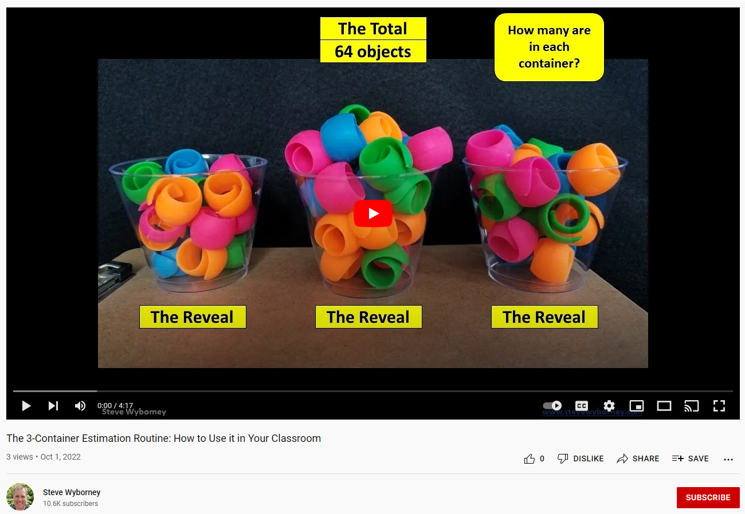
Tips for Using The 3-Container Estimation Routine
1. If The 3-Container Estimation Routine is new to you, start by watching this video.
The questions in the routine are embedded and will be displayed (or indicated) as you play the slides.
There are two estimation slides in this routine. You can use either one of them, or both. I recommend using both.
Make sure the PowerPoint (or Google Slide) is playing. The animations (such as revealing the answers) use animations to display. The slide show needs to be playing for those animations to work.
Students should write down each estimate – and share those estimates and their reasoning with each other.
The 4 Key Questions Embedded in the routine are:
What is the total number objects?
How many are in each container?
How many are in just the first container?
How many are in the 2nd and 3rd containers?
6. Each time you pose a question, or reveal an answer, listen carefully to student discussion.
7. As a learner yourself, engage in the process. Be a wonderer in front of your students. Share your what you notice or wonder aloud. For example, you may notice that one container has a little more (or a little less) than another and you may wonder how many more – or how many less.
8. Enjoy the journey and feel free to share your learning experiences with others!

Slide 3
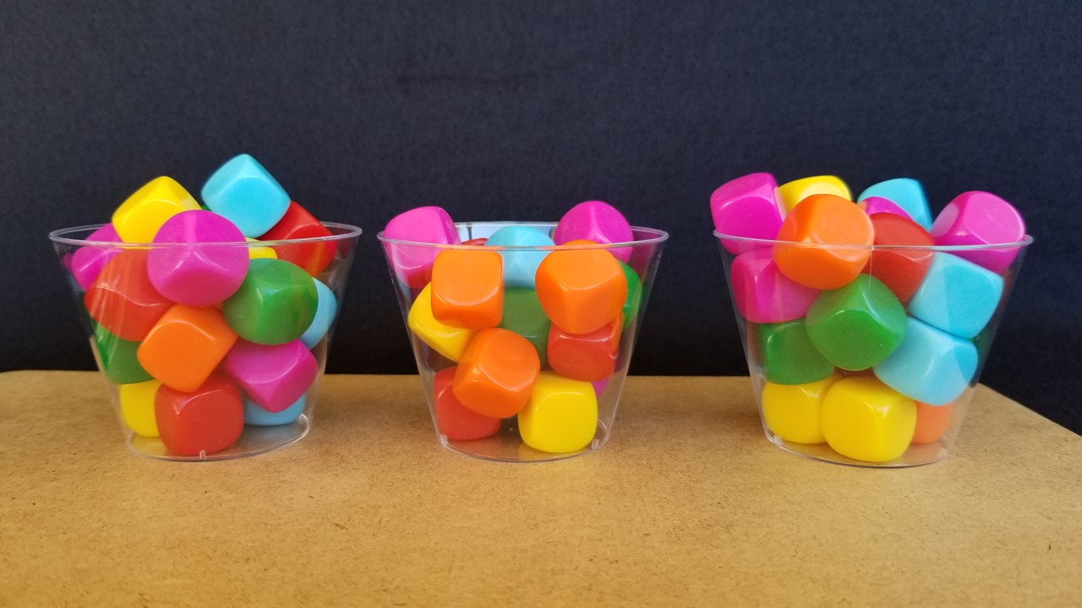
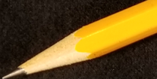

What is the total number of blank dice?
The Total
How many are in each container?
60 blank dice
Important Note:
If you can see this box, then the slide show is not playing and the reveal won’t work.
Here is the solution:
If you are using PowerPoint,
click on Slide Show,
then click on From Current Slide.
If you are using Google Slides,
click on View then Slideshow.
?
?
?
20 blank dice
17 blank dice
23 blank dice
The Reveal
The Reveal
The Reveal
Steve Wyborney
www.stevewyborney.com

Slide 4
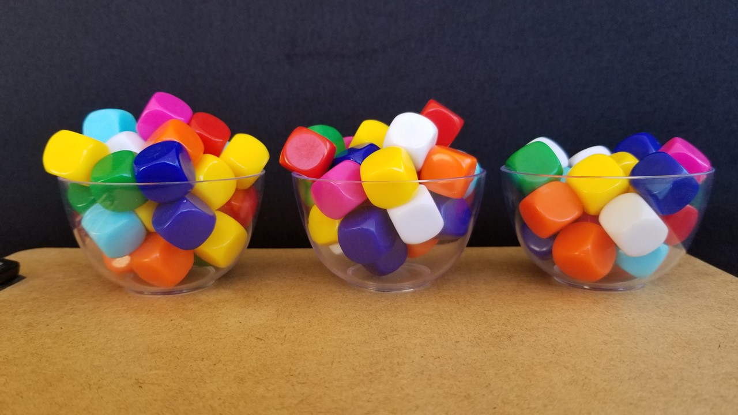
What is the total number of blank dice?
The Total
How many are in each bowl?
78 blank dice
Important Note:
If you can see this box, then the slide show is not playing and the reveal won’t work.
Here is the solution:
If you are using PowerPoint,
click on Slide Show,
then click on From Current Slide.
If you are using Google Slides,
click on View then Slideshow.
?
?
?
The Reveal
21 blank dice
27 blank dice
The Reveal
30 blank dice
The Reveal
Steve Wyborney
www.stevewyborney.com

Slide 5
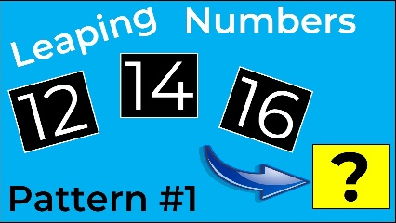
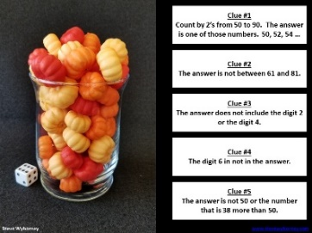
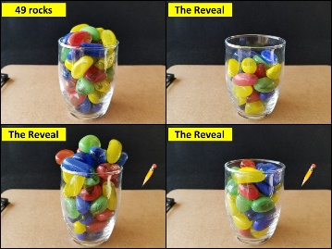

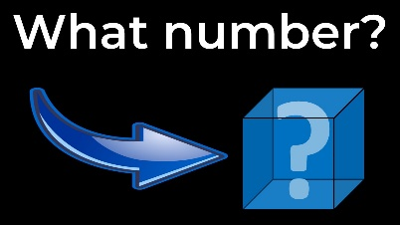
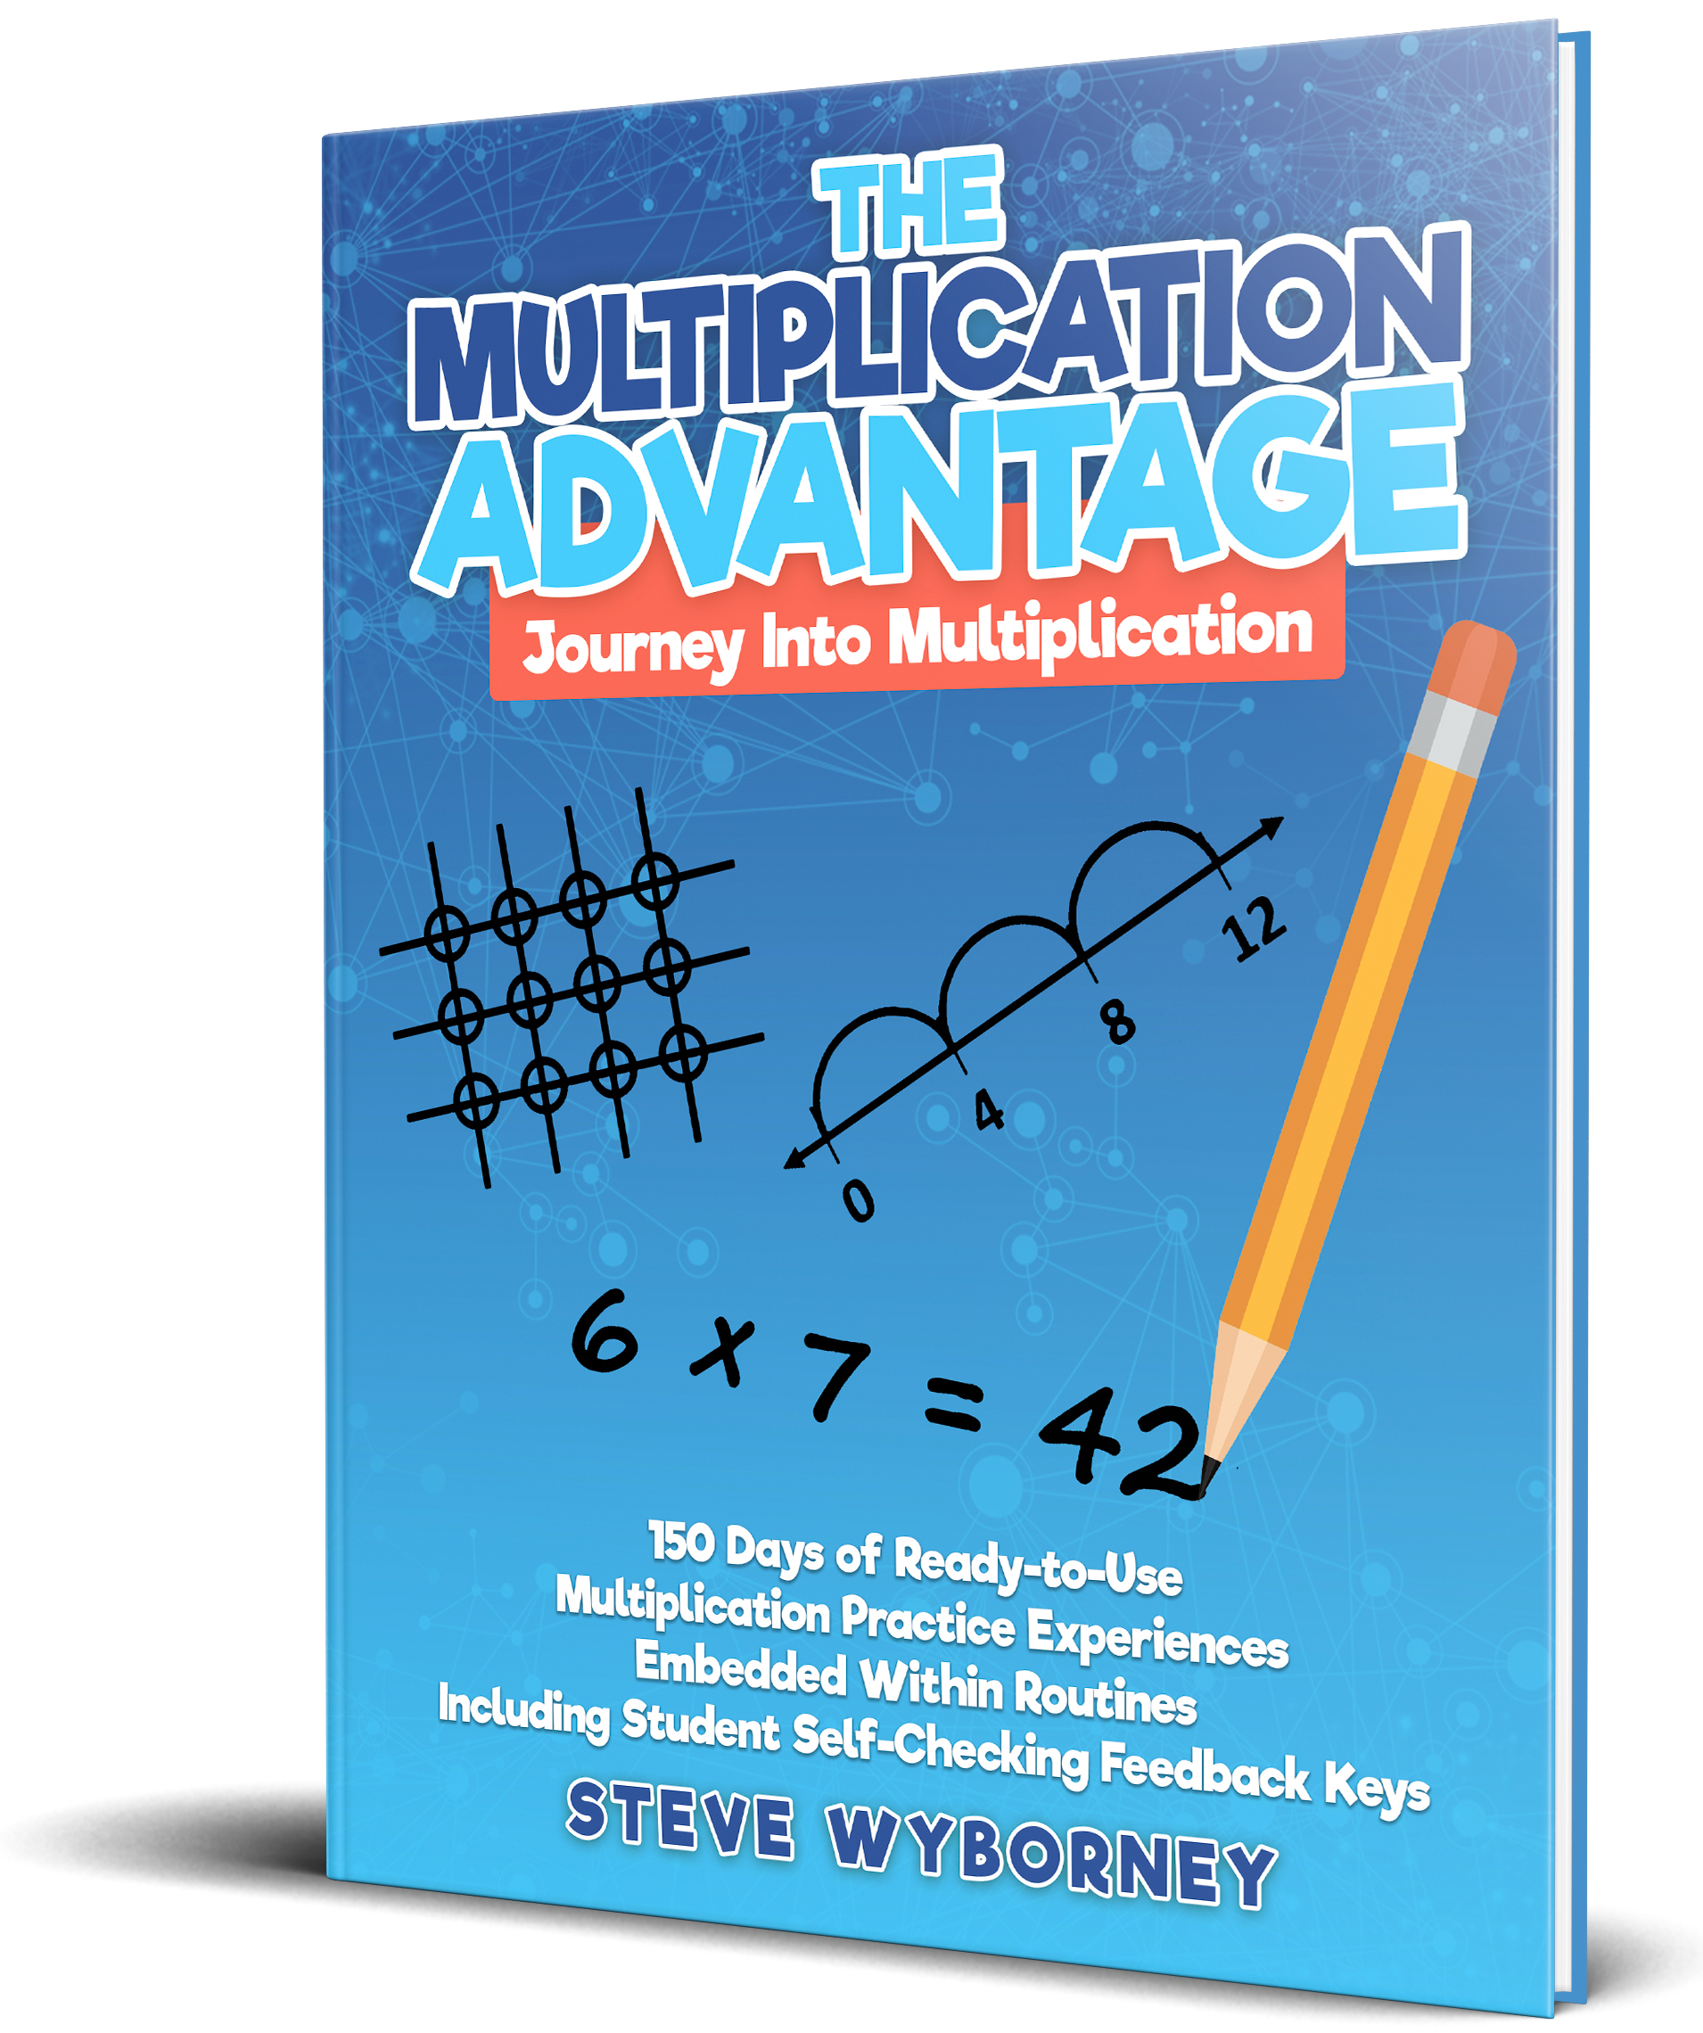
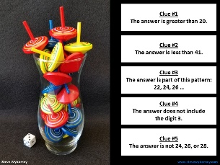
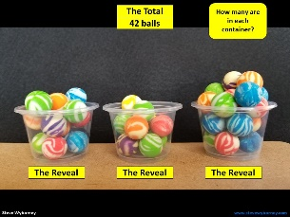
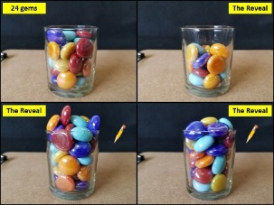
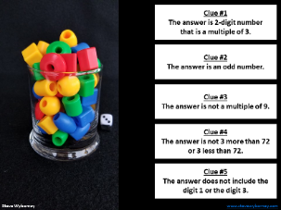
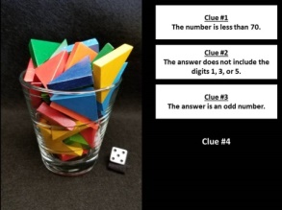
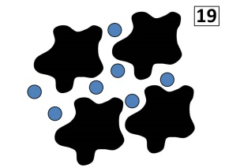
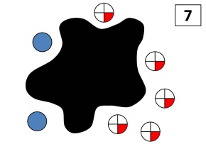
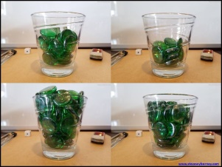
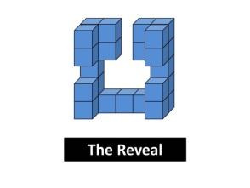

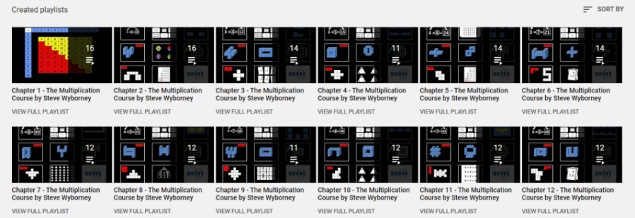
New Materials for 2023-2024
Leaping Numbers Pattern Challenges
Perfect for Leap Day!
View the entire playlist here.
How do I subscribe
to the mailing list?
Sign Up Here
The Mystery Number in the Box
60-Second Math Mystery Videos
View the entire playlist here.
100 New Esti-Mysteries
New Estimation Clipboards
Daily Resources Posted in the 2022-2023 School Year
The Multiplication Advantage!
Ask your school to purchase a copy
for every student in your class.
Learn more here.
170 New Esti-Mysteries
The 3-Container
Estimation Routine
More Estimation Clipboards
(2021-2022)
150 New Esti-Mysteries
More Free, Downloadable Resources From Blog Posts
51 Esti-Mysteries
The Original
50 Splat! Lessons
The Original 20 Fraction Splat! Lessons
The Original 40 Estimation Clipboard Sets
80 Cube Conversations
Lessons
20 Days of Number Sense
& Rich Math Talk
The Multiplication Course (the free course for students and teachers, posted in 2020)
For more information read the blog post about The Multiplication Course here.
To view the course on YouTube:
Click here to see the chapter playlists on my YouTube channel.
You’ll see all 12 chapters in the course.
Each chapter includes a sequence of lessons for students.

