Slide 1
Estimation Clipboard 154
If this is your first time using the Estimation Clipboard in your classroom, I recommend watching this short YouTube video beginning at 0:42.
Note: To make the link active, make sure the slide show is playing. In PPT, click on “Slide Show” then “From Current Slide.” In Google Slides, Click on “Present.”
Then you will be able to click the link to the video.
Steve Wyborney
www.stevewyborney.com

Slide 2
Tips for Using The Estimation Clipboard
When the first image (of 4) appears, invite the class to share some estimates aloud. Typically, a few students will offer some estimates. Don’t spend much time on the first image. After you have received a few responses, reveal the answer.
Make a mental note: If you hear answers from a small number of students, you are also hearing silence from nearly all of your class. Anticipate engaging all students in mathematical reasoning by the time you reach the third image.
When the second image appears, invite the class to share some estimates aloud again. You will likely hear estimates from more students than the first time. You may want to spend a little more time on the second image, but the power of The Estimation Clipboard is yet to come.
When the third image appears, change your approach. Remember, you haven’t heard from several students at this point, but everyone’s context is growing. When you show the third image, instead of asking for answers aloud have all of the students write down their estimate. Then have them discuss these two questions with a partner: “What was your estimate? Why did you choose it?” Listen carefully to the reasoning.
When the moment is right, reveal the third answer. Notice how your students are becoming increasingly engaged in the estimation process. That’s partly because you are re-inviting them into a growing context. It’s also because they have engaged in writing and discussion. The moment of writing has become a springboard for discussion. They have been given space to voice their ideas, and they are learning more about their ideas as they discuss them.
When the fourth image appears, repeat the process from the previous step. Everyone in the classroom writes down their estimate, and then everyone tells their partner what estimate they chose and why they chose it. Expect the conversation to take a little longer here and notice that the conversations about the estimates – and about estimation itself – are becoming more detailed. You may see several students pointing to the screen during their discussions.
When you reveal the final answer, listen to your class. Simply listen. Just take a moment to notice.
As a learner yourself, engage in the process. Be a wonderer in front of your students. If you want a good question to wonder about, begin with this one: “What is estimation?”
Enjoy the journey and feel free to share your learning experiences with others!

Slide 3
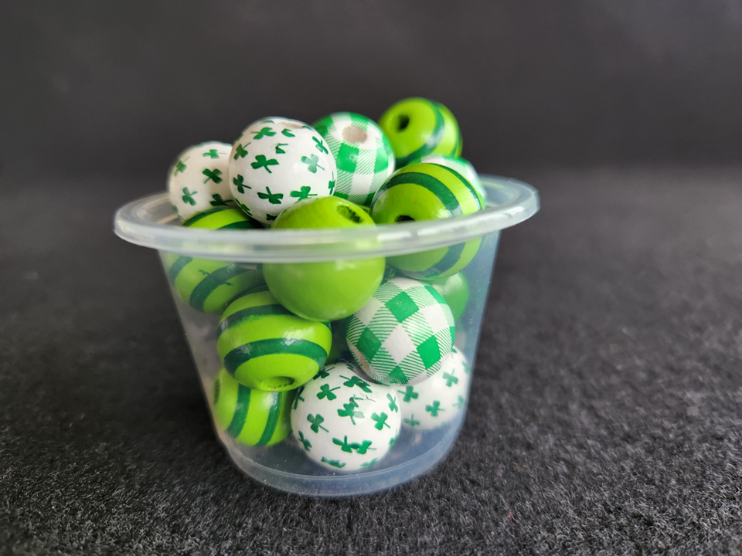
22 beads
The Reveal
How many beads are in
the container?
Important Note:
If you can see this box, then the slide show is not playing and the reveal won’t work.
Here is the solution:
If you are using PowerPoint,
click on Slide Show,
then click on From Current Slide.
If you are using Google Slides,
click on View then Present.
Steve Wyborney

Slide 4
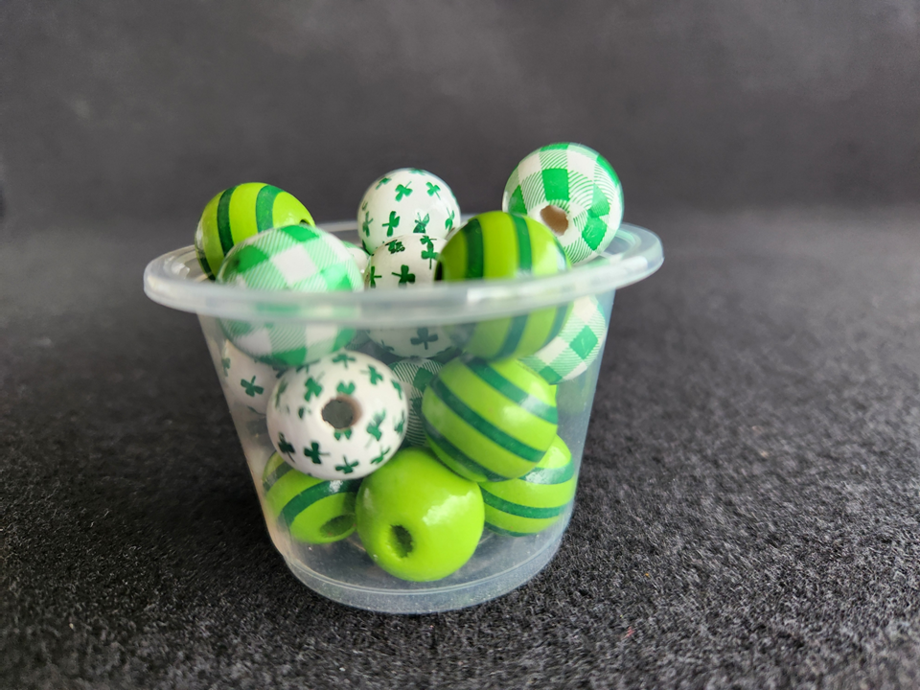
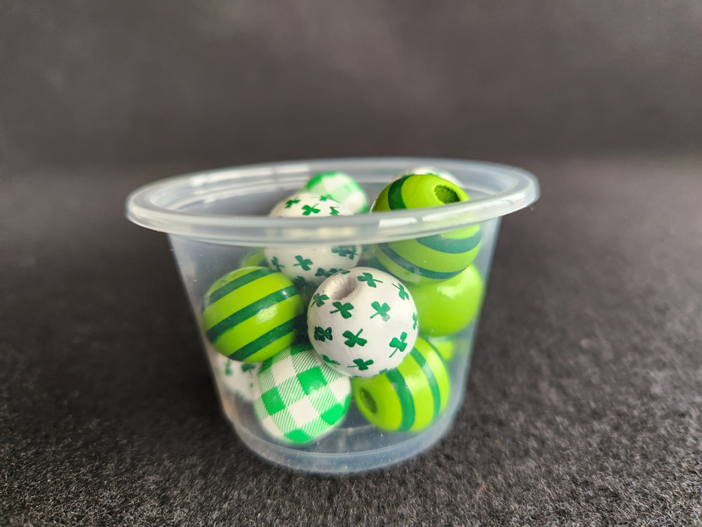
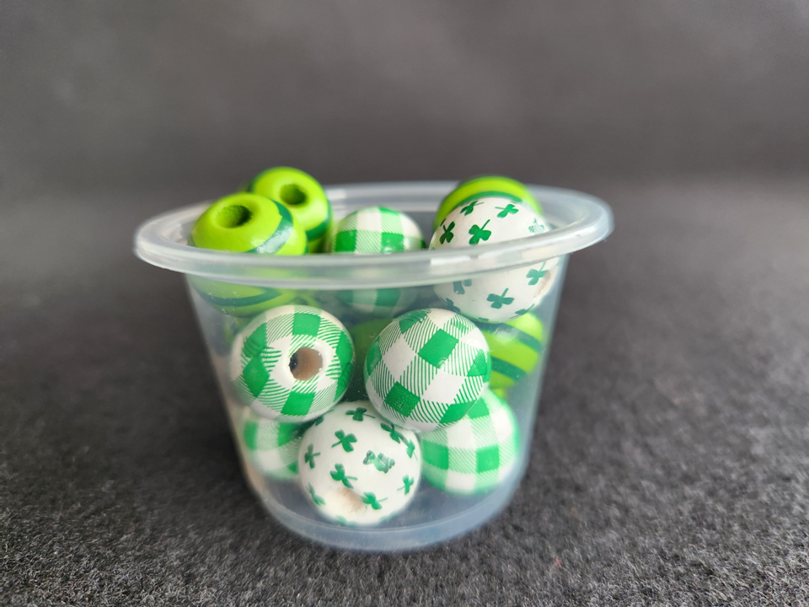
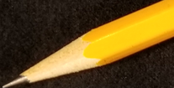

22 beads
The Reveal
20 beads
The Reveal
The Reveal
15 beads
17 beads
Steve Wyborney

Slide 5
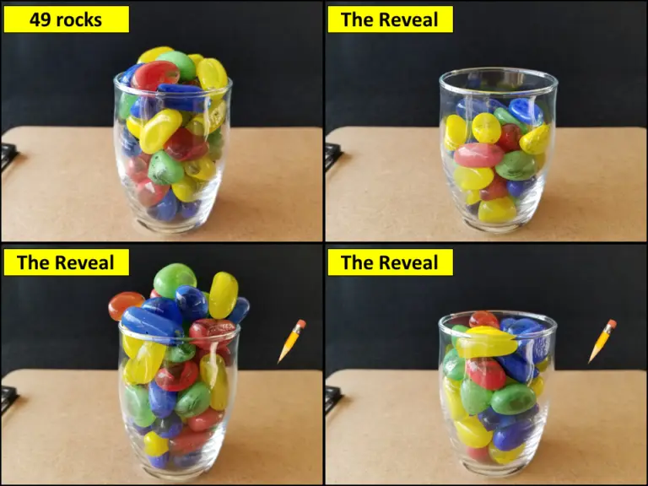

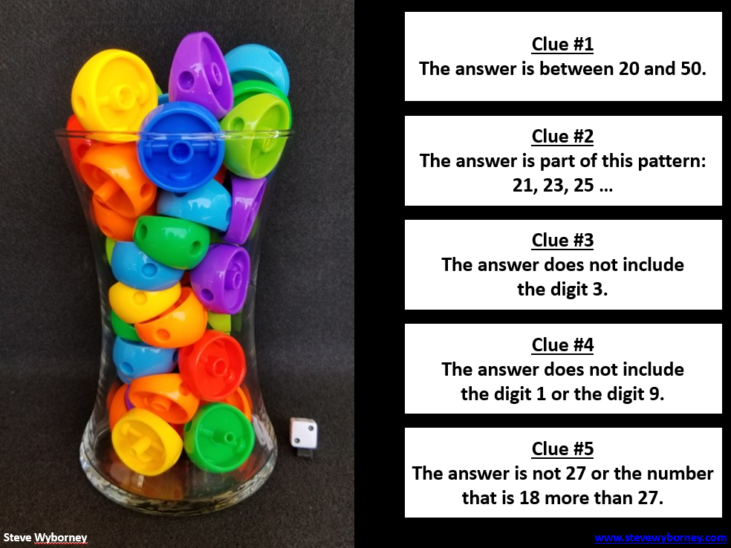
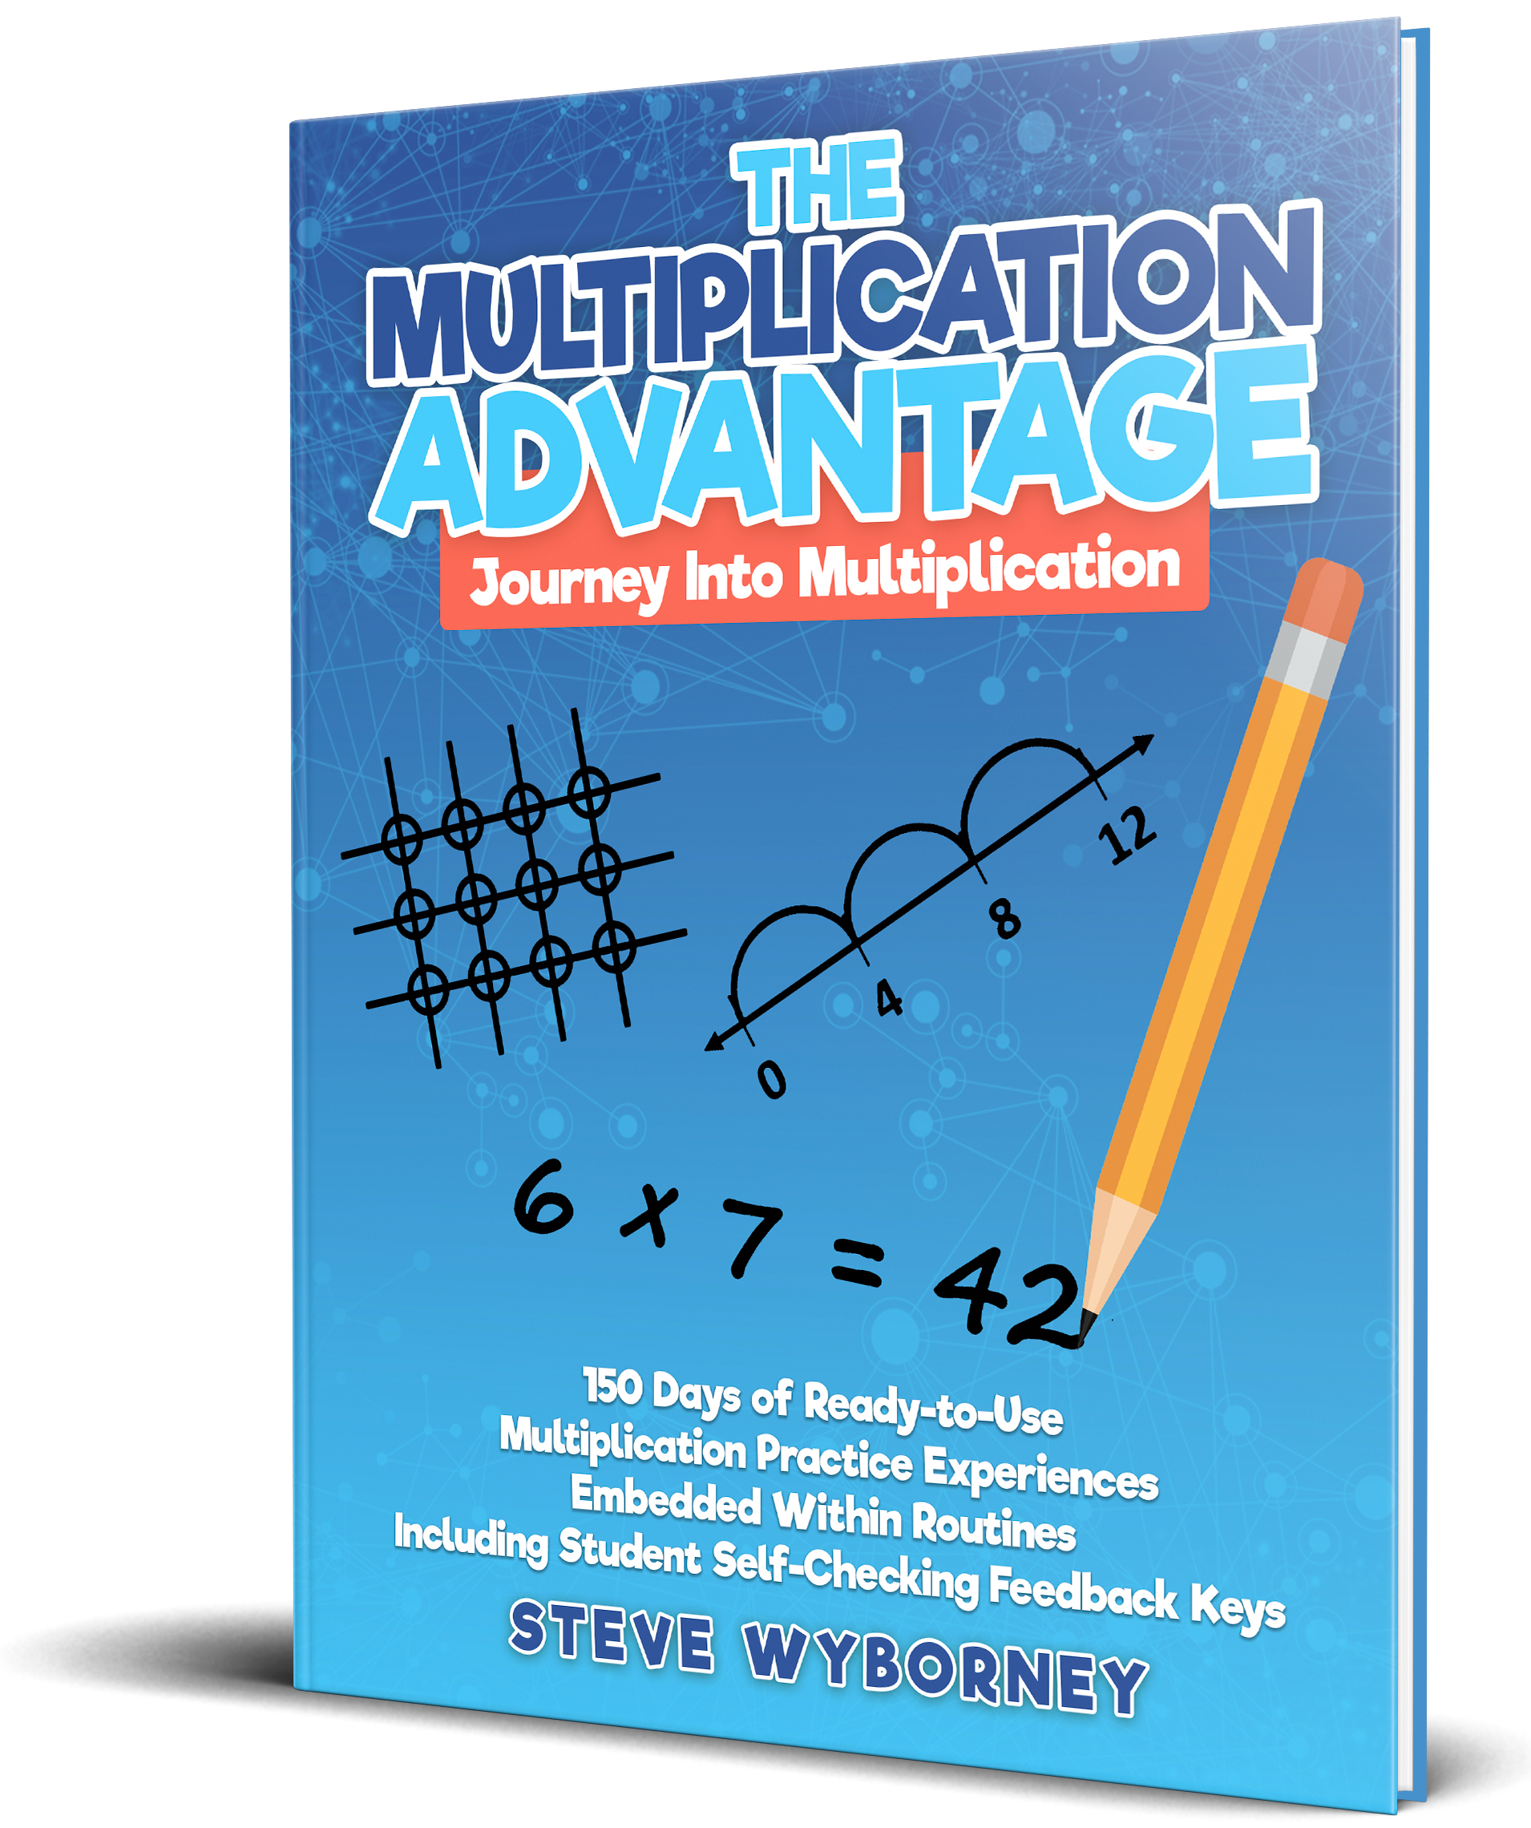




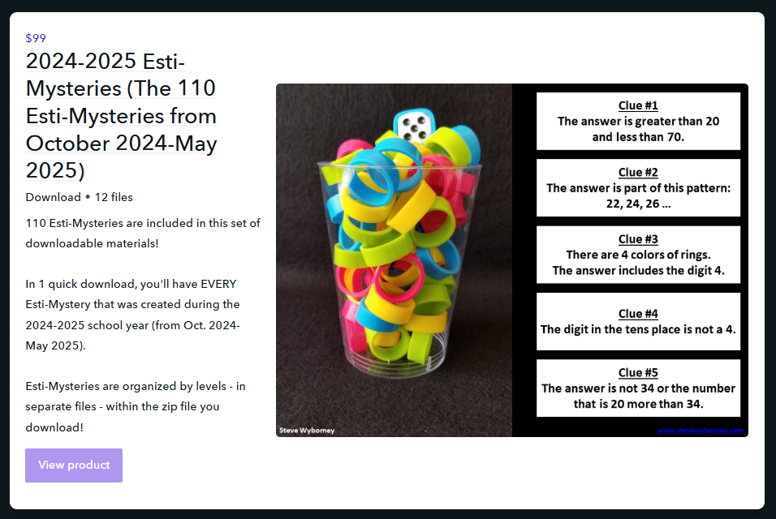
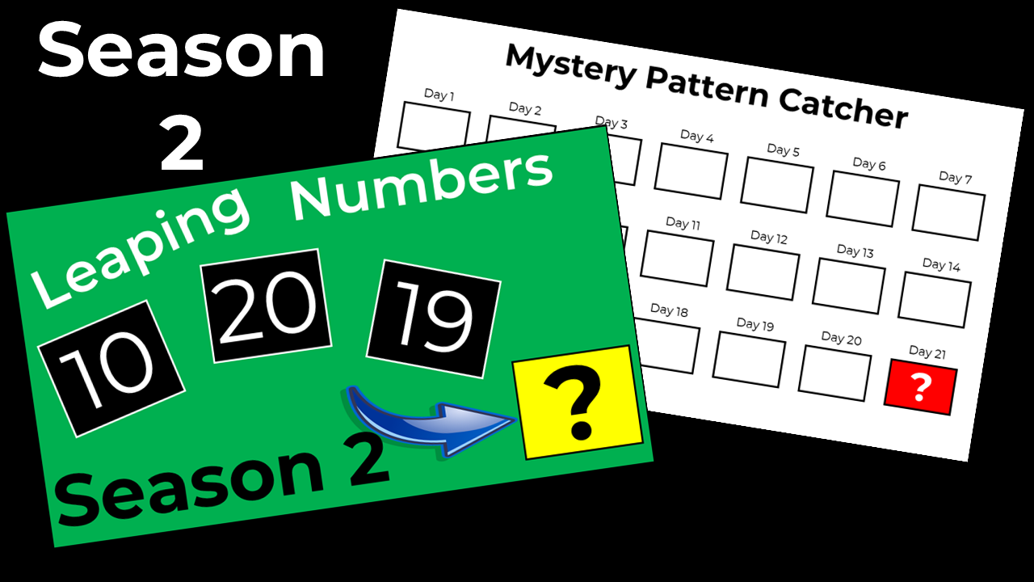
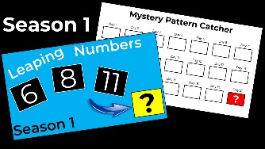


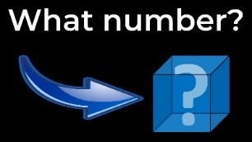





Are you subscribed to the
blog newsletter?
Sign Up Here
New Resources Every Week!
More
Estimation Clipboards
2025-2026
125 New Esti-Mysteries
The Multiplication Advantage!
Ask your school to purchase a copy
for every student in your class.
2024-2025
110 New Esti-Mysteries
2023-2024
100 New Esti-Mysteries
2022-2023
170 New Esti-Mysteries
2021-2022
150 New Esti-Mysteries
Steve Wyborney’s Math Courses
Online courses
Digital Download Bundles
Leaping Numbers
Season 2
February 2025
Leaping Numbers
Season 1
November 2024
The Original
Leaping Numbers
February 2024
The Mystery Number in the Box
60-Second Math Mystery Videos
View the entire playlist here.
The 3-Container
Estimation Routine
The Original
50 Splat! Lessons
The Original 20 Fraction Splat! Lessons
PowerPoint Files
Designed for Google Slides
80 Cube Conversations Lessons
20 Days of Number Sense
& Rich Math Talk

