Slide 1
Estimation Clipboard
103
If this is your first time using the Estimation Clipboard in your classroom, I recommend watching this short YouTube video beginning at 0:42.
Note: To make the link active, make sure the slide show is playing. In PPT, click on “Slide Show” then “From Current Slide.” In Google Slides, Click on “Present.”
Then you will be able to click the link to the video.
Steve Wyborney
www.stevewyborney.com

Slide 2
Tips for Using The Estimation Clipboard
When the first image (of 4) appears, invite the class to share some estimates aloud. Typically, a few students will offer some estimates. Don’t spend much time on the first image. After you have received a few responses, reveal the answer.
Make a mental note: If you hear answers from a small number of students, you are also hearing silence from nearly all of your class. Anticipate engaging all students in mathematical reasoning by the time you reach the third image.
When the second image appears, invite the class to share some estimates aloud again. You will likely hear estimates from more students than the first time. You may want to spend a little more time on the second image, but the power of The Estimation Clipboard is yet to come.
When the third image appears, change your approach. Remember, you haven’t heard from several students at this point, but everyone’s context is growing. When you show the third image, instead of asking for answers aloud have all of the students write down their estimate. Then have them discuss these two questions with a partner: “What was your estimate? Why did you choose it?” Listen carefully to the reasoning. Certainly this may be formatted very differently in distance learning.
When the moment is right, reveal the third answer. Notice how your students are becoming increasingly engaged in the estimation process. That’s partly because you are re-inviting them into a growing context. It’s also because they have engaged in writing and discussion. The moment of writing has become a springboard for discussion. They have been given space to voice their ideas, and they are learning more about their ideas as they discuss them.
When the fourth image appears, repeat the process from the previous step. Everyone in the classroom writes down their estimate, and then everyone tells their partner what estimate they chose and why they chose it. Expect the conversation to take a little longer here and notice that the conversations about the estimates – and about estimation itself – are becoming more detailed. You may see several students pointing to the screen during their discussions.
When you reveal the final answer, listen to your class. Simply listen. Just take a moment to notice.
As a learner yourself, engage in the process. Be a wonderer in front of your students. If you want a good question to wonder about, begin with this one: “What is estimation?”
Enjoy the journey and feel free to share your learning experiences with others! You can find me on Twitter @stevewyborney

Slide 3
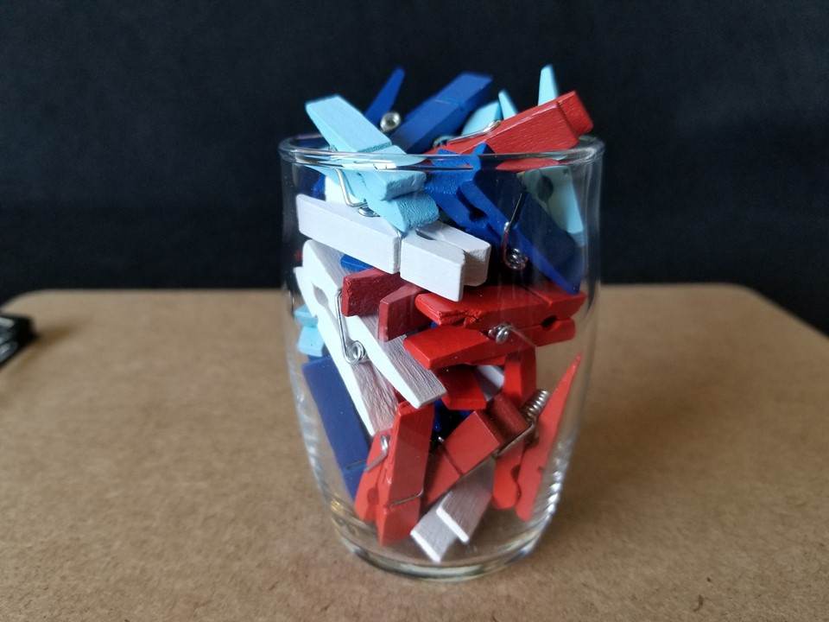
How many clothespins are in
the glass?
Important Note:
If you can see this box, then the slide show is not playing and the reveal won’t work.
Here is the solution:
If you are using PowerPoint, click on Slide Show, then click on From Current Slide.
If you are using Google Slides, click on View then Present.
29 clothespins
The Reveal

Slide 4
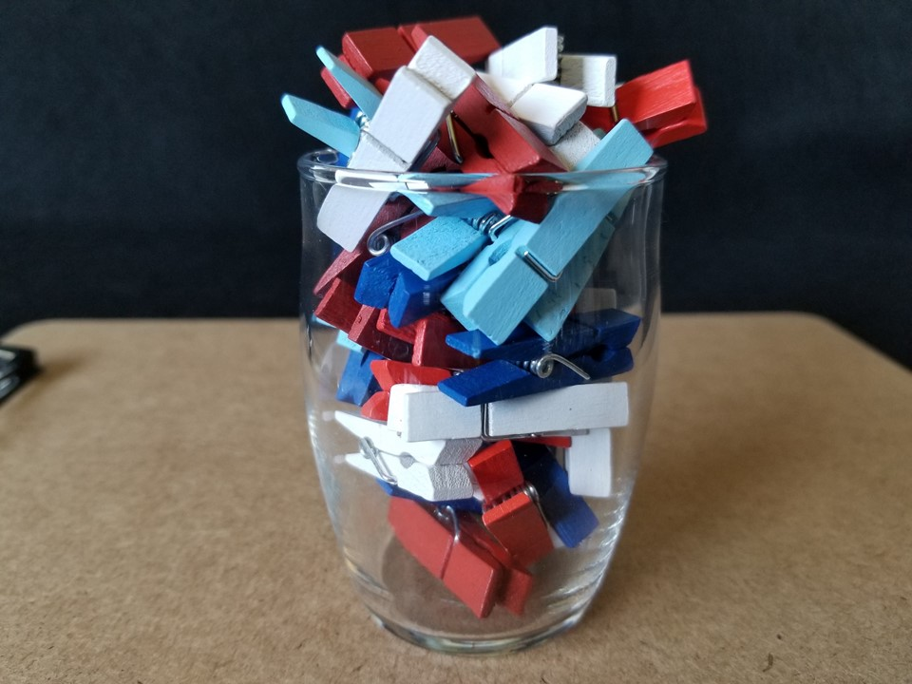
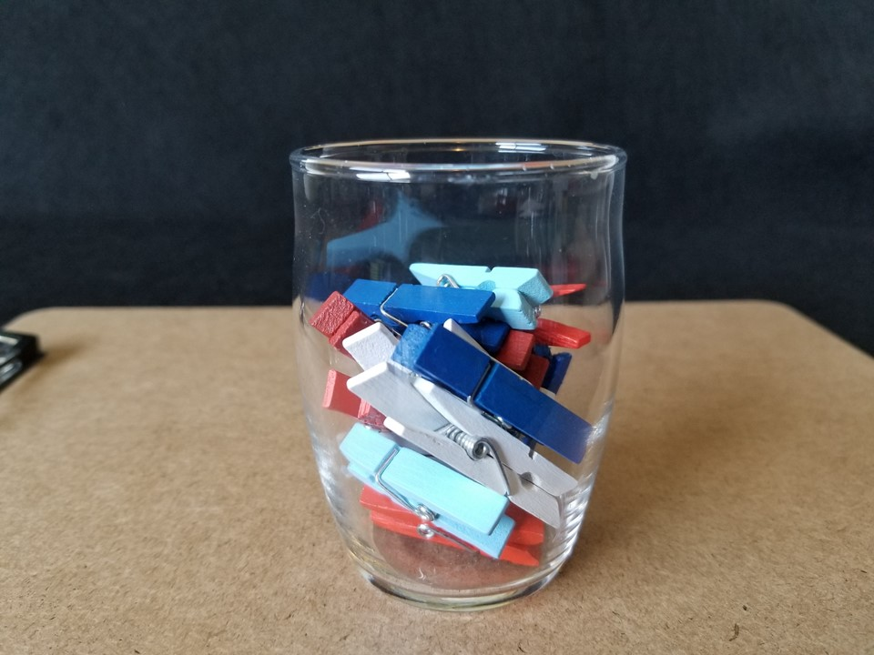
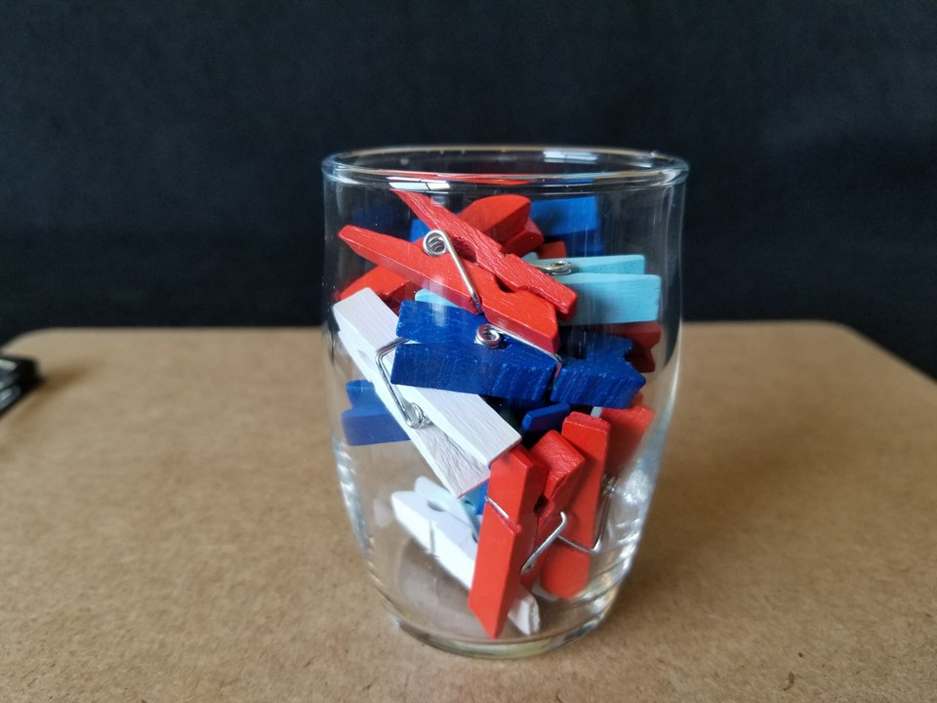
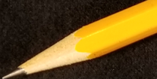

29 clothespins
The Reveal
34 clothespins
The Reveal
The Reveal
17 clothespins
23 clothespins

Slide 5
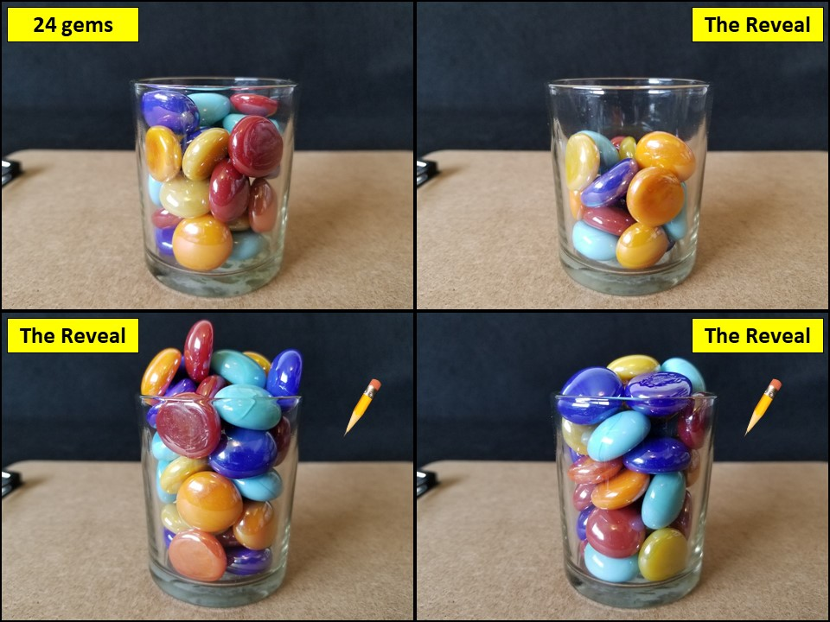
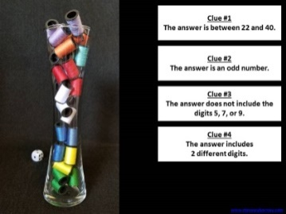
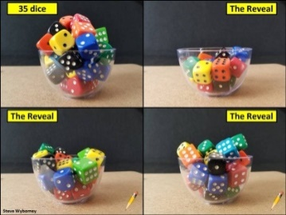
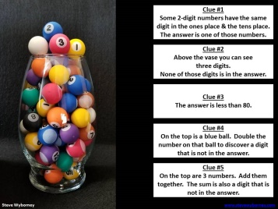
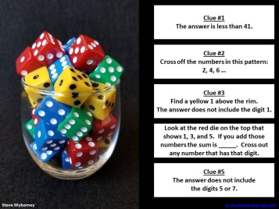
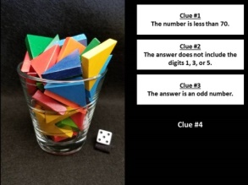
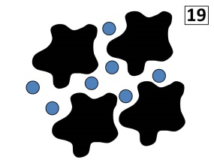
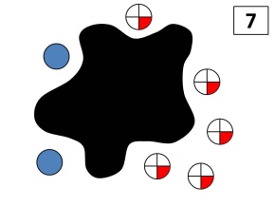
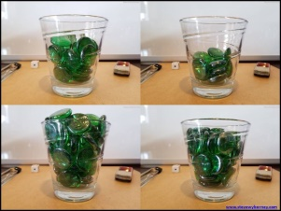
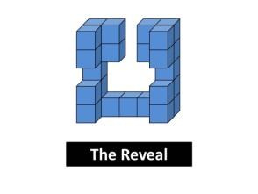

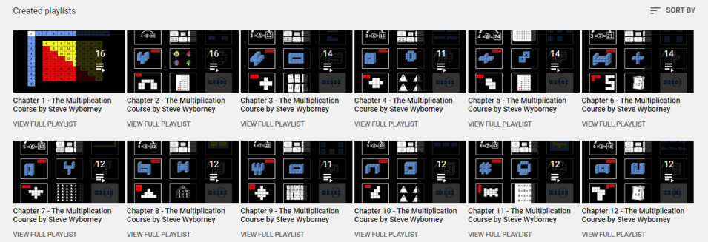
Click here to find “More Estimation Clipboards.”
Daily Resources Posted in the 2020-2021 School Year
New Esti-Mysteries and Number Sense Resources Every Day
for the Rest of the School Year
Part 2 - New Esti-Mysteries and Number Sense Resources Every Day for the Rest of the School Year
Part 3 - New Esti-Mysteries and Number Sense Resources Every Day for the Rest of the School Year
Part 4 - New Esti-Mysteries and Number Sense Resources Every Day for the Rest of the School Year
November 1 – January 8
January 11 – February 26
March 1 – April 16
April 19 – May 28
More Free, Downloadable Resources From Blog Posts
51 Esti-Mysteries
The Original
50 Splat! Lessons
The Original 20 Fraction Splat! Lessons
The Original 40 Estimation Clipboard Sets
80 Cube Conversations
Lessons
20 Days of Number Sense
& Rich Math Talk
The Multiplication Course (a free course for students and teachers)
For more information read the blog post about The Multiplication Course here.
To view the course on YouTube:
Click here to see the chapter playlists on my YouTube channel.
You’ll see all 12 chapters in the course.
Each chapter includes a sequence of lessons for students.

