Slide 1
The Rare, Red Splat!
Part 5
The red Splats! in this set each have their own rule.
That rule changes on each slide.
Read each rule very carefully, and think about all of
the words in each rule.
Steve Wyborney
www.stevewyborney.com

Slide 2
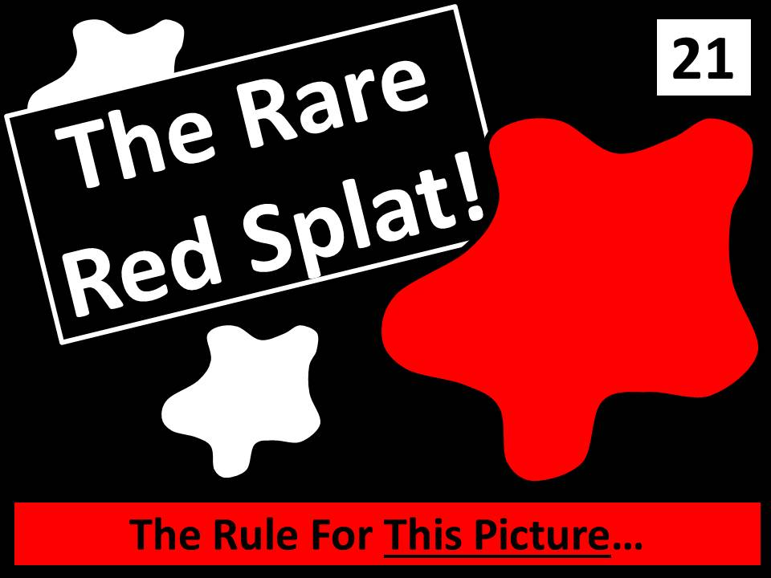
Watch the YouTube video here
to learn how to use this resource.

Slide 3
Level 1

Slide 4
11
4
The next click will reveal the answer.
Important Note:
If you can see this box, then the slide show is not playing and the reveal won’t work.
Here is the solution:
If you are using PowerPoint, click on Slide Show, then click on From Current Slide.
If you are using Google Slides, click on View then Present.
6
The Rule For This Picture: The value of the red Splat is
2 less than the value of the black Splat! What is the value of the red Splat?
www.stevewyborney.com
Steve Wyborney

Slide 5
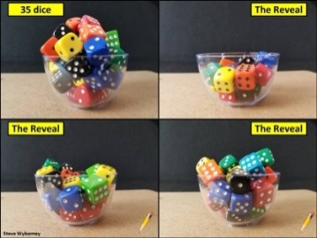
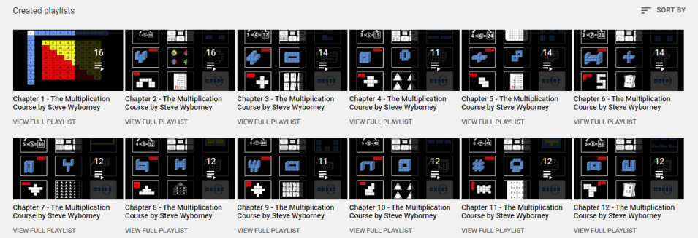
New Esti-Mysteries and Number Sense Resources
Every Day for the Rest of the School Year
Part 2 - New Esti-Mysteries and Number Sense Resources Every Day for the Rest of the School Year
Part 3 - New Esti-Mysteries and Number Sense Resources Every Day for the Rest of the School Year
Part 4 - New Esti-Mysteries and Number Sense Resources Every Day for the Rest of the School Year
November 1 – January 8
January 11 – February 26
March 1 – April 16
April 19 – May 28
More Free, Downloadable Resources From Blog Posts
51 Esti-Mysteries
The Original
50 Splat! Lessons
The Original
20 Fraction
Splat! Lessons
The Original 40 Estimation Clipboard Sets
80 Cube Conversations
Lessons
20 Days of
Number Sense
& Rich Math Talk
To Access The Multiplication Course…
Click here to see the chapter playlists on my YouTube channel.
Click on “sort by” (on the right side) and choose Date created (oldest)
You’ll see all 12 chapters in the course.
Tips for Using the Multiplication Course
When looking at playlists, click on the words “View Full Playlist” instead of the thumbnail or the chapter title.
Then click on the share button.
Copy the link and send it to your class.
Begin with 1 lesson (1 video) per day and then adjust the pacing to meet the needs of your class.
For more information read the blog post about The Multiplication Course here.

Slide 6
Level 2

Slide 7
An Important Reminder
If there is more than 1 black Splat,
each of the black Splats has the same value as each other.
These will have the same value as each other.
www.stevewyborney.com
Steve Wyborney

Slide 8
33
10
The next click will reveal the answer.
Important Note:
If you can see this box, then the slide show is not playing and the reveal won’t work.
Here is the solution:
If you are using PowerPoint, click on Slide Show, then click on From Current Slide.
If you are using Google Slides, click on View then Present.
10
11
The Rule For This Picture: The value of the red Splat is an odd number that is one more than the value of each black Splat. What is the value of the Red Splat?
www.stevewyborney.com
Steve Wyborney

Slide 9
New Esti-Mysteries and Number Sense Resources
Every Day for the Rest of the School Year
Part 2 - New Esti-Mysteries and Number Sense Resources Every Day for the Rest of the School Year
Part 3 - New Esti-Mysteries and Number Sense Resources Every Day for the Rest of the School Year
Part 4 - New Esti-Mysteries and Number Sense Resources Every Day for the Rest of the School Year
November 1 – January 8
January 11 – February 26
March 1 – April 16
April 19 – May 28
More Free, Downloadable Resources From Blog Posts
51 Esti-Mysteries
The Original
50 Splat! Lessons
The Original
20 Fraction
Splat! Lessons
The Original 40 Estimation Clipboard Sets
80 Cube Conversations
Lessons
20 Days of
Number Sense
& Rich Math Talk
To Access The Multiplication Course…
Click here to see the chapter playlists on my YouTube channel.
Click on “sort by” (on the right side) and choose Date created (oldest)
You’ll see all 12 chapters in the course.
Tips for Using the Multiplication Course
When looking at playlists, click on the words “View Full Playlist” instead of the thumbnail or the chapter title.
Then click on the share button.
Copy the link and send it to your class.
Begin with 1 lesson (1 video) per day and then adjust the pacing to meet the needs of your class.
For more information read the blog post about The Multiplication Course here.

Slide 10
Level 3

Slide 11
An Important Reminder
If there is more than 1 black Splat,
each of the black Splats has the same value as each other.
These will have the same value as each other.
www.stevewyborney.com
Steve Wyborney

Slide 12
28
4
The next click will reveal the answer.
14
Important Note:
If you can see this box, then the slide show is not playing and the reveal won’t work.
Here is the solution:
If you are using PowerPoint, click on Slide Show, then click on From Current Slide.
If you are using Google Slides, click on View then Present.
4
4
The Rule For This Picture: The value of the red Splat is TWO MORE than the sum of the black Splats! What is the value of the Red Splat?
www.stevewyborney.com
Steve Wyborney

Slide 13
New Esti-Mysteries and Number Sense Resources
Every Day for the Rest of the School Year
Part 2 - New Esti-Mysteries and Number Sense Resources Every Day for the Rest of the School Year
Part 3 - New Esti-Mysteries and Number Sense Resources Every Day for the Rest of the School Year
Part 4 - New Esti-Mysteries and Number Sense Resources Every Day for the Rest of the School Year
November 1 – January 8
January 11 – February 26
March 1 – April 16
April 19 – May 28
More Free, Downloadable Resources From Blog Posts
51 Esti-Mysteries
The Original
50 Splat! Lessons
The Original
20 Fraction
Splat! Lessons
The Original 40 Estimation Clipboard Sets
80 Cube Conversations
Lessons
20 Days of
Number Sense
& Rich Math Talk
To Access The Multiplication Course…
Click here to see the chapter playlists on my YouTube channel.
Click on “sort by” (on the right side) and choose Date created (oldest)
You’ll see all 12 chapters in the course.
Tips for Using the Multiplication Course
When looking at playlists, click on the words “View Full Playlist” instead of the thumbnail or the chapter title.
Then click on the share button.
Copy the link and send it to your class.
Begin with 1 lesson (1 video) per day and then adjust the pacing to meet the needs of your class.
For more information read the blog post about The Multiplication Course here.

Slide 14
Level 4

Slide 15
An Important Reminder
If there is more than 1 black Splat,
each of the black Splats has the same value as each other.
These will have the same value as each other.
www.stevewyborney.com
Steve Wyborney

Slide 16
15
2
The next click will reveal the answer.
7
Important Note:
If you can see this box, then the slide show is not playing and the reveal won’t work.
Here is the solution:
If you are using PowerPoint, click on Slide Show, then click on From Current Slide.
If you are using Google Slides, click on View then Present.
2
2
The Rule For This Picture: The value of the red Splat is
3 ½ times the value of each black Splat. What is the value of the Red Splat?
www.stevewyborney.com
Steve Wyborney

Slide 17
New Esti-Mysteries and Number Sense Resources
Every Day for the Rest of the School Year
Part 2 - New Esti-Mysteries and Number Sense Resources Every Day for the Rest of the School Year
Part 3 - New Esti-Mysteries and Number Sense Resources Every Day for the Rest of the School Year
Part 4 - New Esti-Mysteries and Number Sense Resources Every Day for the Rest of the School Year
November 1 – January 8
January 11 – February 26
March 1 – April 16
April 19 – May 28
More Free, Downloadable Resources From Blog Posts
51 Esti-Mysteries
The Original
50 Splat! Lessons
The Original
20 Fraction
Splat! Lessons
The Original 40 Estimation Clipboard Sets
80 Cube Conversations
Lessons
20 Days of
Number Sense
& Rich Math Talk
To Access The Multiplication Course…
Click here to see the chapter playlists on my YouTube channel.
Click on “sort by” (on the right side) and choose Date created (oldest)
You’ll see all 12 chapters in the course.
Tips for Using the Multiplication Course
When looking at playlists, click on the words “View Full Playlist” instead of the thumbnail or the chapter title.
Then click on the share button.
Copy the link and send it to your class.
Begin with 1 lesson (1 video) per day and then adjust the pacing to meet the needs of your class.
For more information read the blog post about The Multiplication Course here.

Slide 18
Level 5

Slide 19
An Important Reminder
If there is more than 1 black Splat,
each of the black Splats has the same value as each other.
These will have the same value as each other.
www.stevewyborney.com
Steve Wyborney

Slide 20
32
4
The next click will reveal the answer.
16
Important Note:
If you can see this box, then the slide show is not playing and the reveal won’t work.
Here is the solution:
If you are using PowerPoint, click on Slide Show, then click on From Current Slide.
If you are using Google Slides, click on View then Present.
4
4
The Rule For This Picture: The value of the red Splat is one and one-third
the sum of the black Splats! What is the value of the Red Splat?
www.stevewyborney.com
Steve Wyborney

Slide 21
New Esti-Mysteries and Number Sense Resources
Every Day for the Rest of the School Year
Part 2 - New Esti-Mysteries and Number Sense Resources Every Day for the Rest of the School Year
Part 3 - New Esti-Mysteries and Number Sense Resources Every Day for the Rest of the School Year
Part 4 - New Esti-Mysteries and Number Sense Resources Every Day for the Rest of the School Year
November 1 – January 8
January 11 – February 26
March 1 – April 16
April 19 – May 28
More Free, Downloadable Resources From Blog Posts
51 Esti-Mysteries
The Original
50 Splat! Lessons
The Original
20 Fraction
Splat! Lessons
The Original 40 Estimation Clipboard Sets
80 Cube Conversations
Lessons
20 Days of
Number Sense
& Rich Math Talk
To Access The Multiplication Course…
Click here to see the chapter playlists on my YouTube channel.
Click on “sort by” (on the right side) and choose Date created (oldest)
You’ll see all 12 chapters in the course.
Tips for Using the Multiplication Course
When looking at playlists, click on the words “View Full Playlist” instead of the thumbnail or the chapter title.
Then click on the share button.
Copy the link and send it to your class.
Begin with 1 lesson (1 video) per day and then adjust the pacing to meet the needs of your class.
For more information read the blog post about The Multiplication Course here.

