Slide 1
“A Magnetic Esti-Mystery”
Important Note:
If you can see this box, then the slide show is not playing and the reveal won’t work.
Here is the solution:
If you are using PowerPoint, click on Slide Show, then click on From Current Slide.
If you are using Google Slides, click on View then Present.
Steve Wyborney
www.stevewyborney.com

Slide 2
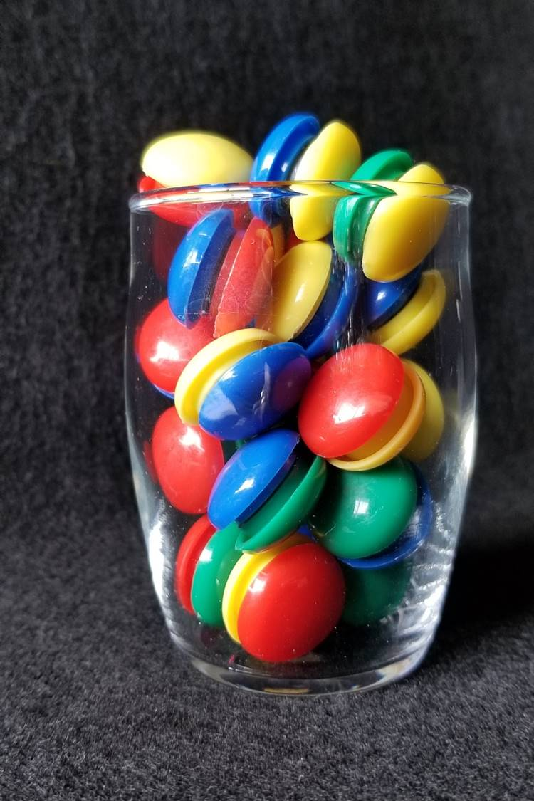
How many magnets
are in the glass?
As the clues appear, use the information to narrow the possibilities to a smaller set. After each clue, use estimation again to determine which of the remaining answers is the most reasonable.
Write down your first estimate. After each clue, you’ll see if your estimate is still a possibility. After each clue, if it is no longer possible write down a new estimate – and be prepared to explain why you chose it.
Steve Wyborney
www.stevewyborney.com

Slide 3
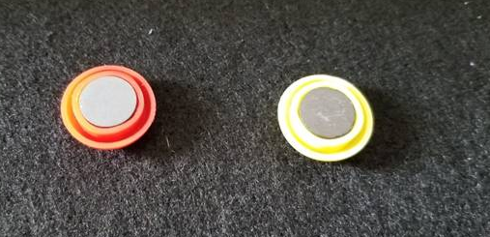
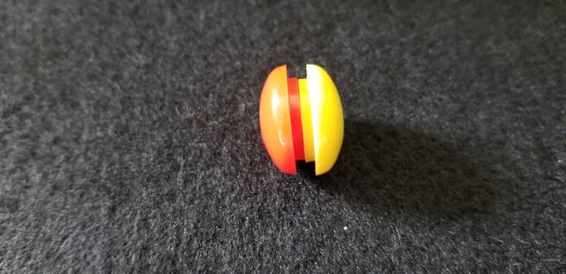
I made this Esti-Mystery with magnets.
If you click you will see two magnets.
These are two of the magnets.
They count as 2.
The two magnets stuck together.
They are a pair.
This still counts as 2.

Slide 4
Clue #1
Clue #1
The answer is greater than 20
and less than 49.
Clue #2
Clue #2
The answer includes the digit 4.
Clue #3
Clue #3
The digit 3 is not in the answer.
Clue #4
Clue #4
Eliminate 3 numbers with this clue.
37, 38, 39, ___, ___, ___
Clue #5
21 | 22 | 23 | 24 | 25 | 26 | 27 | 28 | 29 | 30
31 | 32 | 33 | 34 | 35 | 36 | 37 | 38 | 39 | 40
41 | 42 | 43 | 44 | 45 | 46 | 47 | 48 | 49 | 50
Clue #5
Eliminate 4 numbers with this clue.
41, 42, 43, ___, ___, ___, ____
21 | 22 | 23 | 24 | 25 | 26 | 27 | 28 | 29 | 30
31 | 32 | 33 | 34 | 35 | 36 | 37 | 38 | 39 | 40
41 | 42 | 43 | 44 | 45 | 46 | 47 | 48 | 49 | 50
21 | 22 | 23 | 24 | 25 | 26 | 27 | 28 | 29 | 30
31 | 32 | 33 | 34 | 35 | 36 | 37 | 38 | 39 | 40
41 | 42 | 43 | 44 | 45 | 46 | 47 | 48 | 49 | 50
21 | 22 | 23 | 24 | 25 | 26 | 27 | 28 | 29 | 30
31 | 32 | 33 | 34 | 35 | 36 | 37 | 38 | 39 | 40
41 | 42 | 43 | 44 | 45 | 46 | 47 | 48 | 49 | 50
21 | 22 | 23 | 24 | 25 | 26 | 27 | 28 | 29 | 30
31 | 32 | 33 | 34 | 35 | 36 | 37 | 38 | 39 | 40
41 | 42 | 43 | 44 | 45 | 46 | 47 | 48 | 49 | 50
Steve Wyborney
www.stevewyborney.com

Slide 5
After seeing the clues, you have narrowed the possibilities to a small set of numbers. Before you see the answer, select your final estimate. Write it down, and explain to someone why you chose that number.
Steve Wyborney
www.stevewyborney.com

Slide 6
48 magnets
The Reveal
Click to see the answer.
Important Note:
If you can see this box, then the slide show is not playing and the reveal won’t work.
Here is the solution:
If you are using PowerPoint, click on Slide Show, then click on From Beginning.
If you are using Google Slides, click on View then Present.
Steve Wyborney
www.stevewyborney.com

Slide 7
New Esti-Mysteries and Number Sense Resources
Every Day for the Rest of the School Year
Part 2 - New Esti-Mysteries and Number Sense Resources Every Day for the Rest of the School Year
Part 3 - New Esti-Mysteries and Number Sense Resources Every Day for the Rest of the School Year
Part 4 - New Esti-Mysteries and Number Sense Resources Every Day for the Rest of the School Year
November 1 – January 8
January 11 – February 26
March 1 – April 16
April 19 – May 28
More Free, Downloadable Resources From Blog Posts
51 Esti-Mysteries
The Original
50 Splat! Lessons
The Original
20 Fraction
Splat! Lessons
The Original 40 Estimation Clipboard Sets
80 Cube Conversations
Lessons
20 Days of
Number Sense
& Rich Math Talk
To Access The Multiplication Course…
Click here to see the chapter playlists on my YouTube channel.
Click on “sort by” (on the right side) and choose Date created (oldest)
You’ll see all 12 chapters in the course.
Tips for Using the Multiplication Course
When looking at playlists, click on the words “View Full Playlist” instead of the thumbnail or the chapter title.
Then click on the share button.
Copy the link and send it to your class.
Begin with 1 lesson (1 video) per day and then adjust the pacing to meet the needs of your class.
For more information read the blog post about The Multiplication Course here.

