Slide 1
Estimation Clipboard 68
If this is your first time using the Estimation Clipboard in your classroom, I recommend watching this short YouTube video beginning at 0:42.
Note: To make the link active, make sure the slide show is playing. In PPT, click on “Slide Show” then “From Current Slide.” In Google Slides, Click on “Present.”
Then you will be able to click the link to the video.
Steve Wyborney
www.stevewyborney.com

Slide 2
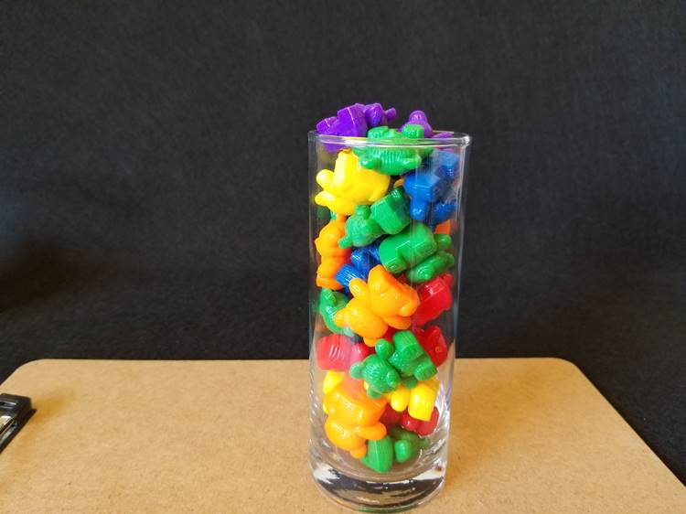
The Reveal
How many bears are in
the vase?
32 bears
Important Note:
If you can see this box, then the slide show is not playing and the reveal won’t work.
Here is the solution:
If you are using PowerPoint, click on Slide Show, then click on From Current Slide.
If you are using Google Slides, click on View then Present.
Steve Wyborney

Slide 3
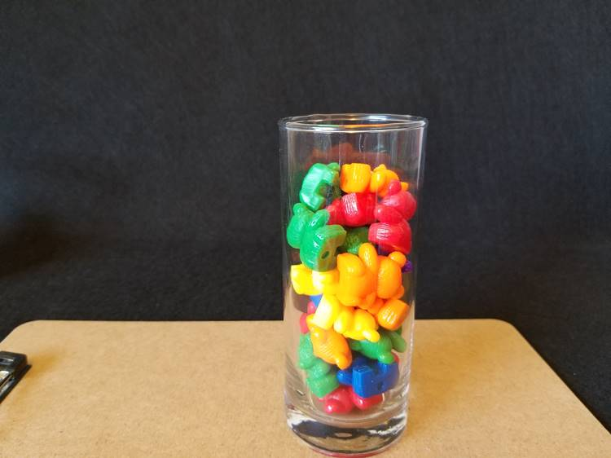
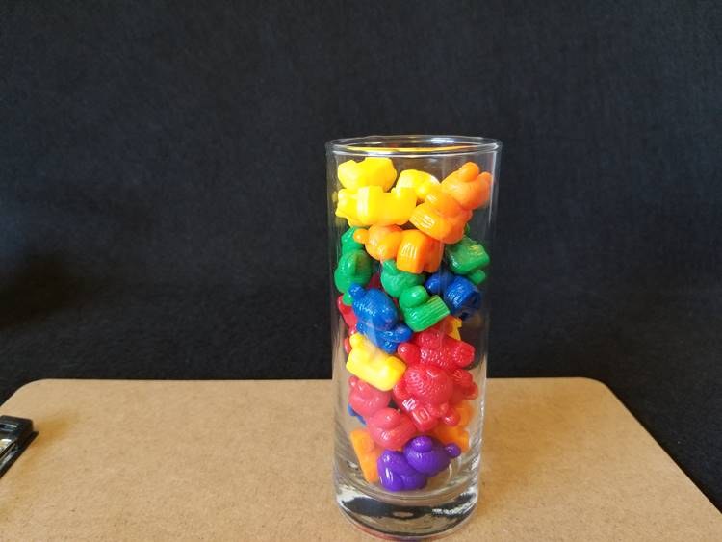
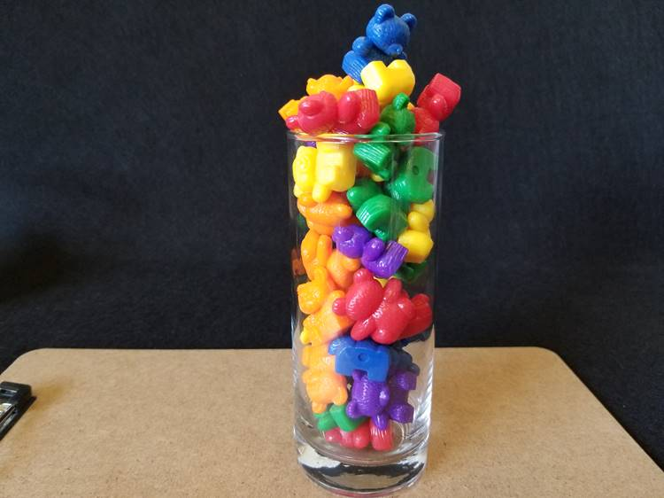
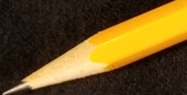
32 bears
The Reveal
25 bears
The Reveal
37 bears
28 bears
The Reveal
Steve Wyborney

Slide 4
New Esti-Mysteries and Number Sense Resources
Every Day for the Rest of the School Year
Part 2 - New Esti-Mysteries and Number Sense Resources Every Day for the Rest of the School Year
Part 3 - New Esti-Mysteries and Number Sense Resources Every Day for the Rest of the School Year
Part 4 - New Esti-Mysteries and Number Sense Resources Every Day for the Rest of the School Year
November 1 – January 8
January 11 – February 26
March 1 – April 16
April 19 – May 28
More Free, Downloadable Resources From Blog Posts
51 Esti-Mysteries
The Original
50 Splat! Lessons
The Original
20 Fraction
Splat! Lessons
The Original 40 Estimation Clipboard Sets
80 Cube Conversations
Lessons
20 Days of
Number Sense
& Rich Math Talk
To Access The Multiplication Course…
Click here to see the chapter playlists on my YouTube channel.
Click on “sort by” (on the right side) and choose Date created (oldest)
You’ll see all 12 chapters in the course.
Tips for Using the Multiplication Course
When looking at playlists, click on the words “View Full Playlist” instead of the thumbnail or the chapter title.
Then click on the share button.
Copy the link and send it to your class.
Begin with 1 lesson (1 video) per day and then adjust the pacing to meet the needs of your class.
For more information read the blog post about The Multiplication Course here.

