Slide 1
10 Subitizing Sets
&
1 Challenge Pattern
Part 3
www.stevewyborney.com

Slide 2
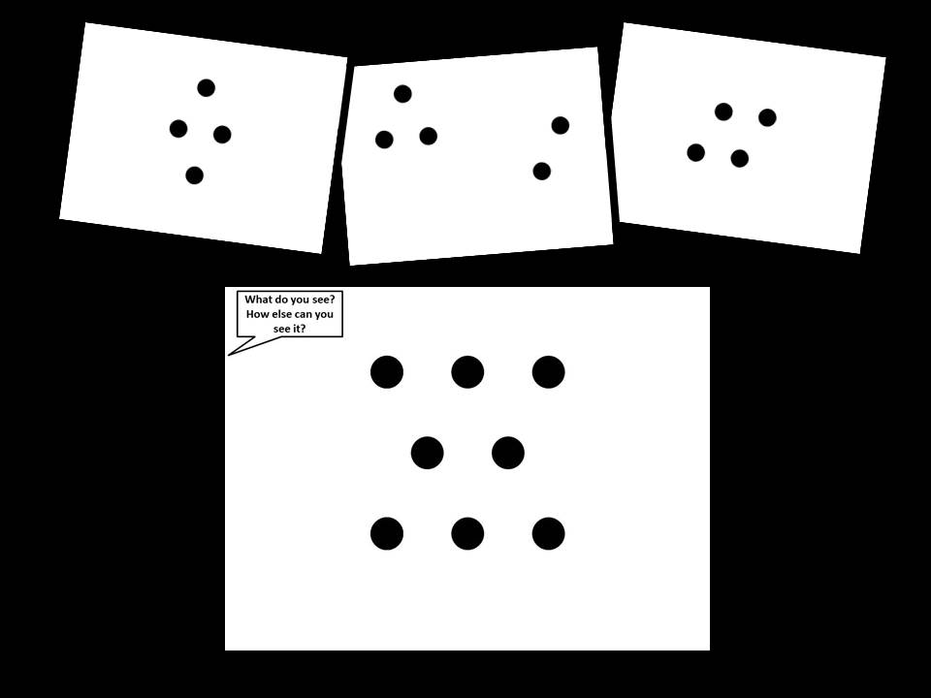
Click here to watch the YouTube video about how to use this resource.
https://www.youtube.com/watch?v=zTXem6IdbhI
www.stevewyborney.com

Slide 3
How do I use these?
Teachers – When you click forward it will make it look like dots appear. Show the slide with the dots for just 1 second. Then click again – and the dots will disappear.
When the dots disappear, ask your students how many they saw.
Follow the suggested text, and adjust as needed.
When you reach the challenge at the end, spend much more time on it. Invite students to share many, many different ways they can see the group. You can annotate on your screen to illustrate the student descriptions of how they see the group.
www.stevewyborney.com

Slide 4
I’m going to click and let you see a picture for 1 second. Then I’ll click again to make the picture disappear.
When the picture has disappeared, I’ll ask you how many dots there were.
Then you’ll have a chance to see it again.
We’ll look at 10 sets – and then I’ll show you 1 challenge. You’ll see the challenge after the 10 sets.
www.stevewyborney.com

Slide 5
Set 1 of 10
Important Note:
If you can see this box, then the slide show is not playing.
Here is the solution:
If you are using PowerPoint, click on Slide Show, then click on From Current Slide.
If you are using Google Slides, click on View then Present.
www.stevewyborney.com

Slide 6
www.stevewyborney.com

Slide 8
How many dots were there?
www.stevewyborney.com

Slide 10
Let’s look at another group.
Set 2 of 10
www.stevewyborney.com

Slide 11
www.stevewyborney.com

Slide 13
How many dots were there?
www.stevewyborney.com

Slide 15
Let’s look at another group.
Set 3 of 10
www.stevewyborney.com

Slide 16
www.stevewyborney.com

Slide 18
How many dots were there?
www.stevewyborney.com

Slide 20
Let’s look at another group.
Set 4 of 10
www.stevewyborney.com

Slide 21
www.stevewyborney.com

Slide 23
How many dots were there?
www.stevewyborney.com

Slide 25
Let’s look at another group.
Set 5 of 10
www.stevewyborney.com

Slide 26
www.stevewyborney.com

Slide 28
How many dots were there?
www.stevewyborney.com

Slide 30
Let’s look at another group.
Set 6 of 10
www.stevewyborney.com

Slide 31
www.stevewyborney.com

Slide 33
How many dots were there?
www.stevewyborney.com

Slide 35
Let’s look at another group.
Set 7 of 10
www.stevewyborney.com

Slide 36
www.stevewyborney.com

Slide 38
How many dots were there?
www.stevewyborney.com

Slide 40
Let’s look at another group.
Set 8 of 10
www.stevewyborney.com

Slide 41
www.stevewyborney.com

Slide 43
How many dots were there?
www.stevewyborney.com

Slide 45
Let’s look at another group.
Set 9 of 10
www.stevewyborney.com

Slide 46
www.stevewyborney.com

Slide 48
How many dots were there?
www.stevewyborney.com

Slide 50
Let’s look at another group.
Set 10 of 10
www.stevewyborney.com

Slide 51
www.stevewyborney.com

Slide 53
How many dots were there?
www.stevewyborney.com

Slide 55
Challenge Example
www.stevewyborney.com

Slide 56
You are about to see a larger group of dots. Instead of saying how many dots there are, find as many ways as you can to show how you know what the total is. Here is an example.
www.stevewyborney.com

Slide 57
2 + 3 + 2 = 7
2 + 3 + 2 = 7
4 + 4 – 1 = 7
Important Note:
If you can see this box, then the slide show is not playing.
Here is the solution:
If you are using PowerPoint, click on Slide Show, then click on From Current Slide.
If you are using Google Slides, click on View then Present.
9 – 2 = 7
5 + 2 = 7
3 + 3 + 1 = 7
www.stevewyborney.com

Slide 58
Now I’ll show you a large copy of your pattern. Then I’ll show you several smaller copies so you can find as many ways as possible of showing different ways of seeing the total. Here it is!
www.stevewyborney.com

Slide 59
What do you see?
How else can you see it?
www.stevewyborney.com

Slide 60
What do you see?
How else can you see it?
www.stevewyborney.com

Slide 61
New Esti-Mysteries and Number Sense Resources
Every Day for the Rest of the School Year
Part 2 - New Esti-Mysteries and Number Sense Resources Every Day for the Rest of the School Year
Part 3 - New Esti-Mysteries and Number Sense Resources Every Day for the Rest of the School Year
Part 4 - New Esti-Mysteries and Number Sense Resources Every Day for the Rest of the School Year
November 1 – January 8
January 11 – February 26
March 1 – April 16
April 19 – May 28
More Free, Downloadable Resources From Blog Posts
51 Esti-Mysteries
The Original
50 Splat! Lessons
The Original
20 Fraction
Splat! Lessons
The Original 40 Estimation Clipboard Sets
80 Cube Conversations
Lessons
20 Days of
Number Sense
& Rich Math Talk
To Access The Multiplication Course…
Click here to see the chapter playlists on my YouTube channel.
Click on “sort by” (on the right side) and choose Date created (oldest)
You’ll see all 12 chapters in the course.
Tips for Using the Multiplication Course
When looking at playlists, click on the words “View Full Playlist” instead of the thumbnail or the chapter title.
Then click on the share button.
Copy the link and send it to your class.
Begin with 1 lesson (1 video) per day and then adjust the pacing to meet the needs of your class.
For more information read the blog post about The Multiplication Course here.

