Slide 1
Cube Connectors
Part 1
Steve Wyborney

Slide 2
Watch the YouTube video here
to learn how to use this resource.

Slide 3
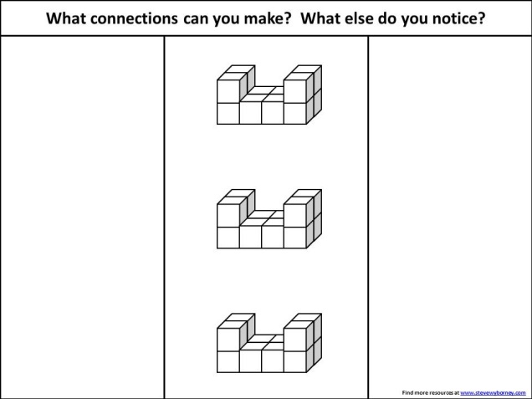
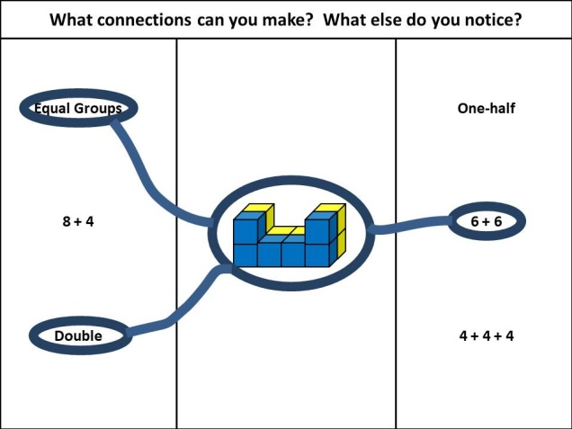
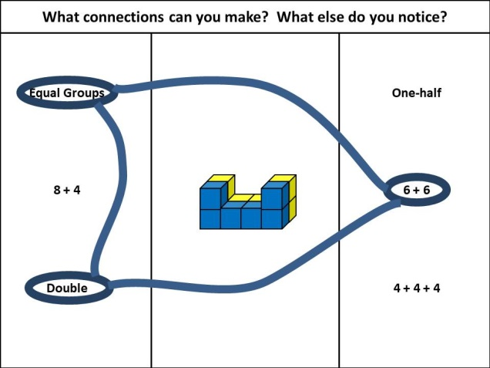
Quick Guide for Teachers
Step 1: Examine the structure.
Step 2: Duplicate the structure and change the colors.
Step 3: Circle descriptions
and connect to structures.
Step 4: Circle structures and connect to descriptions.
Then connect descriptions to descriptions and look for connections.

Slide 4
Level 1
Use this level if multiplication
has not been introduced to your students.
Steve Wyborney

Slide 5
STEP 1: How do you see this structure? How else can you see it? How many cubes are there?
Find more resources at www.stevewyborney.com

Slide 6
STEP 2: I’m going to make 2 copies of this structure...
STEP 2: Now look carefully at the top structure. I’m going to change the colors…
STEP 2: What do you notice? (discussion)
STEP 2: Now look carefully at the middle structure. I’m going to change the colors…
STEP 2: What do you notice? (discussion)
STEP 2: Now look carefully at the bottom structure. I’m going to change the colors…
STEP 2: What do you notice? (discussion)
Find more resources at www.stevewyborney.com

Slide 7
STEP 3: Now I’ll show some descriptions – one at a time. When you see each description, see if you can figure out which structure it is describing. There may be more than one answer, so look at all the structures carefully. Each time I show a new description, I’ll circle it and draw a connecting line to the structure – or structures – that match it. Here is the first one…
STEP 3: (Circle the description and draw lines from it to the matching structure or structures.)
Equal Groups
One-half
8 + 4
6 + 6
Double
4 + 4 + 4
Find more resources at www.stevewyborney.com

Slide 8
STEP 4: (Circle the top structure) Which descriptions match this structure? (Draw lines to those descriptions and circle them.)
STEP 4: (Leave the descriptions circled, but erase the lines and erase the circle around the structure.)
(Now draw lines that connect the circled descriptions to each other and ask…) How are these related to each other?
STEP 4: (Erase all the writing. Circle the middle structure and repeat.)
STEP 4: (Erase all the writing. Circle the bottom structure and repeat.)
Equal Groups
One-half
8 + 4
6 + 6
Double
4 + 4 + 4
Find more resources at www.stevewyborney.com

Slide 9
New Esti-Mysteries and Number Sense Resources
Every Day for the Rest of the School Year
Part 2 - New Esti-Mysteries and Number Sense Resources Every Day for the Rest of the School Year
Part 3 - New Esti-Mysteries and Number Sense Resources Every Day for the Rest of the School Year
November 1 – January 8
January 11 – February 26
March 1 - ongoing
More Free, Downloadable Resources From Blog Posts
51 Esti-Mysteries
The Original
50 Splat! Lessons
The Original
20 Fraction
Splat! Lessons
The Original 40 Estimation Clipboard Sets
80 Cube Conversations
Lessons
20 Days of
Number Sense
& Rich Math Talk
To Access The Multiplication Course…
Click here to see the chapter playlists on my YouTube channel.
Click on “sort by” (on the right side) and choose Date created (oldest)
You’ll see all 12 chapters in the course.
Tips for Using the Multiplication Course
When looking at playlists, click on the words “View Full Playlist” instead of the thumbnail or the chapter title.
Then click on the share button.
Copy the link and send it to your class.
Begin with 1 lesson (1 video) per day and then adjust the pacing to meet the needs of your class.
For more information read the blog post about The Multiplication Course here.

Slide 10
Watch the YouTube video here
to learn how to use this resource.

Slide 11
Quick Guide for Teachers
Step 1: Examine the structure.
Step 2: Duplicate the structure and change the colors.
Step 3: Circle descriptions
and connect to structures.
Step 4: Circle structures and connect to descriptions.
Then connect descriptions to descriptions and look for connections.

Slide 12
Bonus Level
Level 2A
Use this level if multiplication
has been introduced to your students,
but ratios have not been introduced.
Steve Wyborney

Slide 13
STEP 1: How do you see this structure? How else can you see it? How many cubes are there?
Find more resources at www.stevewyborney.com

Slide 14
STEP 2: I’m going to make 2 copies of this structure...
STEP 2: Now look carefully at the top structure. I’m going to change the colors…
STEP 2: What do you notice? (discussion)
STEP 2: Now look carefully at the middle structure. I’m going to change the colors…
STEP 2: What do you notice? (discussion)
STEP 2: Now look carefully at the bottom structure. I’m going to change the colors…
STEP 2: What do you notice? (discussion)
Find more resources at www.stevewyborney.com

Slide 15
STEP 3: Now I’ll show some descriptions – one at a time. When you see each description, see if you can figure out which structure it is describing. There may be more than one answer, so look at all the structures carefully. Each time I show a new description, I’ll circle it and draw a connecting line to the structure – or structures – that match it. Here is the first one…
STEP 3: (Circle the description and draw lines from it to the matching structure or structures.)
8 + 4
Double
Equal Groups
3 × 4
2 × 6
Triple
4 + 4 + 4
One-half
Find more resources at www.stevewyborney.com

Slide 16
STEP 4: (Circle the top structure) Which descriptions match this structure? (Draw lines to those descriptions and circle them.)
STEP 4: (Leave the descriptions circled, but erase the lines and erase the circle around the structure.)
(Now draw lines that connect the circled descriptions to each other and ask…) How are these related to each other?
STEP 4: (Erase all the writing. Circle the middle structure and repeat.)
STEP 4: (Erase all the writing. Circle the bottom structure and repeat.)
8 + 4
Double
Equal Groups
3 × 4
2 × 6
Triple
4 + 4 + 4
One-half
Find more resources at www.stevewyborney.com

Slide 17
New Esti-Mysteries and Number Sense Resources
Every Day for the Rest of the School Year
Part 2 - New Esti-Mysteries and Number Sense Resources Every Day for the Rest of the School Year
Part 3 - New Esti-Mysteries and Number Sense Resources Every Day for the Rest of the School Year
November 1 – January 8
January 11 – February 26
March 1 - ongoing
More Free, Downloadable Resources From Blog Posts
51 Esti-Mysteries
The Original
50 Splat! Lessons
The Original
20 Fraction
Splat! Lessons
The Original 40 Estimation Clipboard Sets
80 Cube Conversations
Lessons
20 Days of
Number Sense
& Rich Math Talk
To Access The Multiplication Course…
Click here to see the chapter playlists on my YouTube channel.
Click on “sort by” (on the right side) and choose Date created (oldest)
You’ll see all 12 chapters in the course.
Tips for Using the Multiplication Course
When looking at playlists, click on the words “View Full Playlist” instead of the thumbnail or the chapter title.
Then click on the share button.
Copy the link and send it to your class.
Begin with 1 lesson (1 video) per day and then adjust the pacing to meet the needs of your class.
For more information read the blog post about The Multiplication Course here.

Slide 18
Watch the YouTube video here
to learn how to use this resource.

Slide 19
Quick Guide for Teachers
Step 1: Examine the structure.
Step 2: Duplicate the structure and change the colors.
Step 3: Circle descriptions
and connect to structures.
Step 4: Circle structures and connect to descriptions.
Then connect descriptions to descriptions and look for connections.

Slide 20
Level 2
Use this level if both
multiplication and ratios
have been introduced your students.
Steve Wyborney

Slide 21
STEP 1: How do you see this structure? How else can you see it? How many cubes are there?
Find more resources at www.stevewyborney.com

Slide 22
STEP 2: I’m going to make 2 copies of this structure...
STEP 2: Now look carefully at the top structure. I’m going to change the colors…
STEP 2: What do you notice? (discussion)
STEP 2: Now look carefully at the middle structure. I’m going to change the colors…
STEP 2: What do you notice? (discussion)
STEP 2: Now look carefully at the bottom structure. I’m going to change the colors…
STEP 2: What do you notice? (discussion)
Find more resources at www.stevewyborney.com

Slide 23
STEP 3: Now I’ll show some descriptions – one at a time. When you see each description, see if you can figure out which structure it is describing. There may be more than one answer, so look at all the structures carefully. Each time I show a new description, I’ll circle it and draw a connecting line to the structure – or structures – that match it. Here is the first one…
STEP 3: (Circle the description and draw lines from it to the matching structure or structures.)
(3 × 4) + 3
5 + 5 + 5
one-third
6 + 9
two-thirds of 9
three equal groups
3 × 5 = 15
one-fifth
Find more resources at www.stevewyborney.com

Slide 24
STEP 4: (Circle the top structure) Which descriptions match this structure? (Draw lines to those descriptions and circle them.)
STEP 4: (Leave the descriptions circled, but erase the lines and erase the circle around the structure.)
(Now draw lines that connect the circled descriptions to each other and ask…) How are these related to each other?
STEP 4: (Erase all the writing. Circle the middle structure and repeat.)
STEP 4: (Erase all the writing. Circle the bottom structure and repeat.)
(3 × 4) + 3
3:1
one-third
4:1
two-thirds of 9
three equal groups
3 × 5 = 15
one-fifth
Find more resources at www.stevewyborney.com

Slide 25
New Esti-Mysteries and Number Sense Resources
Every Day for the Rest of the School Year
Part 2 - New Esti-Mysteries and Number Sense Resources Every Day for the Rest of the School Year
Part 3 - New Esti-Mysteries and Number Sense Resources Every Day for the Rest of the School Year
November 1 – January 8
January 11 – February 26
March 1 - ongoing
More Free, Downloadable Resources From Blog Posts
51 Esti-Mysteries
The Original
50 Splat! Lessons
The Original
20 Fraction
Splat! Lessons
The Original 40 Estimation Clipboard Sets
80 Cube Conversations
Lessons
20 Days of
Number Sense
& Rich Math Talk
To Access The Multiplication Course…
Click here to see the chapter playlists on my YouTube channel.
Click on “sort by” (on the right side) and choose Date created (oldest)
You’ll see all 12 chapters in the course.
Tips for Using the Multiplication Course
When looking at playlists, click on the words “View Full Playlist” instead of the thumbnail or the chapter title.
Then click on the share button.
Copy the link and send it to your class.
Begin with 1 lesson (1 video) per day and then adjust the pacing to meet the needs of your class.
For more information read the blog post about The Multiplication Course here.

