Slide 1
Estimation Clipboard 55
If this is your first time using the Estimation Clipboard in your classroom, I recommend watching this short YouTube video beginning at 0:42.
Note: To make the link active, make sure the slide show is playing. In PPT, click on “Slide Show” then “From Current Slide.” In Google Slides, Click on “Present.”
Then you will be able to click the link to the video.
Steve Wyborney
www.stevewyborney.com

Slide 2
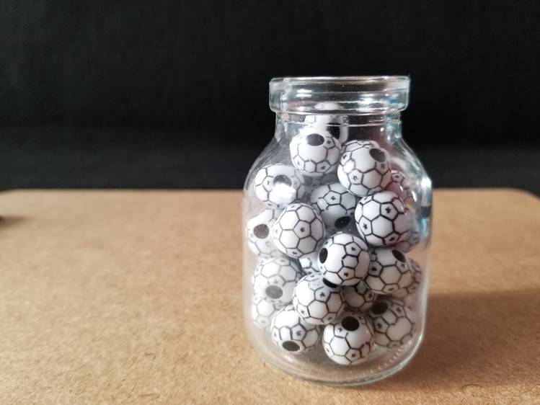
The Reveal
How many beads are in the container?
42 beads
Important Note:
If you can see this box, then the slide show is not playing and the reveal won’t work.
Here is the solution:
If you are using PowerPoint, click on Slide Show, then click on From Current Slide.
If you are using Google Slides, click on View then Present.
Steve Wyborney

Slide 3
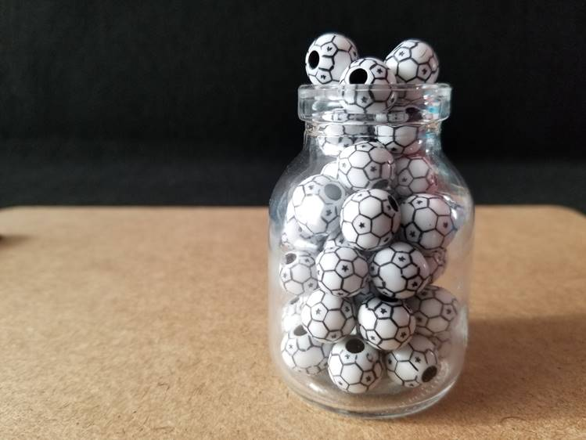
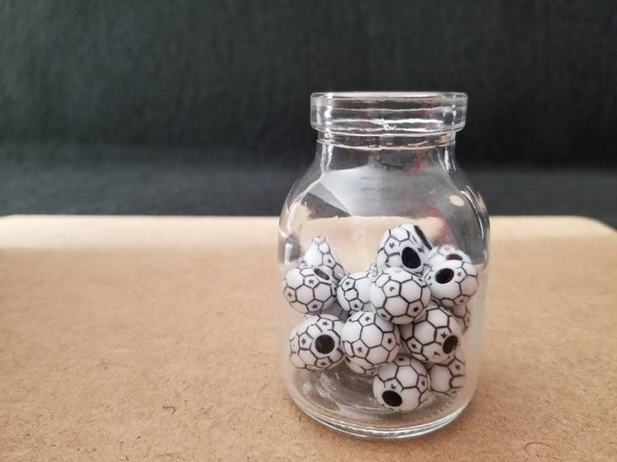
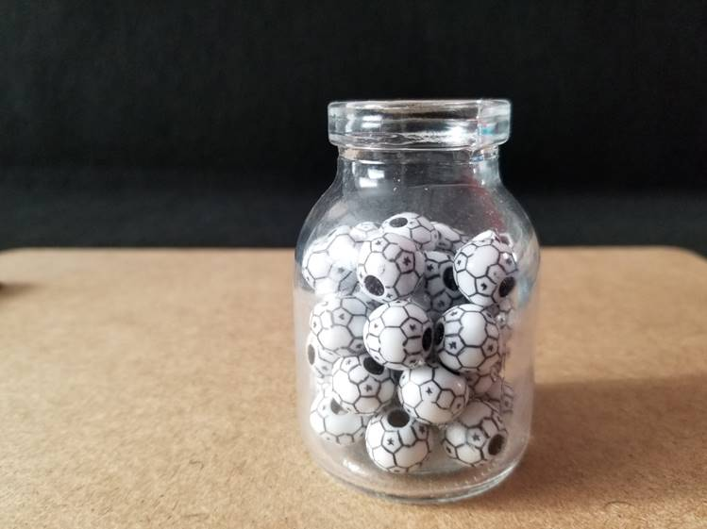
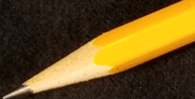
42 beads
The Reveal
47 beads
The Reveal
The Reveal
27 beads
36 beads
Steve Wyborney

Slide 4
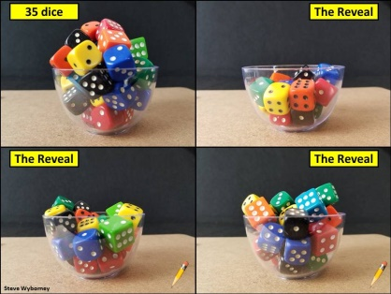
November 1 – January 8
January 11 - (ongoing)
New Esti-Mysteries and
Number Sense Resources
Every Day for the Rest
of the School Year
Part 2 - New Esti-Mysteries and
Number Sense Resources
Every Day for the Rest
of the School Year
More Free, Downloadable Resources From Blog Posts
51 Esti-Mysteries
The Original
50 Splat! Lessons
The Original
20 Fraction
Splat! Lessons
The Original 40 Estimation Clipboard Sets
80 Cube Conversations
Lessons
20 Days of
Number Sense
& Rich Math Talk
To Access The Multiplication Course…
Click here to see the chapter playlists on my YouTube channel.
Click on “sort by” (on the right side) and choose Date created (oldest)
You’ll see all 12 chapters in the course.
Tips for Using the Multiplication Course
When looking at playlists, click on the words “View Full Playlist” instead of the thumbnail or the chapter title.
Then click on the share button.
Copy the link and send it to your class.
Begin with 1 lesson (1 video) per day and then adjust the pacing to meet the needs of your class.
For more information read the blog post about The Multiplication Course here.

