Slide 1
Watch this YouTube video for more information about the charts.
https://youtu.be/pzPby1HUSQs
Which set should I use?
“Esti-Mysteries are already working well for my class.”
Use slides 2-7 if Esti-Mysteries are already working well for you. These slides are exactly the same with no changes. You’re students already have a way of writing down their estimates and are responding to each clue. They may be using a digital platform to record their thinking, or are writing on paper, or are using a dry erase board or chart – or they have another way of responding to clues in writing. You probably already notice that when students write down their estimate after each clue that it helps to propel rich math talk and also builds anticipation for the next clue. If this sounds familiar, then I recommend using slides 1-6.
FURTHER OPTIONS FOR DISTANCE LEARNING
“I need a chart for everyone to see, and I have a way to digitally write on it.”
Use slides 8-13 if you simply need an embedded chart to write on during discussion. This may be particularly useful for distance learning if students do not have easy access to a chart. Perhaps they don’t have a chart at home, or they may not be able to easily navigate between tabs to a digital chart. You can use a digital pen (such as a drawing feature) to record ideas from student discussions and cross out numbers for the whole class to see at the same time.
“I need a step-by-step animated chart that eliminates numbers after every clue.”
Use slides 14-19 if you want to see numbers disappear from the chart after every clue. This may be helpful if you need a chart and don’t have an easy way to digitally write on the chart. You can move forward and backward to see which clues eliminated which numbers.

Slide 2
“20 More or Less”
Important Note:
If you can see this box, then the slide show is not playing and the reveal won’t work.
Here is the solution:
If you are using PowerPoint, click on Slide Show, then click on From Current Slide.
If you are using Google Slides, click on View then Present.
Steve Wyborney
www.stevewyborney.com

Slide 3
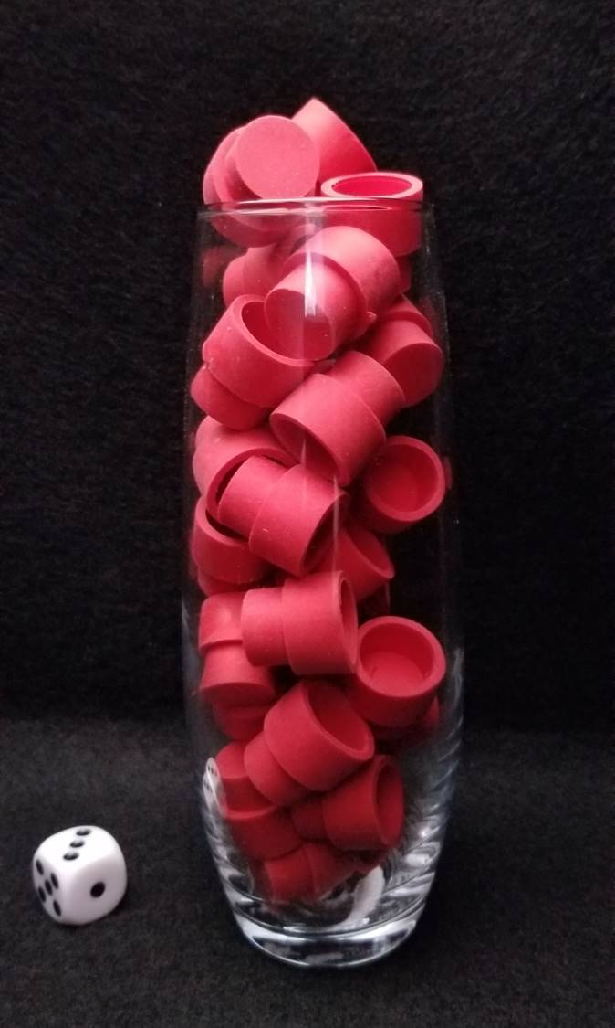
How many erasers are in the vase?
As the clues appear, use the information to narrow the possibilities to a smaller set. After each clue, use estimation again to determine which of the remaining answers is the most reasonable.
Write down your first estimate. After each clue, you’ll see if your estimate is still a possibility. After each clue, if it is no longer possible write down a new estimate – and be prepared to explain why you chose it.
Steve Wyborney
www.stevewyborney.com

Slide 4
Clue #1
Clue #1
The answer is between 20 and 50.
Clue #2
Clue #2
The answer is an odd number.
Cross off the even numbers.
Cross off: 22, 24, 26…
Clue #3
Clue #3
The answer does not include the digit 3.
Clue #4
Clue #4
Find 25. What number is 20 more than 25? Cross off both numbers.
Clue #5
Clue #5
Find 47. What numbers is 20 less than 47? Cross off both numbers.
Steve Wyborney
www.stevewyborney.com

Slide 5
After seeing the clues, you have narrowed the possibilities to a small set of numbers. Before you see the answer, select your final estimate. Write it down, and explain to someone why you chose that number.
Steve Wyborney
www.stevewyborney.com

Slide 6
29 erasers
The Reveal
Click to see the answer.
Important Note:
If you can see this box, then the slide show is not playing and the reveal won’t work.
Here is the solution:
If you are using PowerPoint, click on Slide Show, then click on From Beginning.
If you are using Google Slides, click on View then Present.
Steve Wyborney
www.stevewyborney.com

Slide 7
New Esti-Mysteries and Number Sense Resources Every Day for the Rest of the School Year
More Free, Downloadable Resources From Blog Posts
51 Esti-Mysteries
The Original
50 Splat! Lessons
The Original
20 Fraction
Splat! Lessons
The Original 40 Estimation Clipboard Sets
80 Cube Conversations
Lessons
20 Days of
Number Sense
& Rich Math Talk
To Access The Multiplication Course…
Click here to see the chapter playlists on my YouTube channel.
Click on “sort by” (on the right side) and choose Date created (oldest)
You’ll see all 12 chapters in the course.
Tips for Using the Multiplication Course
When looking at playlists, click on the words “View Full Playlist” instead of the thumbnail or the chapter title.
Then click on the share button.
Copy the link and send it to your class.
Begin with 1 lesson (1 video) per day and then adjust the pacing to meet the needs of your class.
For more information read the blog post about The Multiplication Course here.

Slide 8
“20 More or Less”
Important Note:
If you can see this box, then the slide show is not playing and the reveal won’t work.
Here is the solution:
If you are using PowerPoint, click on Slide Show, then click on From Current Slide.
If you are using Google Slides, click on View then Present.
Steve Wyborney
www.stevewyborney.com

Slide 9
How many erasers are in the vase?
As the clues appear, use the information to narrow the possibilities to a smaller set. After each clue, use estimation again to determine which of the remaining answers is the most reasonable.
Write down your first estimate. After each clue, you’ll see if your estimate is still a possibility. After each clue, if it is no longer possible write down a new estimate – and be prepared to explain why you chose it.
Steve Wyborney
www.stevewyborney.com

Slide 10
Clue #1
Clue #1
The answer is between 20 and 50.
Clue #2
Clue #2
The answer is an odd number.
Cross off the even numbers.
Cross off: 22, 24, 26…
Clue #3
Clue #3
The answer does not include the digit 3.
Clue #4
Clue #4
Find 25. What number is 20 more than 25? Cross off both numbers.
Clue #5
Clue #5
Find 47. What numbers is 20 less than 47? Cross off both numbers.
21 | 22 | 23 | 24 | 25 | 26 | 27 | 28 | 29 | 30
31 | 32 | 33 | 34 | 35 | 36 | 37 | 38 | 39 | 40
41 | 42 | 43 | 44 | 45 | 46 | 47 | 48 | 49 | 50
Steve Wyborney
www.stevewyborney.com

Slide 11
After seeing the clues, you have narrowed the possibilities to a small set of numbers. Before you see the answer, select your final estimate. Write it down, and explain to someone why you chose that number.
Steve Wyborney
www.stevewyborney.com

Slide 12
29 erasers
The Reveal
Click to see the answer.
Important Note:
If you can see this box, then the slide show is not playing and the reveal won’t work.
Here is the solution:
If you are using PowerPoint, click on Slide Show, then click on From Beginning.
If you are using Google Slides, click on View then Present.
Steve Wyborney
www.stevewyborney.com

Slide 13
New Esti-Mysteries and Number Sense Resources Every Day for the Rest of the School Year
More Free, Downloadable Resources From Blog Posts
51 Esti-Mysteries
The Original
50 Splat! Lessons
The Original
20 Fraction
Splat! Lessons
The Original 40 Estimation Clipboard Sets
80 Cube Conversations
Lessons
20 Days of
Number Sense
& Rich Math Talk
To Access The Multiplication Course…
Click here to see the chapter playlists on my YouTube channel.
Click on “sort by” (on the right side) and choose Date created (oldest)
You’ll see all 12 chapters in the course.
Tips for Using the Multiplication Course
When looking at playlists, click on the words “View Full Playlist” instead of the thumbnail or the chapter title.
Then click on the share button.
Copy the link and send it to your class.
Begin with 1 lesson (1 video) per day and then adjust the pacing to meet the needs of your class.
For more information read the blog post about The Multiplication Course here.

Slide 14
“20 More or Less”
Important Note:
If you can see this box, then the slide show is not playing and the reveal won’t work.
Here is the solution:
If you are using PowerPoint, click on Slide Show, then click on From Current Slide.
If you are using Google Slides, click on View then Present.
Steve Wyborney
www.stevewyborney.com

Slide 15
How many erasers are in the vase?
As the clues appear, use the information to narrow the possibilities to a smaller set. After each clue, use estimation again to determine which of the remaining answers is the most reasonable.
Write down your first estimate. After each clue, you’ll see if your estimate is still a possibility. After each clue, if it is no longer possible write down a new estimate – and be prepared to explain why you chose it.
Steve Wyborney
www.stevewyborney.com

Slide 16
Clue #1
Clue #1
The answer is between 20 and 50.
Clue #2
Clue #2
The answer is an odd number.
Cross off the even numbers.
Cross off: 22, 24, 26…
Clue #3
Clue #3
The answer does not include the digit 3.
Clue #4
Clue #4
Find 25. What number is 20 more than 25? Cross off both numbers.
Clue #5
Clue #5
Find 47. What numbers is 20 less than 47? Cross off both numbers.
21 | 22 | 23 | 24 | 25 | 26 | 27 | 28 | 29 | 30
31 | 32 | 33 | 34 | 35 | 36 | 37 | 38 | 39 | 40
41 | 42 | 43 | 44 | 45 | 46 | 47 | 48 | 49 | 50
21 | 22 | 23 | 24 | 25 | 26 | 27 | 28 | 29 | 30
31 | 32 | 33 | 34 | 35 | 36 | 37 | 38 | 39 | 40
41 | 42 | 43 | 44 | 45 | 46 | 47 | 48 | 49 | 50
21 | 22 | 23 | 24 | 25 | 26 | 27 | 28 | 29 | 30
31 | 32 | 33 | 34 | 35 | 36 | 37 | 38 | 39 | 40
41 | 42 | 43 | 44 | 45 | 46 | 47 | 48 | 49 | 50
21 | 22 | 23 | 24 | 25 | 26 | 27 | 28 | 29 | 30
31 | 32 | 33 | 34 | 35 | 36 | 37 | 38 | 39 | 40
41 | 42 | 43 | 44 | 45 | 46 | 47 | 48 | 49 | 50
21 | 22 | 23 | 24 | 25 | 26 | 27 | 28 | 29 | 30
31 | 32 | 33 | 34 | 35 | 36 | 37 | 38 | 39 | 40
41 | 42 | 43 | 44 | 45 | 46 | 47 | 48 | 49 | 50
Steve Wyborney
www.stevewyborney.com

Slide 17
After seeing the clues, you have narrowed the possibilities to a small set of numbers. Before you see the answer, select your final estimate. Write it down, and explain to someone why you chose that number.
Steve Wyborney
www.stevewyborney.com

Slide 18
29 erasers
The Reveal
Click to see the answer.
Important Note:
If you can see this box, then the slide show is not playing and the reveal won’t work.
Here is the solution:
If you are using PowerPoint, click on Slide Show, then click on From Beginning.
If you are using Google Slides, click on View then Present.
Steve Wyborney
www.stevewyborney.com

Slide 19
New Esti-Mysteries and Number Sense Resources Every Day for the Rest of the School Year
More Free, Downloadable Resources From Blog Posts
51 Esti-Mysteries
The Original
50 Splat! Lessons
The Original
20 Fraction
Splat! Lessons
The Original 40 Estimation Clipboard Sets
80 Cube Conversations
Lessons
20 Days of
Number Sense
& Rich Math Talk
To Access The Multiplication Course…
Click here to see the chapter playlists on my YouTube channel.
Click on “sort by” (on the right side) and choose Date created (oldest)
You’ll see all 12 chapters in the course.
Tips for Using the Multiplication Course
When looking at playlists, click on the words “View Full Playlist” instead of the thumbnail or the chapter title.
Then click on the share button.
Copy the link and send it to your class.
Begin with 1 lesson (1 video) per day and then adjust the pacing to meet the needs of your class.
For more information read the blog post about The Multiplication Course here.

