Slide 1
“Rocky Vase,
Level 4”
Important Note:
If you can see this box, then the slide show is not playing and the reveal won’t work.
Here is the solution:
If you are using PowerPoint, click on Slide Show, then click on From Current Slide.
If you are using Google Slides, click on View then Present.
Steve Wyborney
www.stevewyborney.com

Slide 2
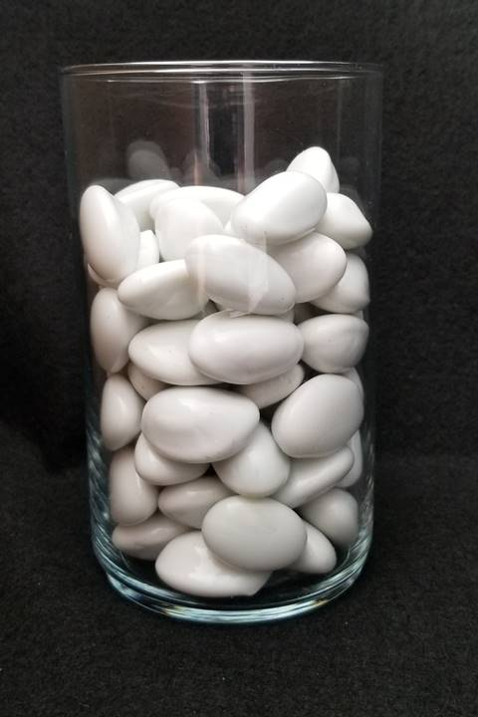
How many rocks are in the vase?
As the clues appear, use the information to narrow the possibilities to a smaller set. After each clue, use estimation again to determine which of the remaining answers is the most reasonable.
Write down your first estimate. After each clue, you’ll see if your estimate is still a possibility. After each clue, if it is no longer possible write down a new estimate – and be prepared to explain why you chose it.
Steve Wyborney
www.stevewyborney.com

Slide 3
Clue #1
Clue #1
You will need a hundreds chart. Cross off the numbers that are eliminated by the clues.
Clue #2
Clue #2
The answer is a multiple of 3.
Clue #3
The answer is not a multiple of 4.
Clue #3
Clue #4
Clue #4
Find the number 42 on your chart. Notice how it is the center of a diagonal group of 3 numbers where the boxes are touching at the corners. Look at the digits in those three numbers. None of those digits is in the answer.
Clue #5
The answer is a multiple of 11.
Clue #5
Steve Wyborney
www.stevewyborney.com

Slide 4
After seeing the clues, you have narrowed the possibilities to a small set of numbers. Before you see the answer, select your final estimate. Write it down, and explain to someone why you chose that number.
Steve Wyborney
www.stevewyborney.com

Slide 5
66 rocks
The Reveal
Click to see the answer.
Important Note:
If you can see this box, then the slide show is not playing and the reveal won’t work.
Here is the solution:
If you are using PowerPoint, click on Slide Show, then click on From Current Slide.
If you are using Google Slides, click on View then Present.
Steve Wyborney
www.stevewyborney.com

Slide 6
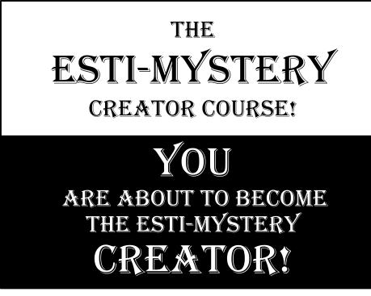
51 Esti-Mysteries
Click here to download more free Esti-Mysteries.
The Esti-Mystery Creator Course
This is the course I’ve designed to teach you how to create
your own Esti-Mysteries that are tailored for your class.
More Free, Downloadable Resources From Blog Posts
The Original
50 Splat! Lessons
The Original
20 Fraction
Splat! Lessons
The Original
80 Cube Conversations
Lessons
The Original 40 Estimation Clipboard Sets
The Maze
Hundreds Chart
20 Days of
Number Sense
& Rich Math Talk

