Slide 1
20 Days
of Number Sense
&
Rich Math Talk
#20DaysNS
Steve Wyborney
www.stevewyborney.com

Slide 2
Day 14 Esti-Mysteries
#20DaysNS

Slide 3
Tips for Using Esti-Mysteries & Answers to Frequently Asked Questions
Selecting which one (or ones) to use – Each day includes 3 different levels of Esti-Mysteries. To choose the one (or ones) that are best for your class, look at the clue page to see if those clues are a good match for your students based on the concepts that you see. Remember that it is okay to use concepts that may seem “too young” because the primary concept is estimation – and providing opportunities to estimate both smaller and larger numbers is vital for each student. Likewise, it’s okay to introduce concepts that are new to your students, ones with clues that may seem “too advanced.” For example, if you see a clue that describes “multiples of 3,” but your class hasn’t yet learned about that concept, you can still use that Esti-Mystery by making a list of multiples of 3.
Questions about The Reveal – Make sure the slide show is playing. The reveal will not show if the slide show is not playing. In PowerPoint, be sure to view the show. In Google Slides, make sure you are presenting the show. Questions about how to use the files with Google Slides are often resolved by (1) Saving the file in your Google Drive, (2) Opening the file with Google Slides, (3) Clicking on Present.
The number that is revealed is the actual number of objects in the container. I’ve designed every Esti-Mystery specifically so that the clues do not narrow the options to a single answer. Rather, the clues narrow the options to a small set of choices, and in the end the students will return to estimation one more time to decide which of those options is the most reasonable. As an example, consider a case in which the clues will narrow the options to 28, 58, and 78. According to the clues, none of those numbers has been eliminated. However, only one of them is the actual number of objects in the container. The reveal will show which one is the actual number. The reason I don’t narrow it down to only a single number is that there would then be no need to estimate after the final clue, and there would be no mystery left at the end.
I’ve included appearing charts on the fist day of Esti-Mysteries to provide students with a visual of how a chart might be used to identify or eliminate numbers. After the first day, the charts will no longer appear on the slides, so students will have the opportunity to select the resource that they find effective. I most often use charts, lists, and T-charts to solve the Esti-Mysteries.
It is important to have students write down their estimate after each clue appears. Be sure that students explain to one another (1) the number they wrote down and (2) why they chose that number. In some cases, a previous estimate will still stand when a new clue appears. In other cases, a prior estimate will be eliminated, so the student will consider the available options and estimate again. Be sure students have ample opportunities to share their reasoning with each other.
Generally, the earlier clues move more quickly than ones that follow.
Feel free to enjoy the process yourself and allow your students to hear your reasoning.
Enjoy the journey and feel free to share your learning experiences with others! You can find me on Twitter @stevewyborney

Slide 4
20 Days of Number Sense &
Rich Math Talk
Day #14 (of 20)
Exclusive Esti-Mysteries
(These Esti-Mysteries do not appear anywhere else.)
Steve Wyborney
www.stevewyborney.com

Slide 5
“Orange Yarn”
Level 1
Exclusive Esti-Mysteries
(These Esti-Mysteries do not appear anywhere else.)
Steve Wyborney
www.stevewyborney.com

Slide 6
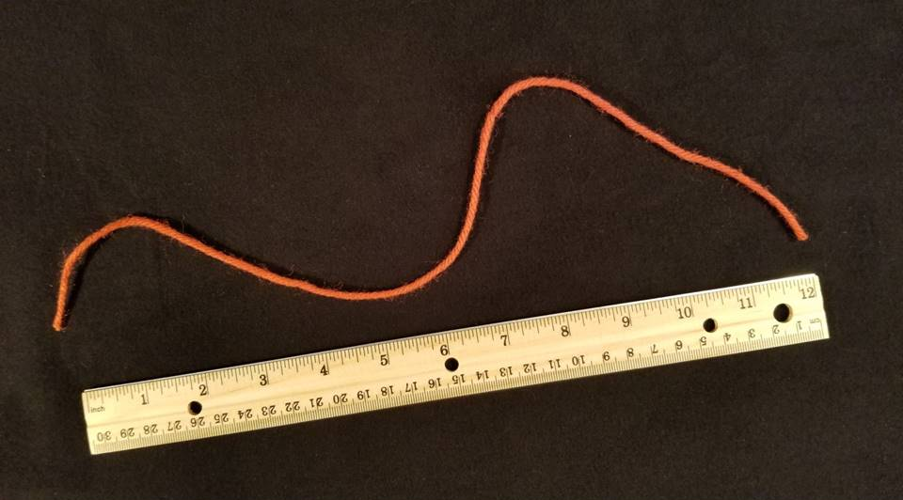
What is the length of the yarn – in whole inches – when it is straight?
As the clues appear, use the information to narrow the possibilities to a smaller set. After each clue, use estimation again to determine which of the remaining answers is the most reasonable.
Write down your first estimate. After each clue, you’ll see if your estimate is still a possibility. After each clue, if it is no longer possible write down a new estimate – and be prepared to explain why you chose it.
Steve Wyborney
www.stevewyborney.com

Slide 7
Clue #1
Clue #3
Clue #1
The answer between 12 and 30.
Clue #3
The yarn has 2 ends. Cross of any numbers that include the digit 2.
Clue #2
Clue #4
Clue #2
The yarn nearly touches the 4, 5, and 6. Cross off any numbers that include the digit 4, 5, or 6.
Clue #4
The yarn is far from the numbers 8 and 9. Cross off any numbers that include the digits 8 or 9.
Steve Wyborney
www.stevewyborney.com

Slide 8
After seeing the clues, you have narrowed the possibilities to a small set of numbers. Before you see the answer, select your final estimate. Write it down, and explain to someone why you chose that number.
Steve Wyborney
www.stevewyborney.com

Slide 9
The Reveal
Click to see the answer.
17 inches
Steve Wyborney
www.stevewyborney.com

Slide 10
20 Days
of Number Sense &
Rich Math Talk
by Steve Wyborney
Click here or on the image to view the next set of resources
from 20 Days of Number Sense & Rich Math Talk.
Other Downloadable Resources From Previous Blog Posts
The Original
50 Splat! Lessons
The Original
20 Fraction
Splat! Lessons
The Original
80 Cube Conversations
Lessons
The Original 40 Estimation Clipboard Sets
The Maze
Hundreds Chart
The Original
Esti-Mysteries

Slide 11
20 Days of Number Sense &
Rich Math Talk
Day #14 (of 20)
Exclusive Esti-Mysteries
(These Esti-Mysteries do not appear anywhere else.)
Steve Wyborney
www.stevewyborney.com

Slide 12
“Bottles of Beads”
Level 2
Exclusive Esti-Mysteries
(These Esti-Mysteries do not appear anywhere else.)
Steve Wyborney
www.stevewyborney.com

Slide 13
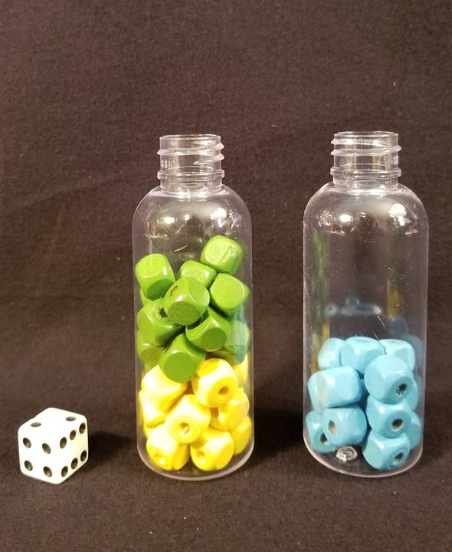
What is the TOTAL number of beads?
As the clues appear, use the information to narrow the possibilities to a smaller set. After each clue, use estimation again to determine which of the remaining answers is the most reasonable.
Write down your first estimate. After each clue, you’ll see if your estimate is still a possibility. After each clue, if it is no longer possible write down a new estimate – and be prepared to explain why you chose it.
Steve Wyborney
www.stevewyborney.com

Slide 14
Clue #1
Clue #1
The TOTAL is between 35 and 85. Remember you are looking for
the TOTAL.
Clue #2
Clue #2
The number of beads of each color is the same. That means the answer is a multiple of 3.
Clue #3
Clue #3
The die is showing the numbers 2, 4, and 6. The digits 2, 4, and 6 are not in the TOTAL.
Clue #4
Clue #4
The digit 7 is not in the answer.
Steve Wyborney
www.stevewyborney.com

Slide 15
After seeing the clues, you have narrowed the possibilities to a small set of numbers. Before you see the answer, select your final estimate. Write it down, and explain to someone why you chose that number.
Steve Wyborney
www.stevewyborney.com

Slide 16
The Reveal
Click to see the answer.
51 beads
Steve Wyborney
www.stevewyborney.com

Slide 17
20 Days
of Number Sense &
Rich Math Talk
by Steve Wyborney
Click here or on the image to view the next set of resources
from 20 Days of Number Sense & Rich Math Talk.
Other Downloadable Resources From Previous Blog Posts
The Original
50 Splat! Lessons
The Original
20 Fraction
Splat! Lessons
The Original
80 Cube Conversations
Lessons
The Original 40 Estimation Clipboard Sets
The Maze
Hundreds Chart
The Original
Esti-Mysteries

Slide 18
20 Days of Number Sense &
Rich Math Talk
Day #14 (of 20)
Exclusive Esti-Mysteries
(These Esti-Mysteries do not appear anywhere else.)
Steve Wyborney
www.stevewyborney.com

Slide 19
“Card Stack”
Level 3
Exclusive Esti-Mysteries
(These Esti-Mysteries do not appear anywhere else.)
Steve Wyborney
www.stevewyborney.com

Slide 20
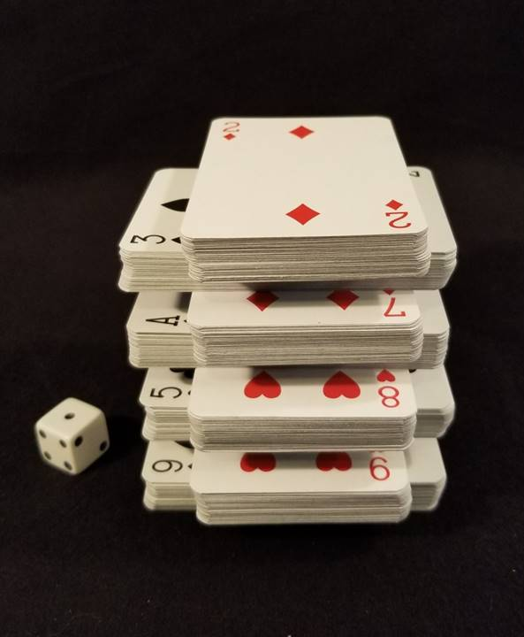
How many cards are there?
As the clues appear, use the information to narrow the possibilities to a smaller set. After each clue, use estimation again to determine which of the remaining answers is the most reasonable.
Write down your first estimate. After each clue, you’ll see if your estimate is still a possibility. After each clue, if it is no longer possible write down a new estimate – and be prepared to explain why you chose it.
Steve Wyborney
www.stevewyborney.com

Slide 21
Clue #1
Clue #1
The total is less than 400.
Clue #2
Clue #2
All 8 stacks have the same number of cards – so the answer is a multiple of 8.
Clue #3
Clue #3
The answer is also a multiple of 7.
Clue #4
Clue #4
The top card is a 2. A certain digit appears twice in the answer.
Clue #5
Clue #5
It may be helpful to think about the most reasonable number of cards in each stack.
Steve Wyborney
www.stevewyborney.com

Slide 22
After seeing the clues, you have narrowed the possibilities to a small set of numbers. Before you see the answer, select your final estimate. Write it down, and explain to someone why you chose that number.
Steve Wyborney
www.stevewyborney.com

Slide 23
The Reveal
Click to see the answer.
Remember: You are looking for the TOTAL number of cards – not the number in each small stack. NOW click to see THE REVEAL.
336 cards
Steve Wyborney
www.stevewyborney.com

Slide 24
20 Days
of Number Sense &
Rich Math Talk
by Steve Wyborney
Click here or on the image to view the next set of resources
from 20 Days of Number Sense & Rich Math Talk.
Other Downloadable Resources From Previous Blog Posts
The Original
50 Splat! Lessons
The Original
20 Fraction
Splat! Lessons
The Original
80 Cube Conversations
Lessons
The Original 40 Estimation Clipboard Sets
The Maze
Hundreds Chart
The Original
Esti-Mysteries

