Slide 1
20 Days
of Number Sense
&
Rich Math Talk
#20DaysNS
Steve Wyborney
www.stevewyborney.com

Slide 2
Day 1 The Estimation Clipboard

Slide 3
Tips for Using The Estimation Clipboard
When the first image (of 4) appears, invite the class to share some estimates aloud. Typically, a few students will offer some estimates. Don’t spend much time on the first image. After you have received a few responses, reveal the answer.
Make a mental note: If you hear answers from a small number of students, you are also hearing silence from nearly all of your class. Anticipate engaging all students in mathematical reasoning by the time you reach the third image.
When the second image appears, invite the class to share some estimates aloud again. You will likely hear estimates from more students than the first time. You may want to spend a little more time on the second image, but the power of The Estimation Clipboard is yet to come.
When the third image appears, change your approach. Remember, you haven’t heard from several students at this point, but everyone’s context is growing. When you show the third image, instead of asking for answers aloud have all of the students write down their estimate. Then have them discuss these two questions with a partner: “What was your estimate? Why did you choose it?” Listen carefully to the reasoning.
When the moment is right, reveal the third answer. Notice how your students are becoming increasingly engaged in the estimation process. That’s partly because you are re-inviting them into a growing context. It’s also because they have engaged in writing and discussion. The moment of writing has become a springboard for discussion. They have been given space to voice their ideas, and they are learning more about their ideas as they discuss them.
When the fourth image appears, repeat the process from the previous step. Everyone in the classroom writes down their estimate, and then everyone tells their partner what estimate they chose and why they chose it. Expect the conversation to take a little longer here and notice that the conversations about the estimates – and about estimation itself – are becoming more detailed. You may see several students pointing to the screen during their discussions.
When you reveal the final answer, listen to your class. Simply listen. Just take a moment to notice.
Eventually , perhaps after you have tried several sets , introduce the concept of using a range to estimate – rather than using a single number. Look for opportunities to encourage your students to self-select whether a range or a single number would be more useful.
As a learner yourself, engage in the process. Be a wonderer in front of your students. If you want a good question to wonder about, begin with this one: “What is estimation?”
Enjoy the journey and feel free to share your learning experiences with others! You can find me on Twitter @stevewyborney

Slide 4
20 Days of Number Sense &
Rich Math Talk
Day #1 (of 20)
Exclusive Estimation Clipboards
(These Estimation Clipboards do not appear anywhere else.)
Steve Wyborney
www.stevewyborney.com

Slide 5
Set 1
All Grade Levels

Slide 6
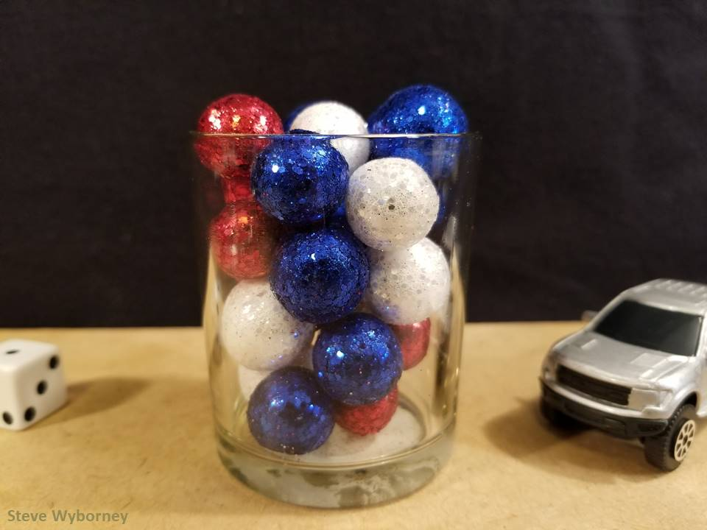
How many objects are in the container?
24 objects
The Reveal
www.stevewyborney.com

Slide 7
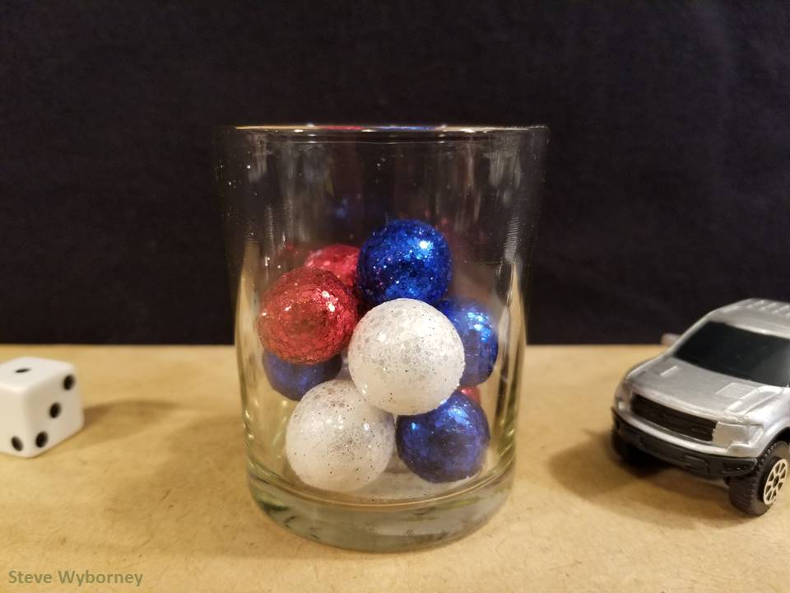
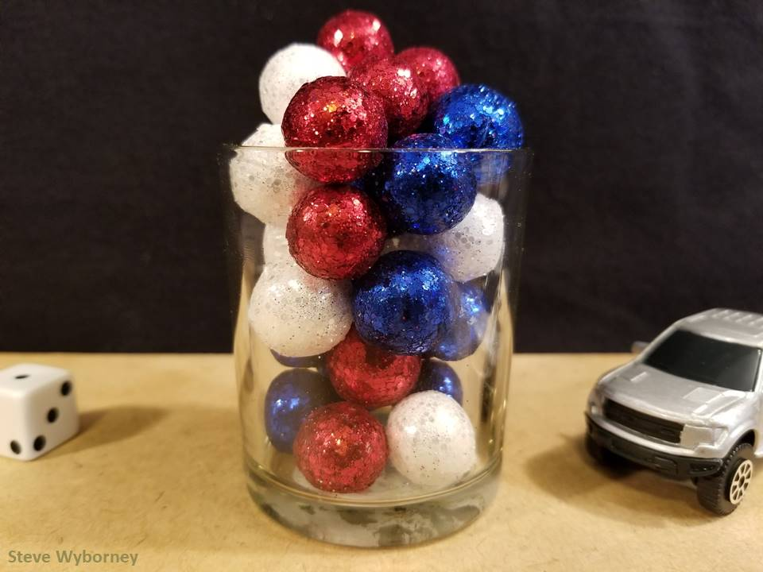
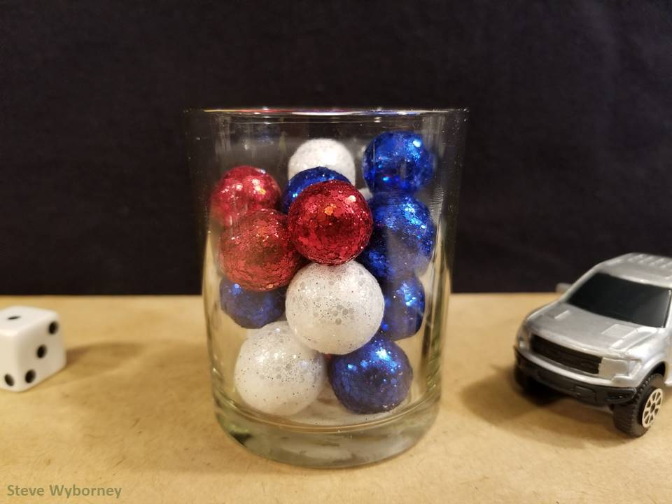
24 objects
11 objects
The Reveal
29 objects
The Reveal
17 objects
The Reveal
www.stevewyborney.com

Slide 8
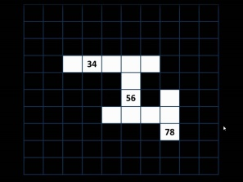
20 Days
of Number Sense &
Rich Math Talk
by Steve Wyborney
Click here or on the image to view the next set of resources
from 20 Days of Number Sense & Rich Math Talk.
Other Downloadable Resources From Previous Blog Posts
The Original
50 Splat! Lessons
The Original
20 Fraction
Splat! Lessons
The Original
80 Cube Conversations
Lessons
The Original 40 Estimation Clipboard Sets
The Maze
Hundreds Chart
The Original
Esti-Mysteries

Slide 9
20 Days of Number Sense &
Rich Math Talk
Day #1 (of 20)
Exclusive Estimation Clipboards
(These Estimation Clipboards do not appear anywhere else.)
Steve Wyborney
www.stevewyborney.com

Slide 10
Set 2
All Grade Levels

Slide 11
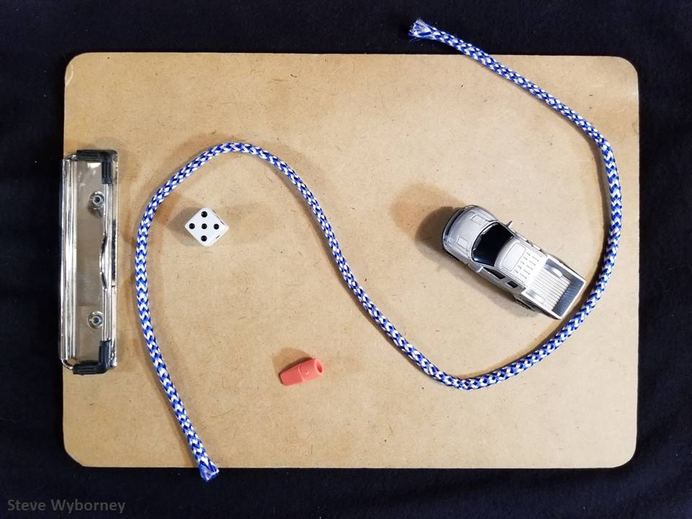
28 inches
What is the length of the rope in whole inches?
The Reveal
www.stevewyborney.com

Slide 12
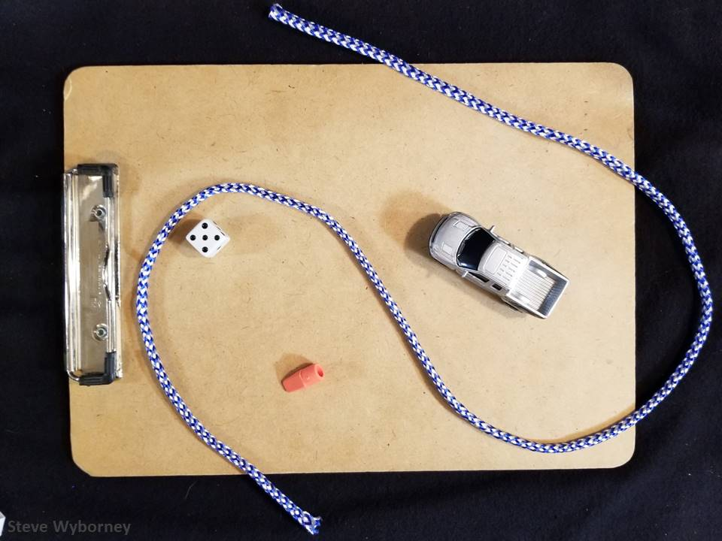
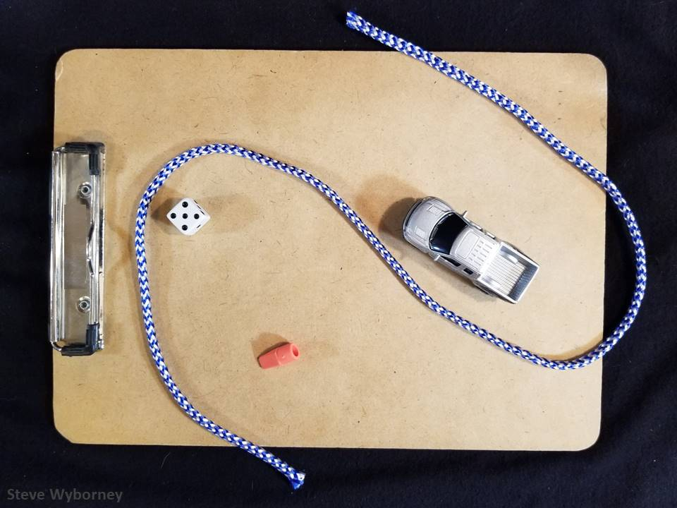
28 inches
22 inches
The Reveal
37 inches
The Reveal
32 inches
The Reveal
www.stevewyborney.com

Slide 13
20 Days
of Number Sense &
Rich Math Talk
by Steve Wyborney
Click here or on the image to view the next set of resources
from 20 Days of Number Sense & Rich Math Talk.
Other Downloadable Resources From Previous Blog Posts
The Original
50 Splat! Lessons
The Original
20 Fraction
Splat! Lessons
The Original
80 Cube Conversations
Lessons
The Original 40 Estimation Clipboard Sets
The Maze
Hundreds Chart
The Original
Esti-Mysteries

Slide 14
20 Days of Number Sense &
Rich Math Talk
Day #1 (of 20)
Exclusive Estimation Clipboards
(These Estimation Clipboards do not appear anywhere else.)
Steve Wyborney
www.stevewyborney.com

Slide 15
Set 3
All Grade Levels

Slide 16
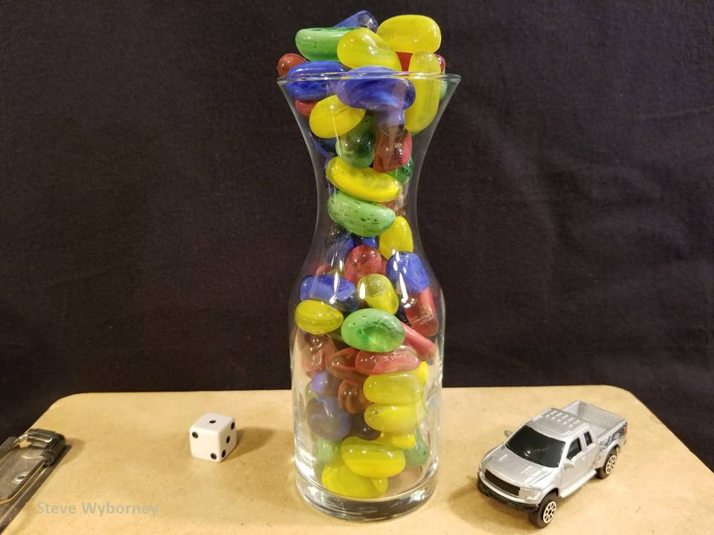
How many pebbles are in the vase?
89 pebbles
The Reveal
www.stevewyborney.com

Slide 17
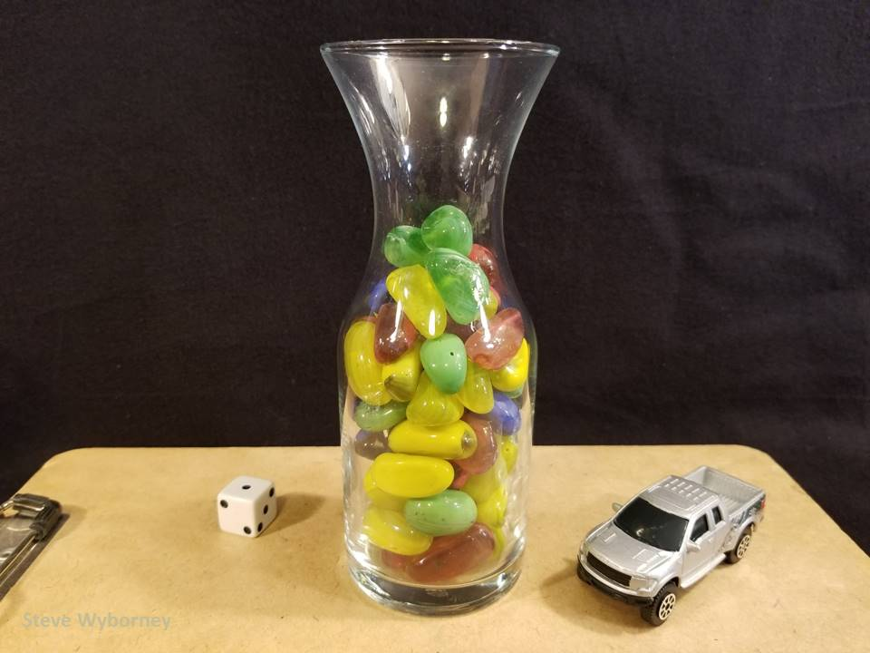
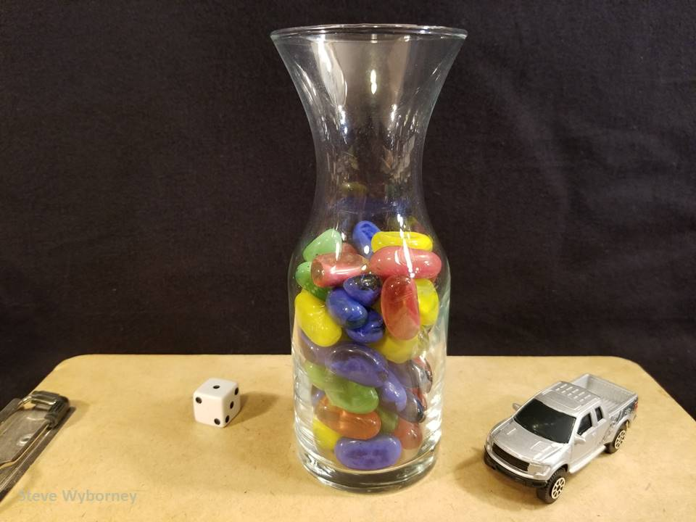
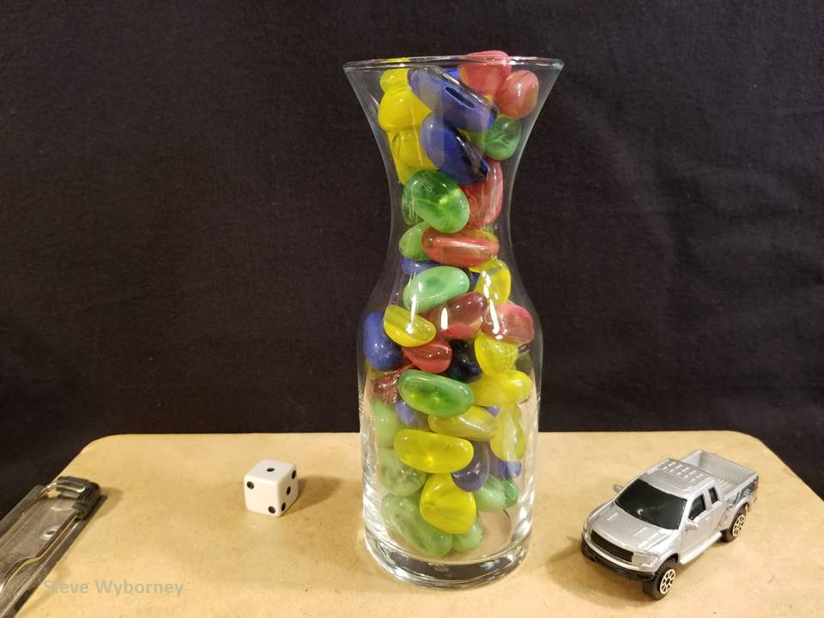
89 pebbles
61 pebbles
The Reveal
54 pebbles
The Reveal
76 pebbles
The Reveal
www.stevewyborney.com

Slide 18
20 Days
of Number Sense &
Rich Math Talk
by Steve Wyborney
Click here or on the image to view the next set of resources
from 20 Days of Number Sense & Rich Math Talk.
Other Downloadable Resources From Previous Blog Posts
The Original
50 Splat! Lessons
The Original
20 Fraction
Splat! Lessons
The Original
80 Cube Conversations
Lessons
The Original 40 Estimation Clipboard Sets
The Maze
Hundreds Chart
The Original
Esti-Mysteries

