Slide 1
ESTI - MYSTERIES
Estimation Meets Math Mysteries
Esti – Mystery #9
“Cupside Down”
Steve Wyborney
www.stevewyborney.com

Slide 2
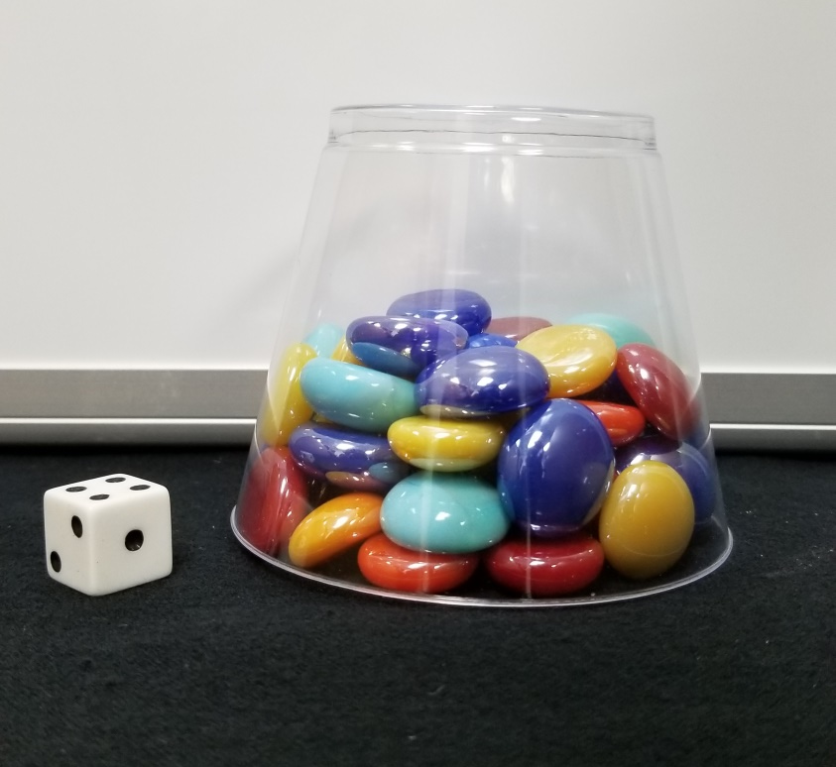
Before seeing the clues, estimate how many objects are in the cup.
As the clues appear, use the information to narrow the possibilities to a smaller set. Then use estimation to determine which of the remaining answers is the most reasonable.
Steve Wyborney
www.stevewyborney.com

Slide 3
Clue #1
Clue #1
The answer is an odd number.
Clue #2
Clue #2
Look at the visible faces on the die. What do you see? Those 3 digits are not in the answer.
Clue #3
Clue #3
Add the visible numbers on the die. The sum is not a digit in the answer.
Clue #4
Clue #4
The answer does not include
the digit 6.
Clue #5
Look at the die again. The visible numbers are part of a counting sequence – except one number is missing.
That missing number represents a digit that is in the answer.
Clue #5
Steve Wyborney
www.stevewyborney.com

Slide 4
By combining the clues and estimation, you now have enough information to determine the answer.
Steve Wyborney
www.stevewyborney.com

Slide 5
The Reveal
Click to see the answer.
53 objects
Steve Wyborney

Slide 6
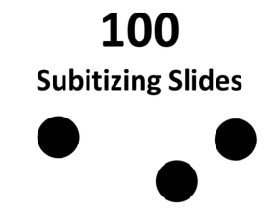
Esti - Mysteries
Mystery #1
Click here (or on the image) to download more Esti – Mysteries.
Other Downloadable Resources
50 Splat! Lessons
(for PowerPoint)
20 Fraction
Splat! Lessons
(for PowerPoint)
80 Cube Conversations
Lessons
100 Subitizing Slides
&
10 Challenge Patterns
The Estimation Clipboard
Splat!
for Google Slides

