Slide 1
ESTI - MYSTERIES
Estimation Meets
Math Mysteries
Esti – Mystery #6
Steve Wyborney
www.stevewyborney.com

Slide 2
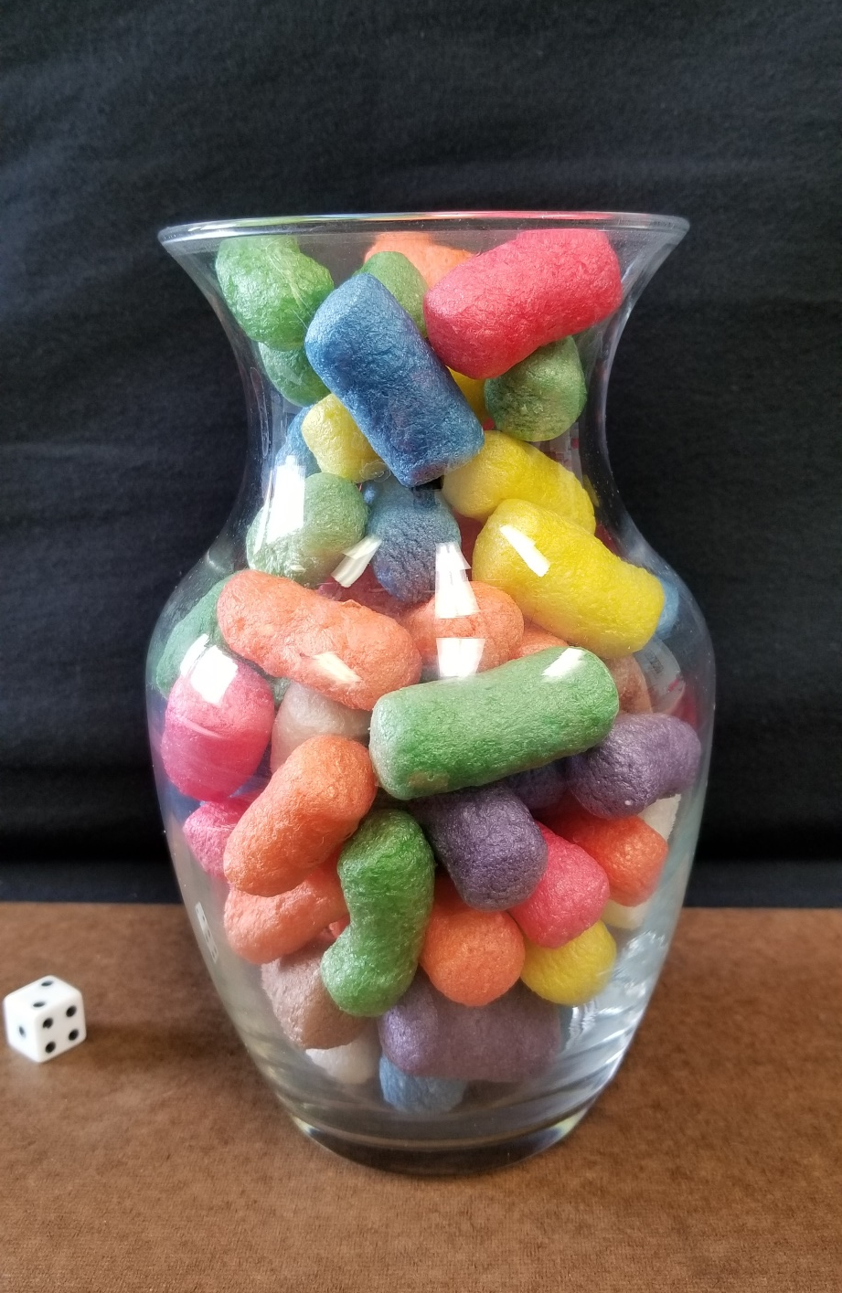
Before seeing the clues, estimate the number of foam pieces in the vase.
As the clues appear, use the information to narrow the possibilities to a smaller set. Then use estimation to determine which of the remaining answers is the most reasonable.
Steve Wyborney
www.stevewyborney.com

Slide 3
Clue #1
Clue #1
The number is less than 125.
Clue #2
Add the numbers that can be seen on the die. The answer is a multiple of that number.
Clue #2
Clue #3
Clue #3
The answer is not a multiple of 3.
Clue #4
Clue #4
The answer is an even number.
Clue #5
Clue #5
The answer is not a multiple of 8.
Steve Wyborney
www.stevewyborney.com

Slide 4
By combining the clues and estimation, you now have enough information to determine the answer.
Steve Wyborney
www.stevewyborney.com

Slide 5
The Reveal
Click to see the answer.
70 objects
Steve Wyborney
www.stevewyborney.com

Slide 6
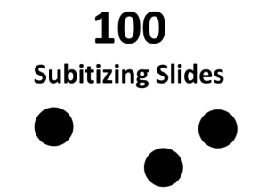
Esti - Mysteries
Mystery #6
Click here (or on the image) to download more Esti – Mysteries.
Other Downloadable Resources
50 Splat! Lessons
(for PowerPoint)
20 Fraction
Splat! Lessons
(for PowerPoint)
80 Cube Conversations
Lessons
100 Subitizing Slides
&
10 Challenge Patterns
The Estimation Clipboard
Splat!
for Google Slides

