Slide 1
ESTI - MYSTERIES
Estimation Meets
Math Mysteries
Esti – Mystery #1
Steve Wyborney
www.stevewyborney.com

Slide 2
How many objects
are in the glass?
As the clues appear, use the information to narrow the possibilities to a smaller set. Then use estimation to determine which of the remaining answers is the most reasonable.
Steve Wyborney
www.stevewyborney.com

Slide 3
Clue #1
Clue #1
The answer is a number
less than 50.
Clue #2
Clue #2
The answer is an odd number.
Clue #3
Clue #3
The answer is a multiple of 3.
For example: 3, 6, 9, 12 …
Clue #4
Clue #4
The answer includes 2 different digits.
Clue #5
Clue #5
Neither of the digits
is a 2 or a 4.
Steve Wyborney
www.stevewyborney.com

Slide 4
By combining the clues and estimation, you now have enough information to determine the answer.
Steve Wyborney
www.stevewyborney.com

Slide 5
The Reveal
Click to see the answer.
39 objects
Steve Wyborney
www.stevewyborney.com

Slide 6
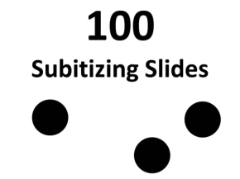
Esti - Mysteries
Mystery #1
Click here (or on the image) to download more Esti – Mysteries.
Other Downloadable Resources
50 Splat! Lessons
(for PowerPoint)
20 Fraction
Splat! Lessons
(for PowerPoint)
80 Cube Conversations
Lessons
100 Subitizing Slides
&
10 Challenge Patterns
The Estimation Clipboard
Splat!
for Google Slides

