Slide 1
This is a custom version of Splat! designed to work in Google Slides.
Splat!
Set 4.4
This set includes instant multiple splats with an unknown total.
Remember: Each splat (of the same color) must have the same number.
You can download more free sets here.
Steve Wyborney

Slide 2
?
14
How is the list of possible totals like the picture?
Let’s look under one splat to see how many shapes are there.
Splat!
We don’t know the total number of blue shapes. We do know that because both of the splats are the same color they must have the same number under each of them.
What could the total be?
What are some possibilities?
How are the possibilities connected?
What is the total?
www.stevewyborney.com
Steve Wyborney

Slide 3
?
11
www.stevewyborney.com
Steve Wyborney

Slide 4
?
20
www.stevewyborney.com
Steve Wyborney

Slide 5
?
21
www.stevewyborney.com
Steve Wyborney

Slide 6
?
21
www.stevewyborney.com
Steve Wyborney

Slide 7
?
27
www.stevewyborney.com
Steve Wyborney

Slide 8
?
23
www.stevewyborney.com
Steve Wyborney

Slide 9
?
35
www.stevewyborney.com
Steve Wyborney

Slide 10
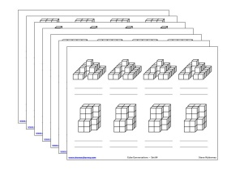
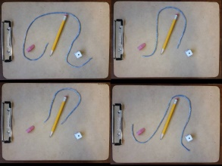
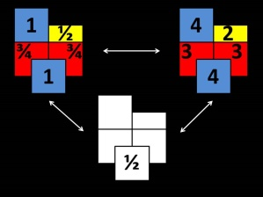
Splat! Set 4.4
(for Google Slides)
Click here (or on the image) to download more Splat! sets for Google Slides.
Other Downloadable Resources
50 Splat! Lessons
(for PowerPoint)
20 Fraction
Splat! Lessons
(for PowerPoint)
80 Cube Conversations
Lessons
80 Printable Cube
Conversations Pages
The Estimation Clipboard
3 Powerful Tile Strategies (and 40 new downloadable pages)

