Slide 1
This is a custom version of Splat! designed to work in Google Slides.
The Fraction Splat! Series
Set 12.5
This set includes Instant Splats! and unit fractions.
You can download more free sets here.
Steve Wyborney

Slide 2
Let’s look under the splat to see what number is there.
6
The total is…
Splat!
What number is under the splat?
What can we learn from this picture?
www.stevewyborney.com
Steve Wyborney

Slide 3
4
www.stevewyborney.com
Steve Wyborney

Slide 4
5
www.stevewyborney.com
Steve Wyborney

Slide 5
6
www.stevewyborney.com
Steve Wyborney

Slide 6
7
www.stevewyborney.com
Steve Wyborney

Slide 7
8
www.stevewyborney.com
Steve Wyborney

Slide 8
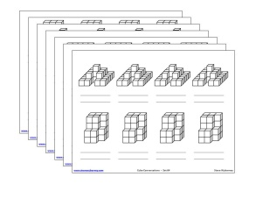
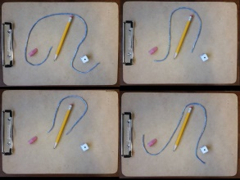
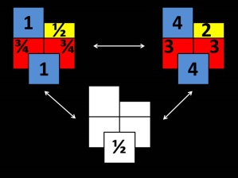
The Fraction Splat! Series
Set 12.5
(for Google Slides)
Click here (or on the image) to download more Splat! sets for Google Slides.
Other Downloadable Resources
50 Splat! Lessons
(for PowerPoint)
20 Fraction
Splat! Lessons
(for PowerPoint)
80 Cube Conversations
Lessons
80 Printable Cube
Conversations Pages
The Estimation Clipboard
3 Powerful Tile Strategies (and 40 new downloadable pages)

