Slide 1
This is a custom version of Splat! designed to work in Google Slides.
The Fraction Splat! Series
Set 11.4
This set includes unit fractions and a single Splat!
You can download more free sets here.
Steve Wyborney

Slide 2
How else could you know?
5
Let’s look under the splat to see the total.
What number does this represent?
Splat!
What is the total under the splat?
How do you know?
What can we learn from this picture?
www.stevewyborney.com
Steve Wyborney

Slide 3
7
www.stevewyborney.com
Steve Wyborney

Slide 4
5
www.stevewyborney.com
Steve Wyborney

Slide 5
7
www.stevewyborney.com
Steve Wyborney

Slide 6
6
www.stevewyborney.com
Steve Wyborney

Slide 7
7
www.stevewyborney.com
Steve Wyborney

Slide 8
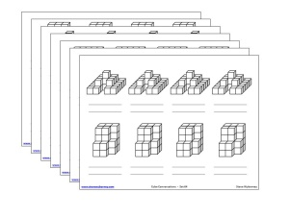
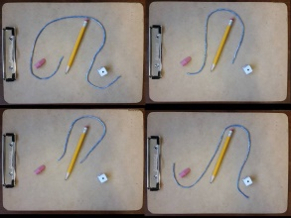
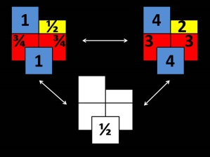
The Fraction Splat! Series
Set 11.4
(for Google Slides)
Click here (or on the image) to download more Splat! sets for Google Slides.
Other Downloadable Resources
50 Splat! Lessons
(for PowerPoint)
20 Fraction
Splat! Lessons
(for PowerPoint)
80 Cube Conversations
Lessons
80 Printable Cube
Conversations Pages
The Estimation Clipboard
3 Powerful Tile Strategies (and 40 new downloadable pages)

