Slide 1
This is a custom version of Splat! designed to work in Google Slides.
Splat!
Set 1.4
This set includes the numbers 3 through 10.
You can download more free sets here.
Steve Wyborney

Slide 2
How else could you know?
8
Let’s look under the splat to see how many shapes are there.
How many blue shapes do you see?
Splat!
How many shapes are under the splat? How do you know?
What can we learn from this picture?
www.stevewyborney.com
Steve Wyborney

Slide 3
10
www.stevewyborney.com
Steve Wyborney

Slide 4
9
www.stevewyborney.com
Steve Wyborney

Slide 5
10
www.stevewyborney.com
Steve Wyborney

Slide 6
8
www.stevewyborney.com
Steve Wyborney

Slide 7
9
www.stevewyborney.com
Steve Wyborney

Slide 8
10
www.stevewyborney.com
Steve Wyborney

Slide 9
9
www.stevewyborney.com
Steve Wyborney

Slide 10
10
www.stevewyborney.com
Steve Wyborney

Slide 11
10
www.stevewyborney.com
Steve Wyborney

Slide 12
9
www.stevewyborney.com
Steve Wyborney

Slide 13
8
www.stevewyborney.com
Steve Wyborney

Slide 14
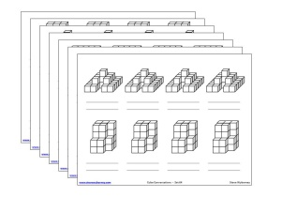
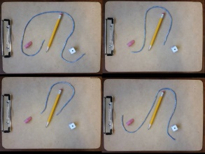
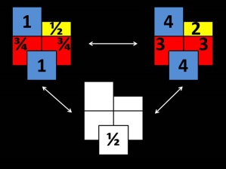
Splat! Set 1.4
(for Google Slides)
Click here (or on the image) to download more Splat! sets for Google Slides.
Other Downloadable Resources
50 Splat! Lessons
(for PowerPoint)
20 Fraction
Splat! Lessons
(for PowerPoint)
80 Cube Conversations
Lessons
80 Printable Cube
Conversations Pages
The Estimation Clipboard
3 Powerful Tile Strategies (and 40 new downloadable pages)

