Slide 1
100
Subitizing Slides
www.stevewyborney.com

Slide 2
Set 4
www.stevewyborney.com

Slide 3
www.stevewyborney.com

Slide 4
www.stevewyborney.com

Slide 5
www.stevewyborney.com

Slide 6
www.stevewyborney.com

Slide 7
www.stevewyborney.com

Slide 8
www.stevewyborney.com

Slide 9
www.stevewyborney.com

Slide 10
www.stevewyborney.com

Slide 11
www.stevewyborney.com

Slide 12
www.stevewyborney.com

Slide 13
www.stevewyborney.com

Slide 14
www.stevewyborney.com

Slide 15
www.stevewyborney.com

Slide 16
www.stevewyborney.com

Slide 17
www.stevewyborney.com

Slide 18
www.stevewyborney.com

Slide 19
www.stevewyborney.com

Slide 20
www.stevewyborney.com

Slide 21
www.stevewyborney.com

Slide 22
www.stevewyborney.com

Slide 23
www.stevewyborney.com

Slide 24
Set 4 CHALLENGE
www.stevewyborney.com

Slide 25
You are about to see a larger group of dots.
Instead of saying how may dots there are, find as many ways as you can to show how you know what the total is.
Here is an example.
www.stevewyborney.com

Slide 26
2 + 3 + 2 = 7
2 + 3 + 2 = 7
4 + 4 – 1 = 7
9 – 2 = 7
5 + 2 = 7
3 + 3 + 1 = 7

Slide 27
Now I’ll show you a large copy of your pattern.
Then I’ll show you several smaller copies so you can find as many ways as possible of showing different ways of seeing the total.
Here it is!
www.stevewyborney.com

Slide 28
www.stevewyborney.com

Slide 29
www.stevewyborney.com

Slide 30
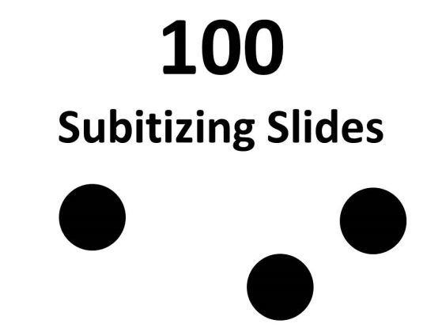
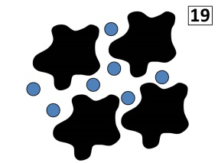
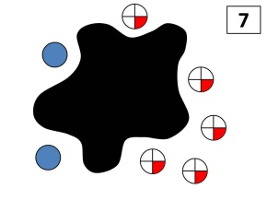
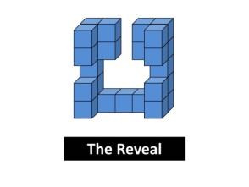

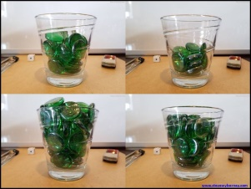

100 Subitizing Slides
(Set 4 of 10)
Click here (or on the image) to download more Subitizing Slide Sets.
Other Downloadable Resources
50 Splat! Lessons
(for PowerPoint)
20 Fraction
Splat! Lessons
(for PowerPoint)
80 Cube Conversations
Lessons
How to Create 9 Identical Dot Patterns in 10 Seconds or Less
The Estimation Clipboard
Splat!
for Google Slides

