Slide 1
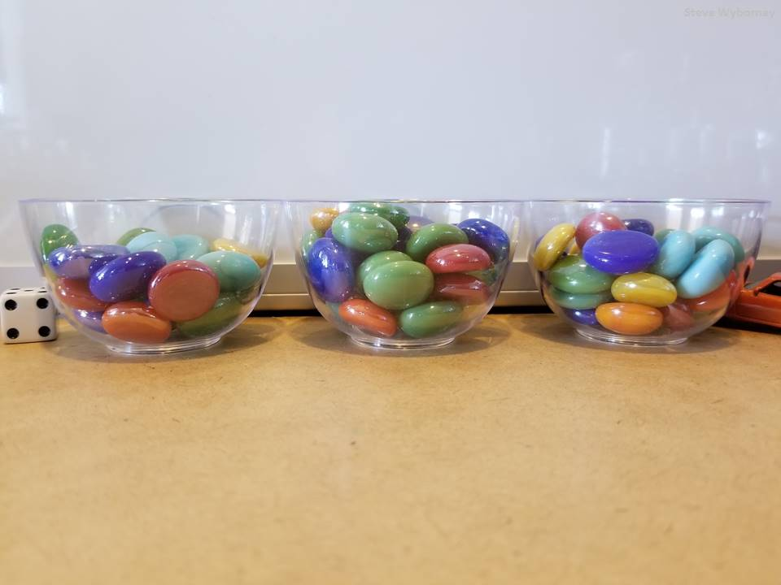
The Estimation Clipboard
Sets 37 – 40 of 40
Download more free sets here.
Steve Wyborney

Slide 2
Tips for Using The Estimation Clipboard
When the first image (of 4) appears, invite the class to share some estimates aloud. Typically, a few students will offer some estimates. Don’t spend much time on the first image. After you have received a few responses, reveal the answer.
Make a mental note: If you hear answers from a small number of students, you are also hearing silence from nearly all of your class. Anticipate engaging all students in mathematical reasoning by the time you reach the third image.
When the second image appears, invite the class to share some estimates aloud again. You will likely hear estimates from more students than the first time. You may want to spend a little more time on the second image, but the power of The Estimation Clipboard is yet to come.
When the third image appears, change your approach. Remember, you haven’t heard from several students at this point, but everyone’s context is growing. When you show the third image, instead of asking for answers aloud have all of the students write down their estimate. Then have them discuss these two questions with a partner: “What was your estimate? Why did you choose it?” Listen carefully to the reasoning.
When the moment is right, reveal the third answer. Notice how your students are becoming increasingly engaged in the estimation process. That’s partly because you are re-inviting them into a growing context. It’s also because they have engaged in writing and discussion. The moment of writing has become a springboard for discussion. They have been given space to voice their ideas, and they are learning more about their ideas as they discuss them.
When the fourth image appears, repeat the process from the previous step. Everyone in the classroom writes down their estimate, and then everyone tells their partner what estimate they chose and why they chose it. Expect the conversation to take a little longer here and notice that the conversations about the estimates – and about estimation itself – are becoming more detailed. You may see several students pointing to the screen during their discussions.
When you reveal the final answer, listen to your class. Simply listen. Just take a moment to notice.
Eventually , perhaps after you have tried several sets , introduce the concept of using a range to estimate – rather than using a single number. Look for opportunities to encourage your students to self-select whether a range or a single number would be more useful.
As a learner yourself, engage in the process. Be a wonderer in front of your students. If you want a good question to wonder about, begin with this one: “What is estimation?”
Enjoy the journey and feel free to share your learning experiences with others! You can find me on Twitter @stevewyborney

Slide 3
The Estimation Clipboard
Set 37 of 40
Download more free sets here.
Steve Wyborney

Slide 4
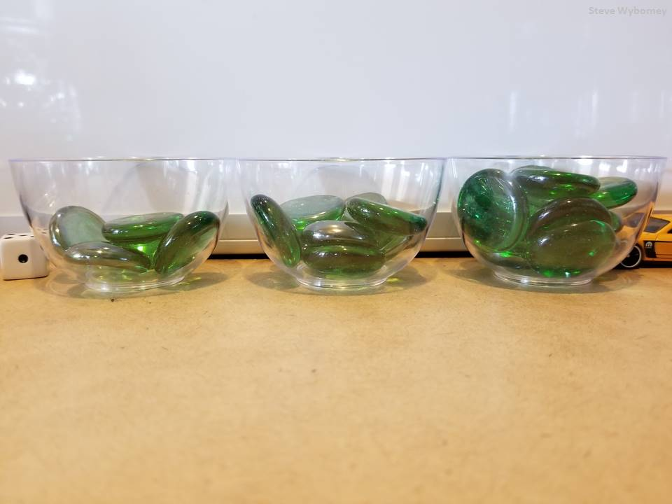
The total is 25 glass gems.
The Total
5 glass gems
?
?
?
8 glass gems
12 glass gems
What is the total number of glass gems?
How many are in each bowl?
www.stevewyborney.com

Slide 5
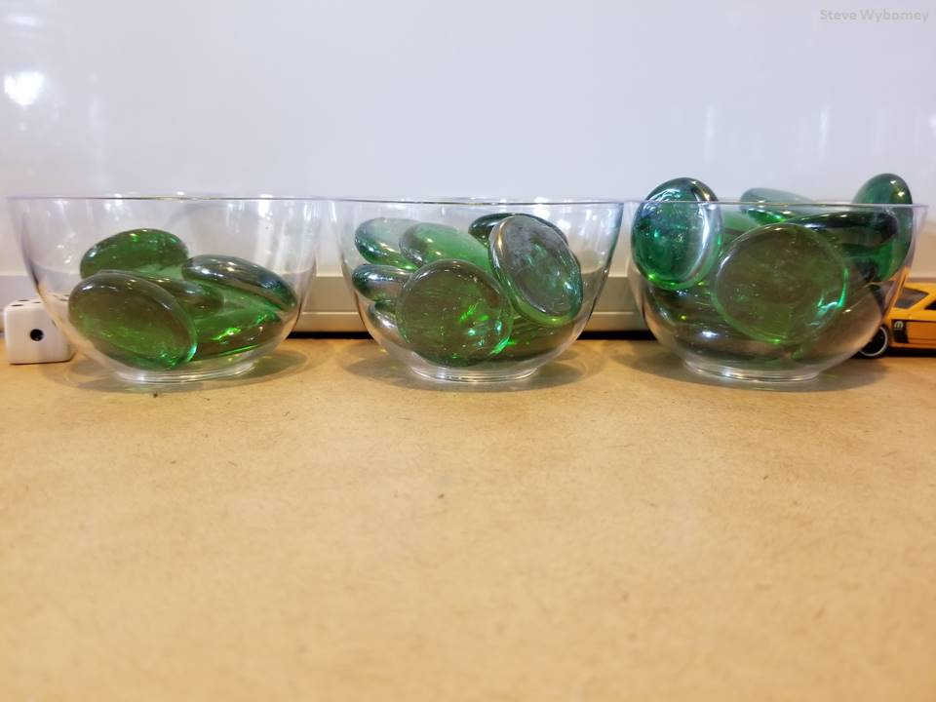
The total is 34 glass gems.
The Total
7 glass gems
?
?
?
11 glass gems
16 glass gems
What is the total number of glass gems?
How many are in each bowl?
www.stevewyborney.com

Slide 6
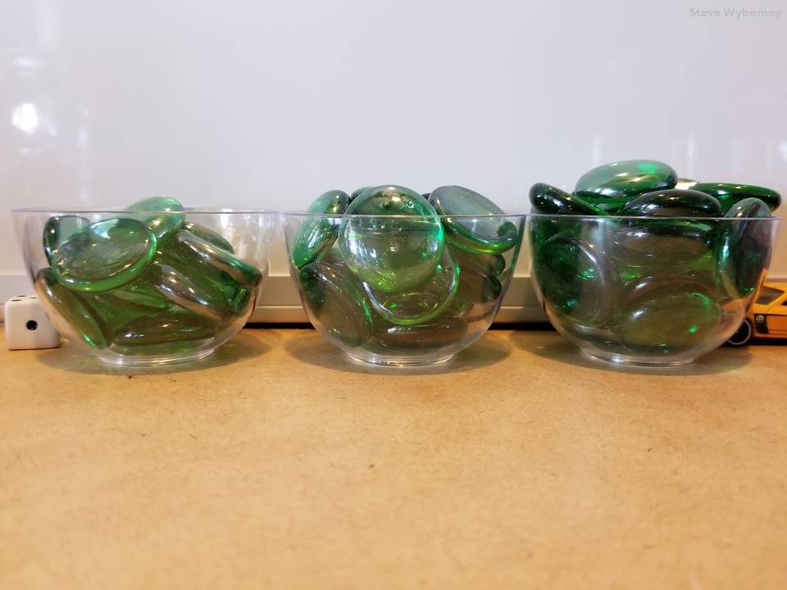
The total is 53 glass gems.
The Total
12 glass gems
?
?
?
18 glass gems
23 glass gems
What is the total number of glass gems?
How many are in each bowl?
www.stevewyborney.com

Slide 7
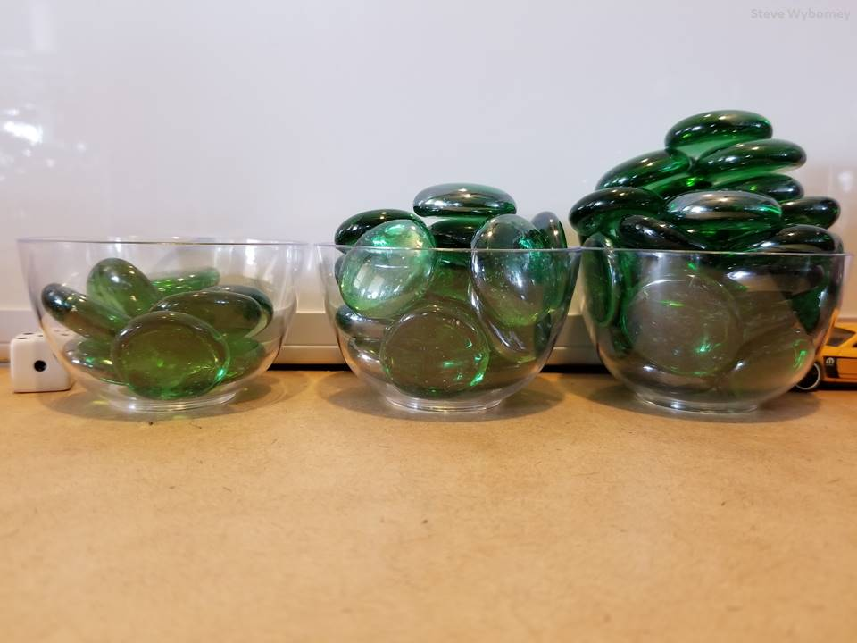
The total is 62 glass gems.
The Total
9 glass gems
?
?
?
21 glass gems
32 glass gems
What is the total number of glass gems?
How many are in each bowl?
www.stevewyborney.com

Slide 8
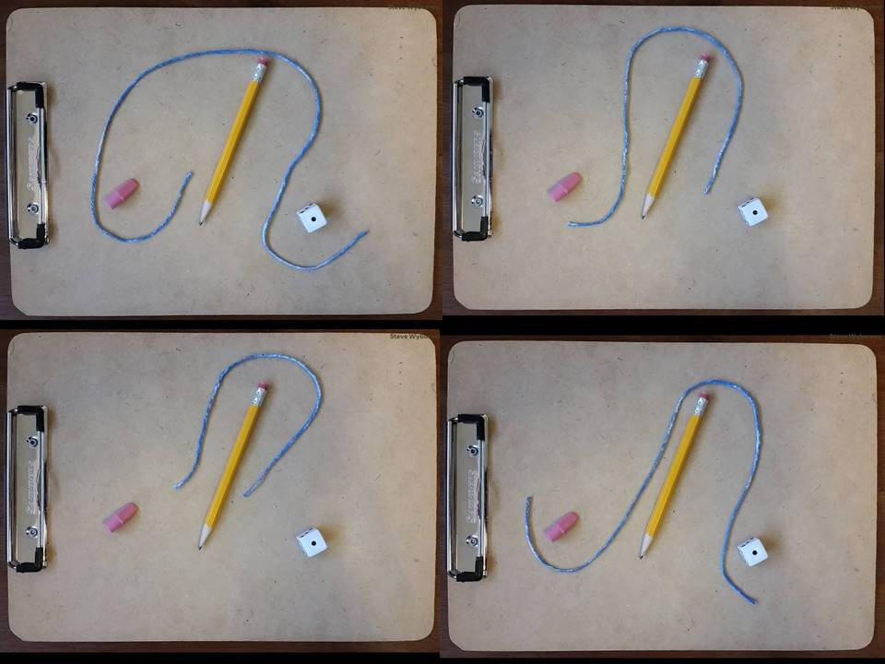
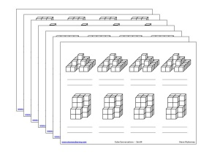
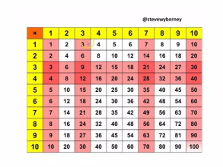
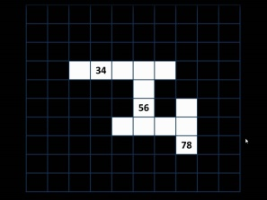
The Estimation Clipboard
Set 37 of 40
Click here (or on the image) to download more Estimation Clipboard sets.
Other Downloadable Resources
50 Splat! Lessons
20 Fraction
Splat! Lessons
80 Cube Conversations
Lessons
80 Printable Cube
Conversations Pages
The Animated
Multiplication Table
The Maze
Hundreds Chart

Slide 9
The Estimation Clipboard
Set 38 of 40
Download more free sets here.
Steve Wyborney

Slide 10
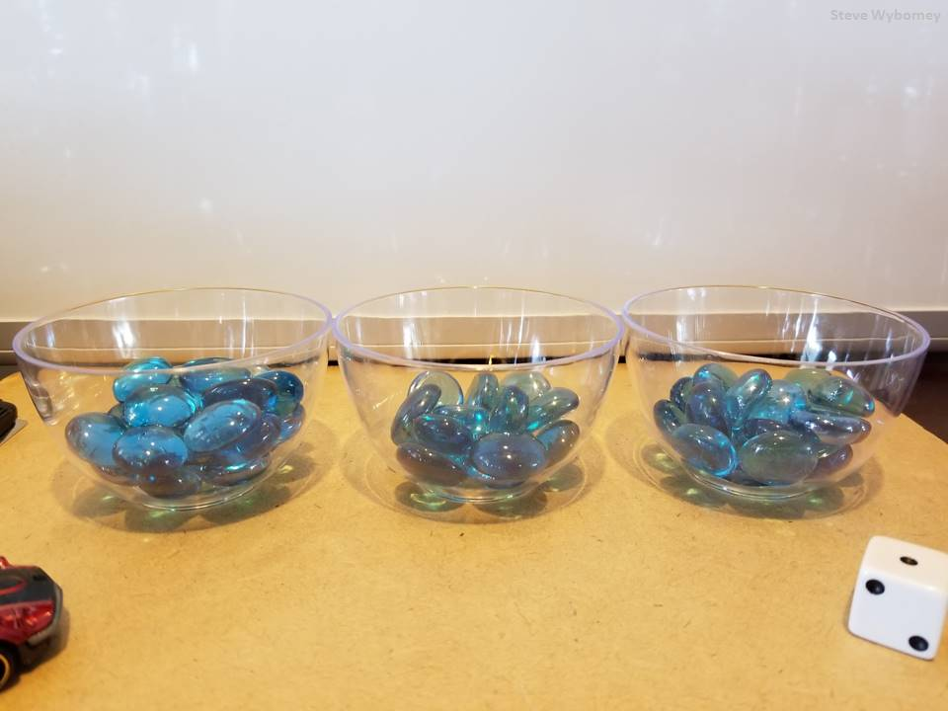
The total is 54 glass gems.
The Total
What is the total number of glass gems?
How many are in each bowl?
22 glass gems
14 glass gems
18 glass gems
?
?
?
www.stevewyborney.com

Slide 11
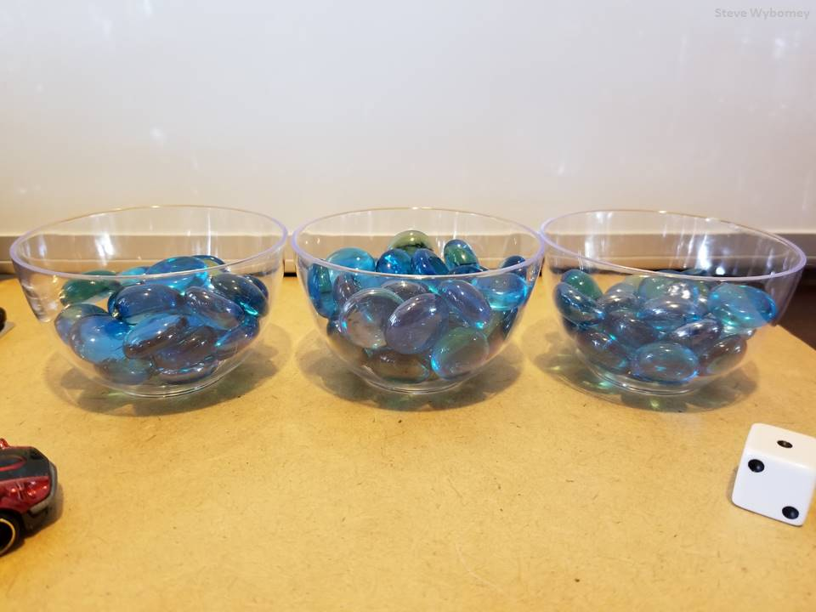
The total is 86 glass gems.
The Total
What is the total number of glass gems?
How many are in each bowl?
27 glass gems
36 glass gems
23 glass gems
?
?
?
www.stevewyborney.com

Slide 12
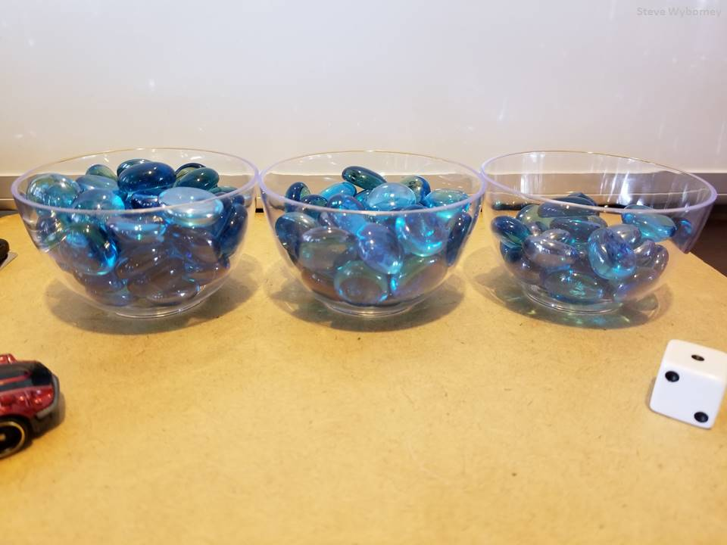
The total is 108 glass gems.
The Total
44 glass gems
39 glass gems
25 glass gems
?
?
?
What is the total number of glass gems?
How many are in each bowl?
www.stevewyborney.com

Slide 13
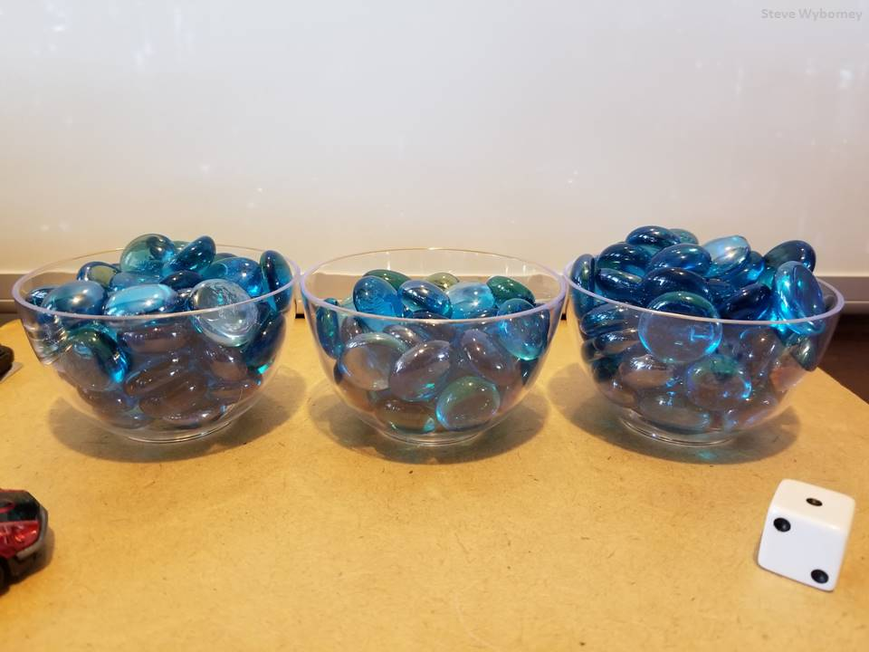
The total is 154 glass gems.
The Total
What is the total number of glass gems?
How many are in each bowl?
52 glass gems
41 glass gems
61 glass gems
?
?
?
www.stevewyborney.com

Slide 14
The Estimation Clipboard
Set 38 of 40
Click here (or on the image) to download more Estimation Clipboard sets.
Other Downloadable Resources
50 Splat! Lessons
20 Fraction
Splat! Lessons
80 Cube Conversations
Lessons
80 Printable Cube
Conversations Pages
The Animated
Multiplication Table
The Maze
Hundreds Chart

Slide 15
The Estimation Clipboard
Set 39 of 40
Download more free sets here.
Steve Wyborney

Slide 16
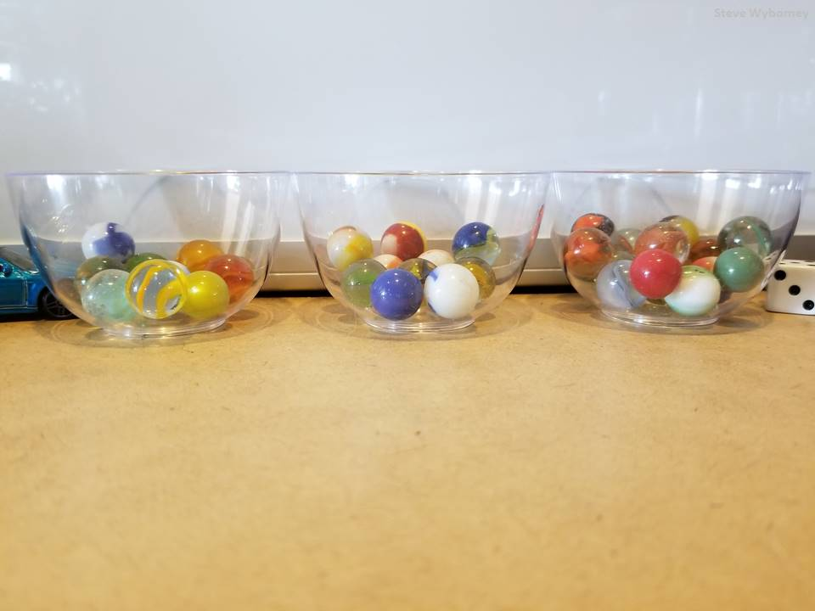
The total is 34 marbles.
The Total
9 marbles
?
?
?
10 marbles
15 marbles
What is the total number of marbles?
How many are in each bowl?
www.stevewyborney.com

Slide 17
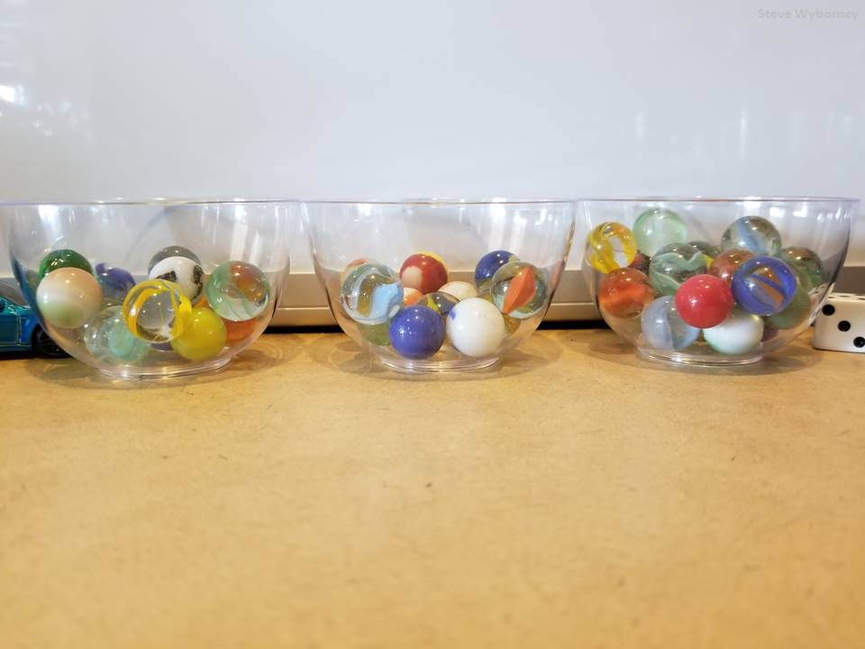
The total is 47 marbles.
The Total
14 marbles
12 marbles
21 marbles
?
?
?
What is the total number of marbles?
How many are in each bowl?
www.stevewyborney.com

Slide 18
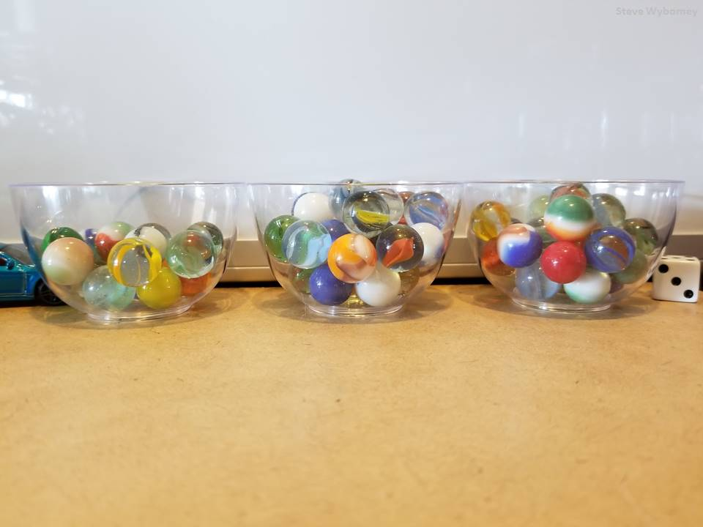
The total is 68 marbles.
The Total
17 marbles
?
?
?
27 marbles
24 marbles
What is the total number of marbles?
How many are in each bowl?
www.stevewyborney.com

Slide 19
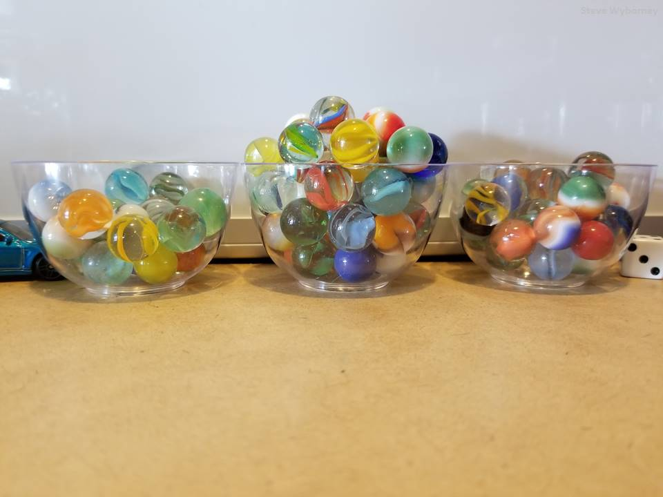
The total is 102 marbles.
The Total
23 marbles
?
?
?
51 marbles
28 marbles
What is the total number of marbles?
How many are in each bowl?
www.stevewyborney.com

Slide 20
The Estimation Clipboard
Set 39 of 40
Click here (or on the image) to download more Estimation Clipboard sets.
Other Downloadable Resources
50 Splat! Lessons
20 Fraction
Splat! Lessons
80 Cube Conversations
Lessons
80 Printable Cube
Conversations Pages
The Animated
Multiplication Table
The Maze
Hundreds Chart

Slide 21
The Estimation Clipboard
Set 40 of 40
Download more free sets here.
Steve Wyborney

Slide 22
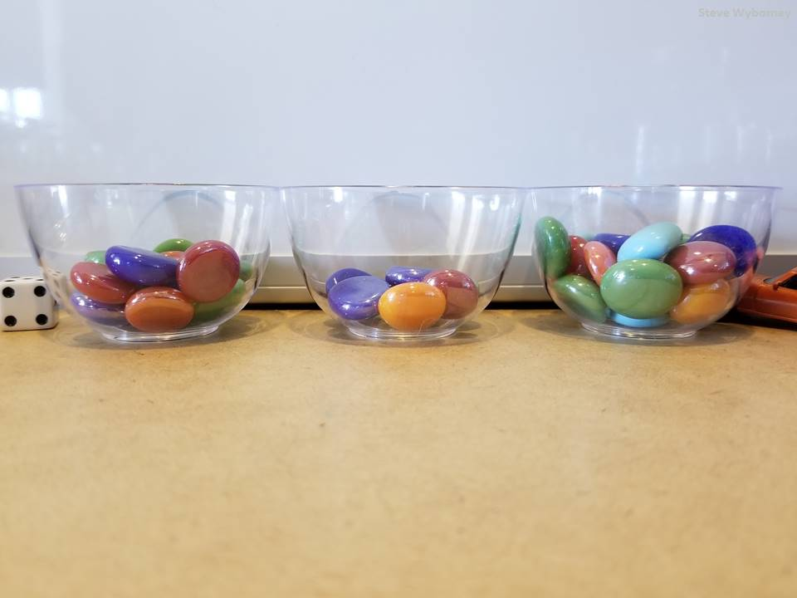
The total is 43 glass gems.
The Total
14 glass gems
?
?
?
8 glass gems
21 glass gems
What is the total number of glass gems?
How many are in each bowl?
www.stevewyborney.com

Slide 23
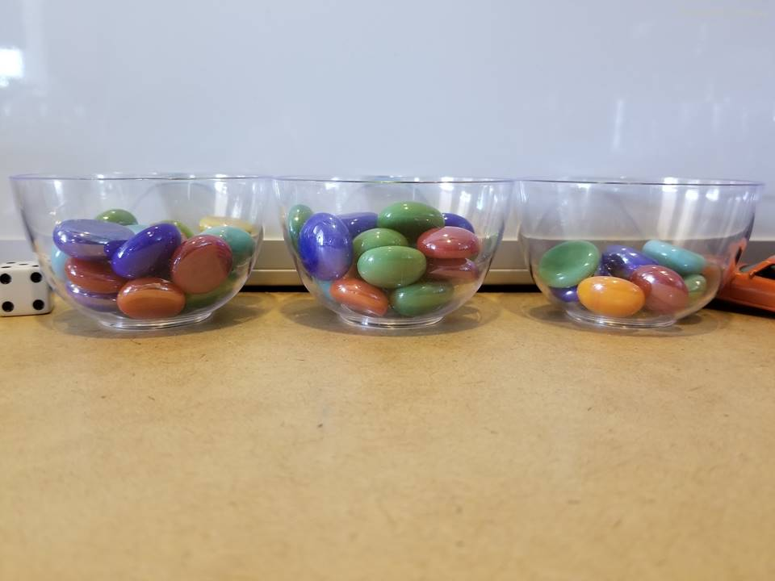
The total is 53 glass gems.
The Total
19 glass gems
?
?
?
23 glass gems
11 glass gems
What is the total number of glass gems?
How many are in each bowl?
www.stevewyborney.com

Slide 24
The total is 77 glass gems.
The Total
21 glass gems
?
?
?
29 glass gems
27 glass gems
What is the total number of glass gems?
How many are in each bowl?
www.stevewyborney.com

Slide 25
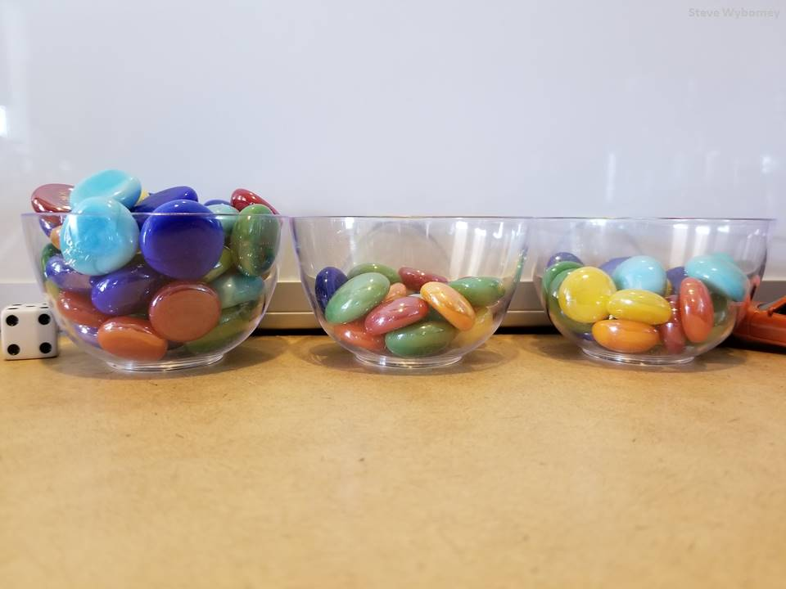
The total is 80 glass gems.
The Total
43 glass gems
?
?
?
16 glass gems
21 glass gems
What is the total number of glass gems?
How many are in each bowl?
www.stevewyborney.com

Slide 26
The Estimation Clipboard
Set 40 of 40
Click here (or on the image) to download more Estimation Clipboard sets.
Other Downloadable Resources
50 Splat! Lessons
20 Fraction
Splat! Lessons
80 Cube Conversations
Lessons
80 Printable Cube
Conversations Pages
The Animated
Multiplication Table
The Maze
Hundreds Chart

